Slide 1
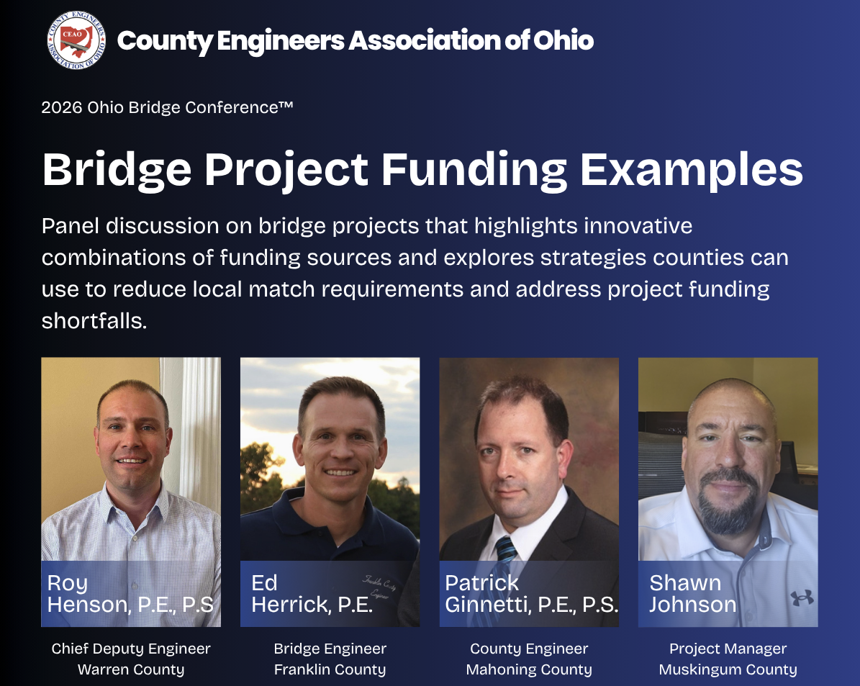
Grant
SIB Loan
LBR
Local Major
OPWC
Local Match
TRAC

Slide 2

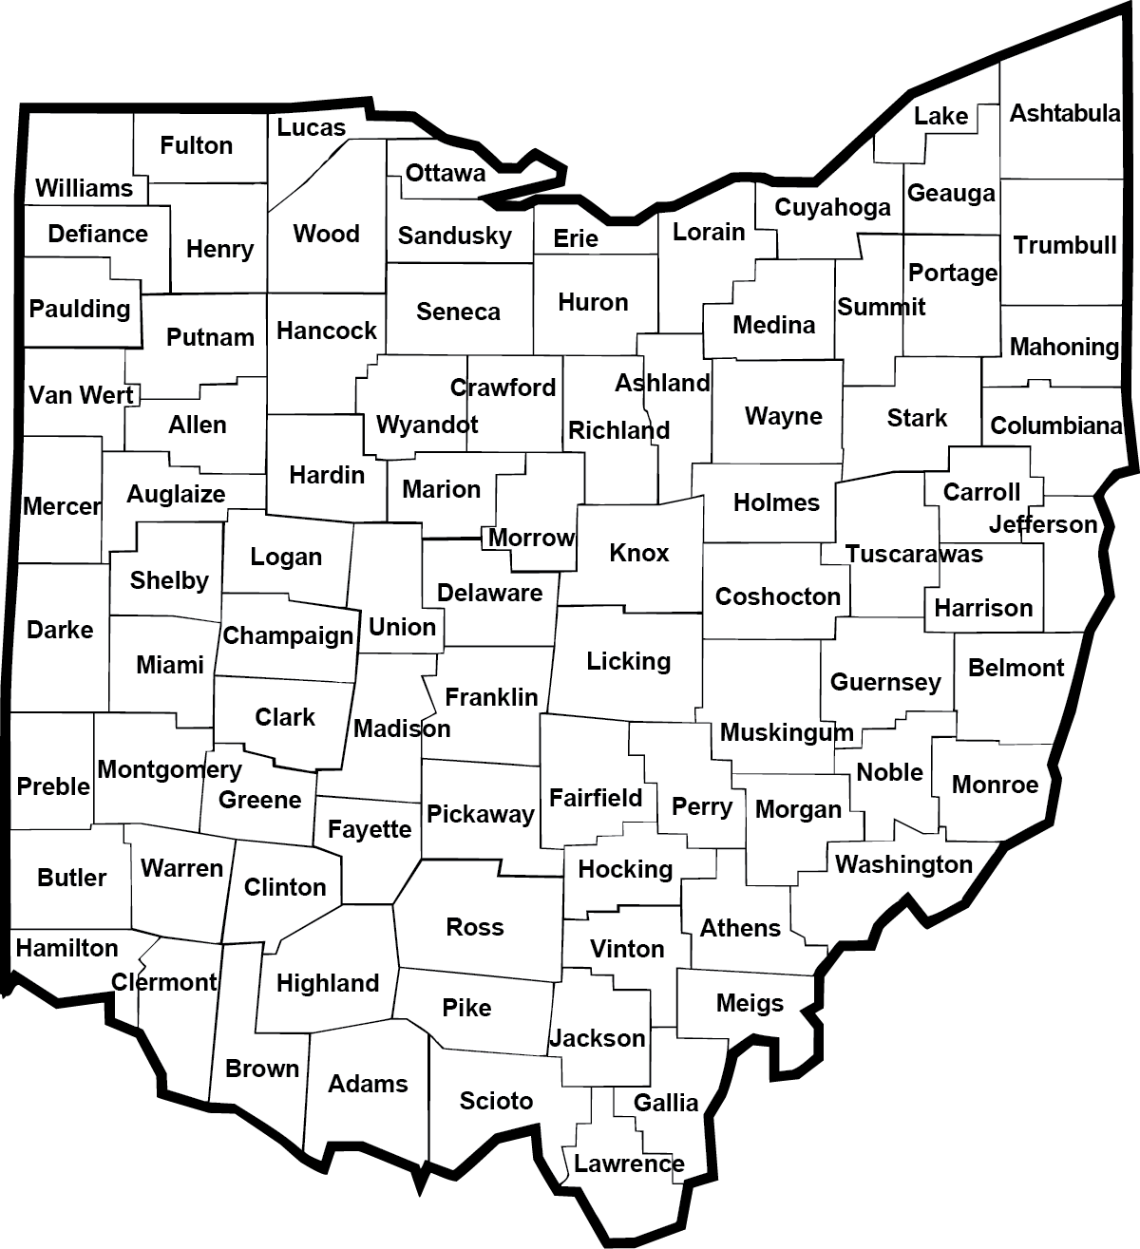
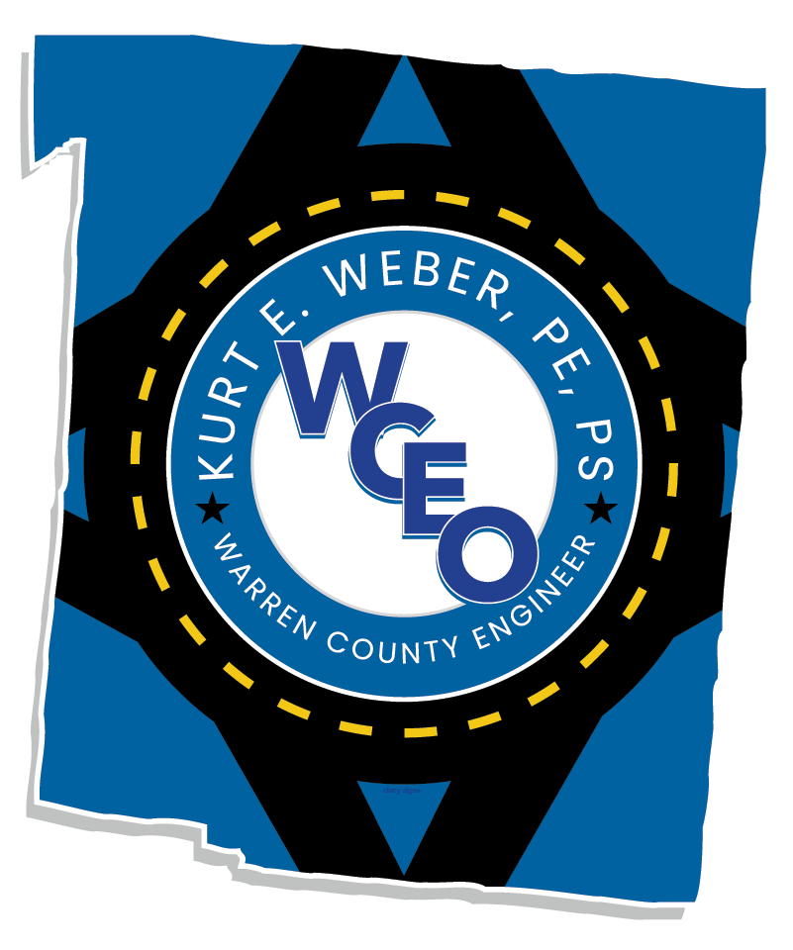
Warren County
Warren County Engineer’s Office
Kurt E. Weber, P.E., P.S.
Warren County Engineer
210 W. Main Street, Lebanon, OH 45036
Phone: (513) 695-3301 Fax: (513) 695-7714
https://engineer.warrencountyohio.gov/
Warren
Warren County Engineer’s Office Staff
16 Employees
7 Engineers
6 Inspectors or Technical Positions
3 Administrative Positions
Bridge Project Funding Examples August 12, 2026

Slide 3
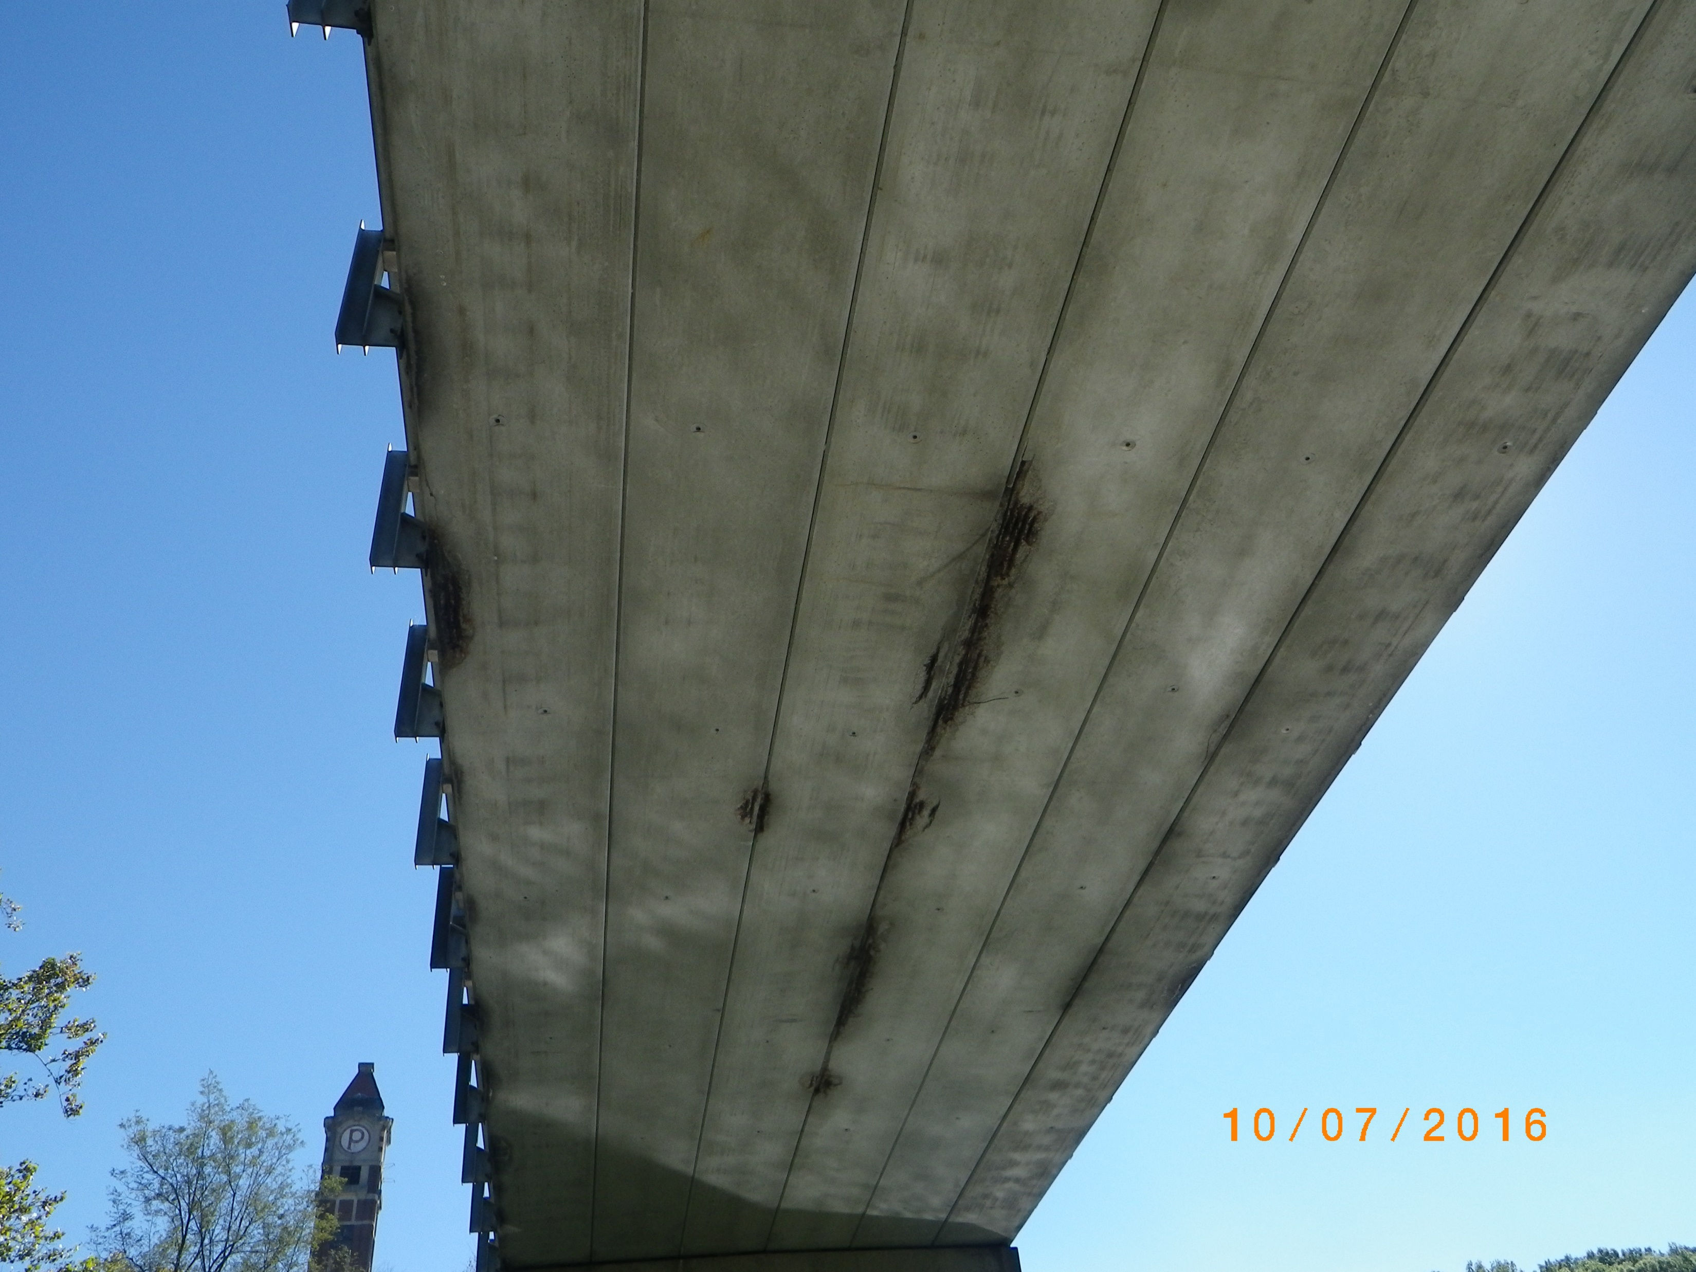
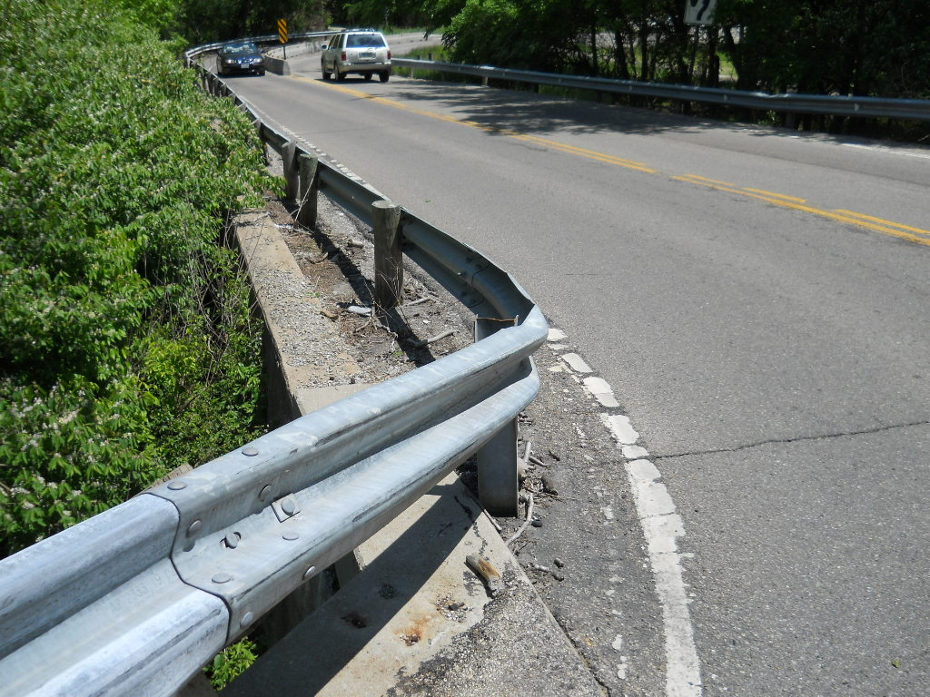
King Avenue Bridge Replacement over Little Miami River
EXISTING CONDITIONS
Bridge: Existing 6-span concrete box beam bridge deteriorated to a point of posting for reduced weights
Roadway: Existing roadway had narrow lanes and shoulders, steep vertical profile down to the bridge, and sharp horizontal curves on both bridge approaches
Trail: Existing trail had dangerous at grade road crossing near a curve and did not have an improved access or parking area
Bridge Project Funding Examples August 12, 2026

Slide 4
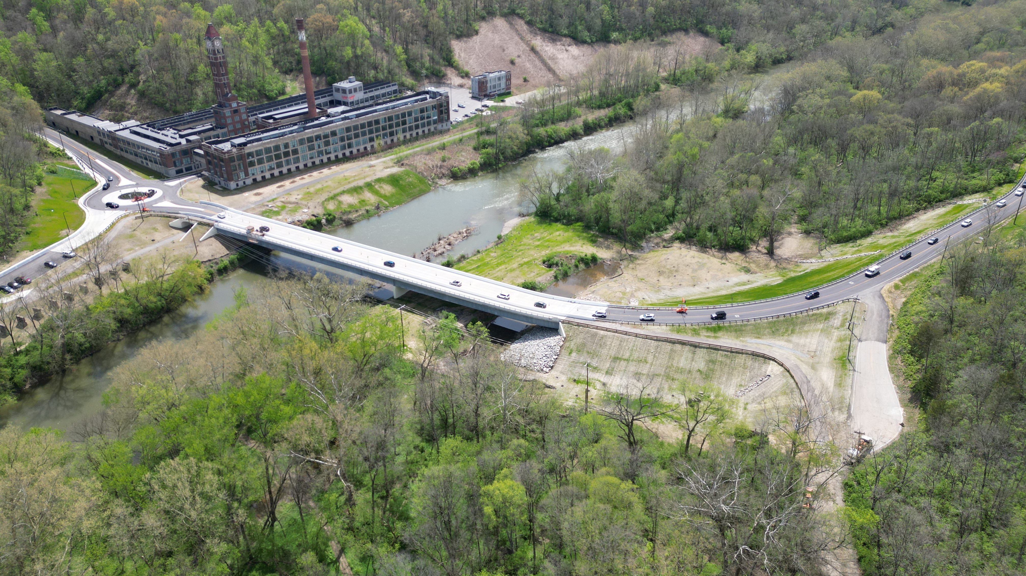
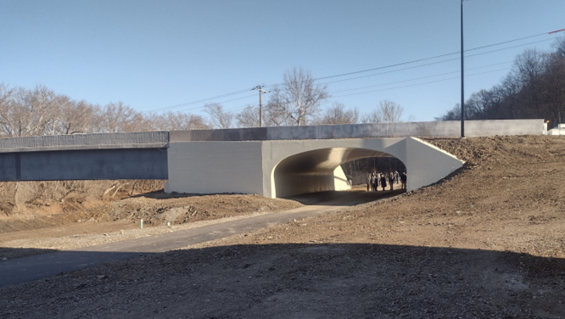
King Avenue Bridge Replacement over Little Miami River
2-span steel girder bridge over National Scenic River (total length 520 ft) with stub abutments on H-Piles and wall pier on drilled shafts
Bridge accommodates 2 lanes of traffic with wider shoulders and a 12 ft shared use path
Improved roadway geometry at both bridge approaches
Roundabout at entrance to trail parking lot and new development
Precast arch structure now provides grade separation for Little Miami Scenic Trail
Bridge Project Funding Examples August 12, 2026

Slide 5

Project Funding
King Avenue Bridge Replacement over Little Miami River
Largest WCEO project constructed to date ($22,041,788.13)
$5M in Federal Local Bridge Replacement Funds (LBR)
$6.27M in Federal Surface Transportation Block Grant Funds (STBG)
$800,000 in Ohio Public Works Commission Funds (OPWC)
$3M in Congressional Directed Spending (CDS)
Outside funding kept our local portion at $4,045,669.50, just under 20% of the total construction cost
Bridge Project Funding Examples August 12, 2026

Slide 6
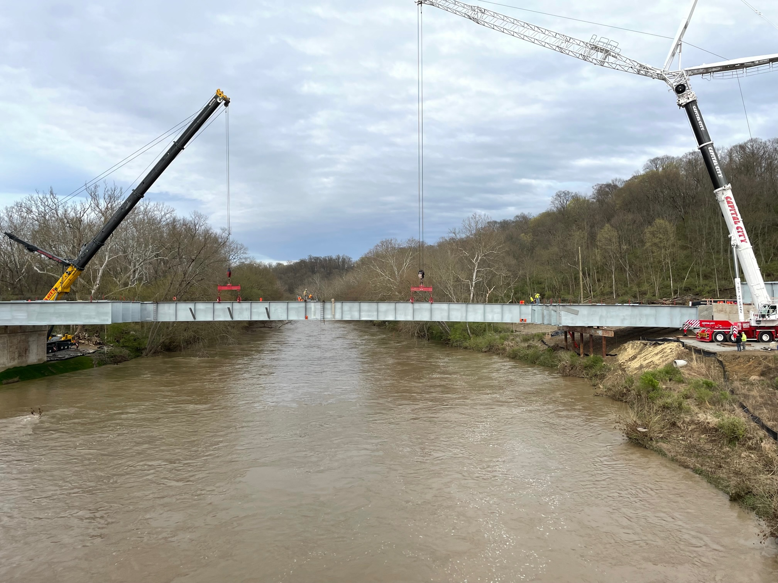
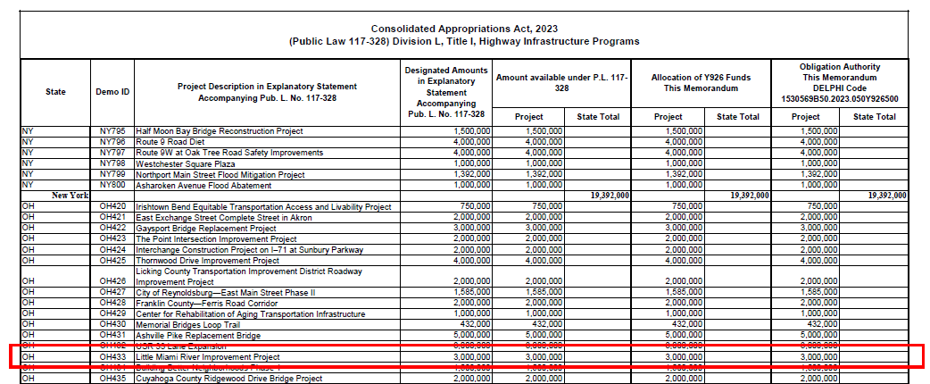
Congressional Directed Spending (CDS)
King Avenue Bridge Replacement over Little Miami River
WCEO was contacted for interest in transportation construction funding by Steve Chabot’s Office
Staff member followed up with us and provided funding details
Application was simple and straightforward
Several members from Chabot’s staff came to Warren County for a project site visit and interview
About a year after the application was submitted our project was awarded $3M
Thankfully, we still had enough construction left to fully use the maximum $3M award
No real suggestions with his type of funding other than reaching out to your local representatives and ODOT Districts on an annual basis
Bridge Project Funding Examples August 12, 2026

Slide 7
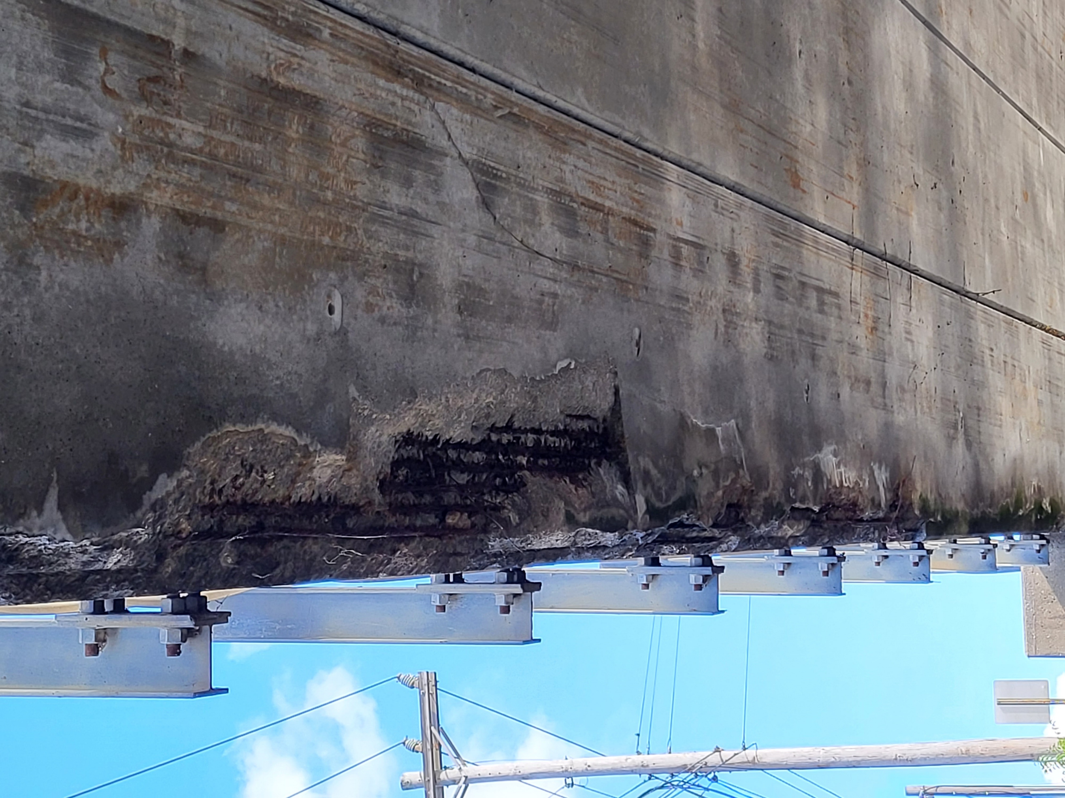
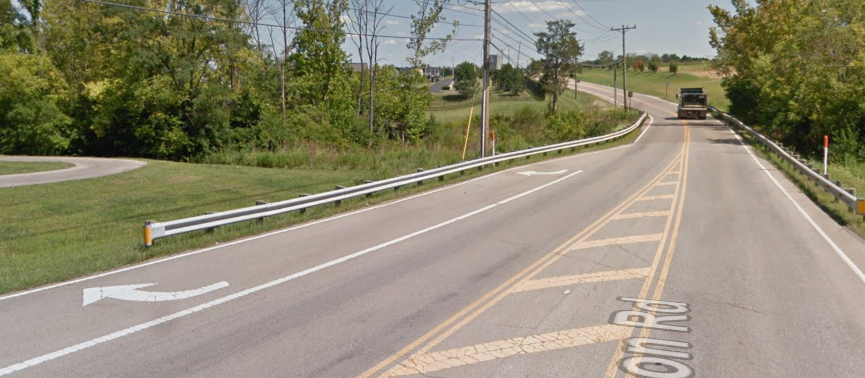
Mason-Morrow-Millgrove Road Bridge Replacement
EXISTING CONDITIONS
Bridge: Existing single span concrete box beam bridge deteriorated to a point of posting for reduced weights
Trail: Mason Sports Park did not have pedestrian access from several neighborhoods to the east
Bridge Project Funding Examples August 12, 2026

Slide 8
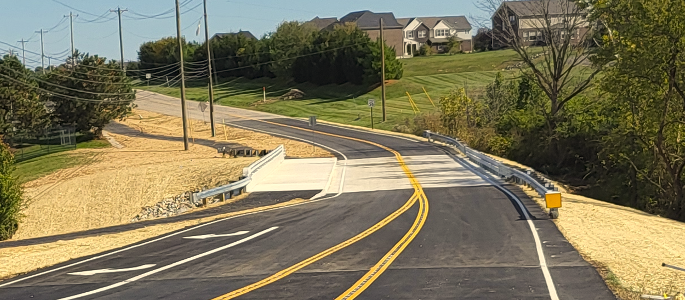
Mason-Morrow-Millgrove Road Bridge Replacement
Single span (85 ft) prestressed concrete I-beam superstructure on semi-integral abutments resting on drilled shafts
Bridge accommodates 2 lanes of traffic and a 12 ft shared use path
Access to Mason’s Sports Park over Muddy Creek from nearby neighborhoods
Bridge Project Funding Examples August 12, 2026

Slide 9
Project Funding
Mason-Morrow-Millgrove Road Bridge Replacement
Overall Joint Project Construction Cost ($2,006,278.41)
City of Mason’s Portion for Shared Use Path ($521,356.44)
$882,000 in Ohio Public Works Commission Funds (OPWC)
$140,342.52 Grant Reimbursement from ODOT’s Office of Jobs & Commerce
Outside funding kept our local portion at $462,579.45, just under 20% of the total construction cost
Bridge Project Funding Examples August 12, 2026

Slide 10
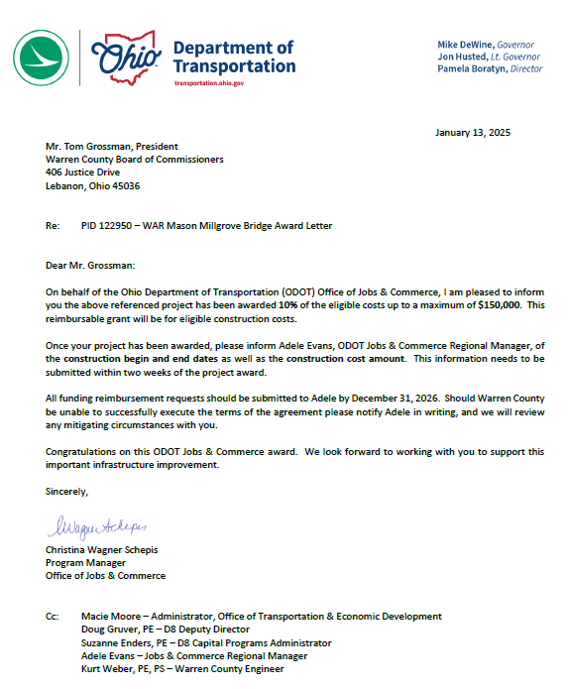
ODOT’s Office of Jobs & Commerce
Mason-Morrow-Millgrove Road Bridge Replacement
WCEO connected with our Regional Manager of ODOT’s Jobs & Commerce
We answered a few questions by email and provided a construction cost estimate
Entire process was quick and painless
Within two months we received the Award Letter for roadway and bridge portion of work, as shared use path work was not eligible
ODOT was barely involved in the project with this type of state grant
We provided copies of Contractor pay estimates and proof of our payments for state reimbursement
Jobs & Commerce grants can only be used when there are new or retained jobs in a JobsOhio industry sector and a capital investment is being made by the company
Projects can’t be related to residential or retail
Each ODOT District has a regional manager that can help discuss projects and determine eligibility
Bridge Project Funding Examples August 12, 2026

Slide 11

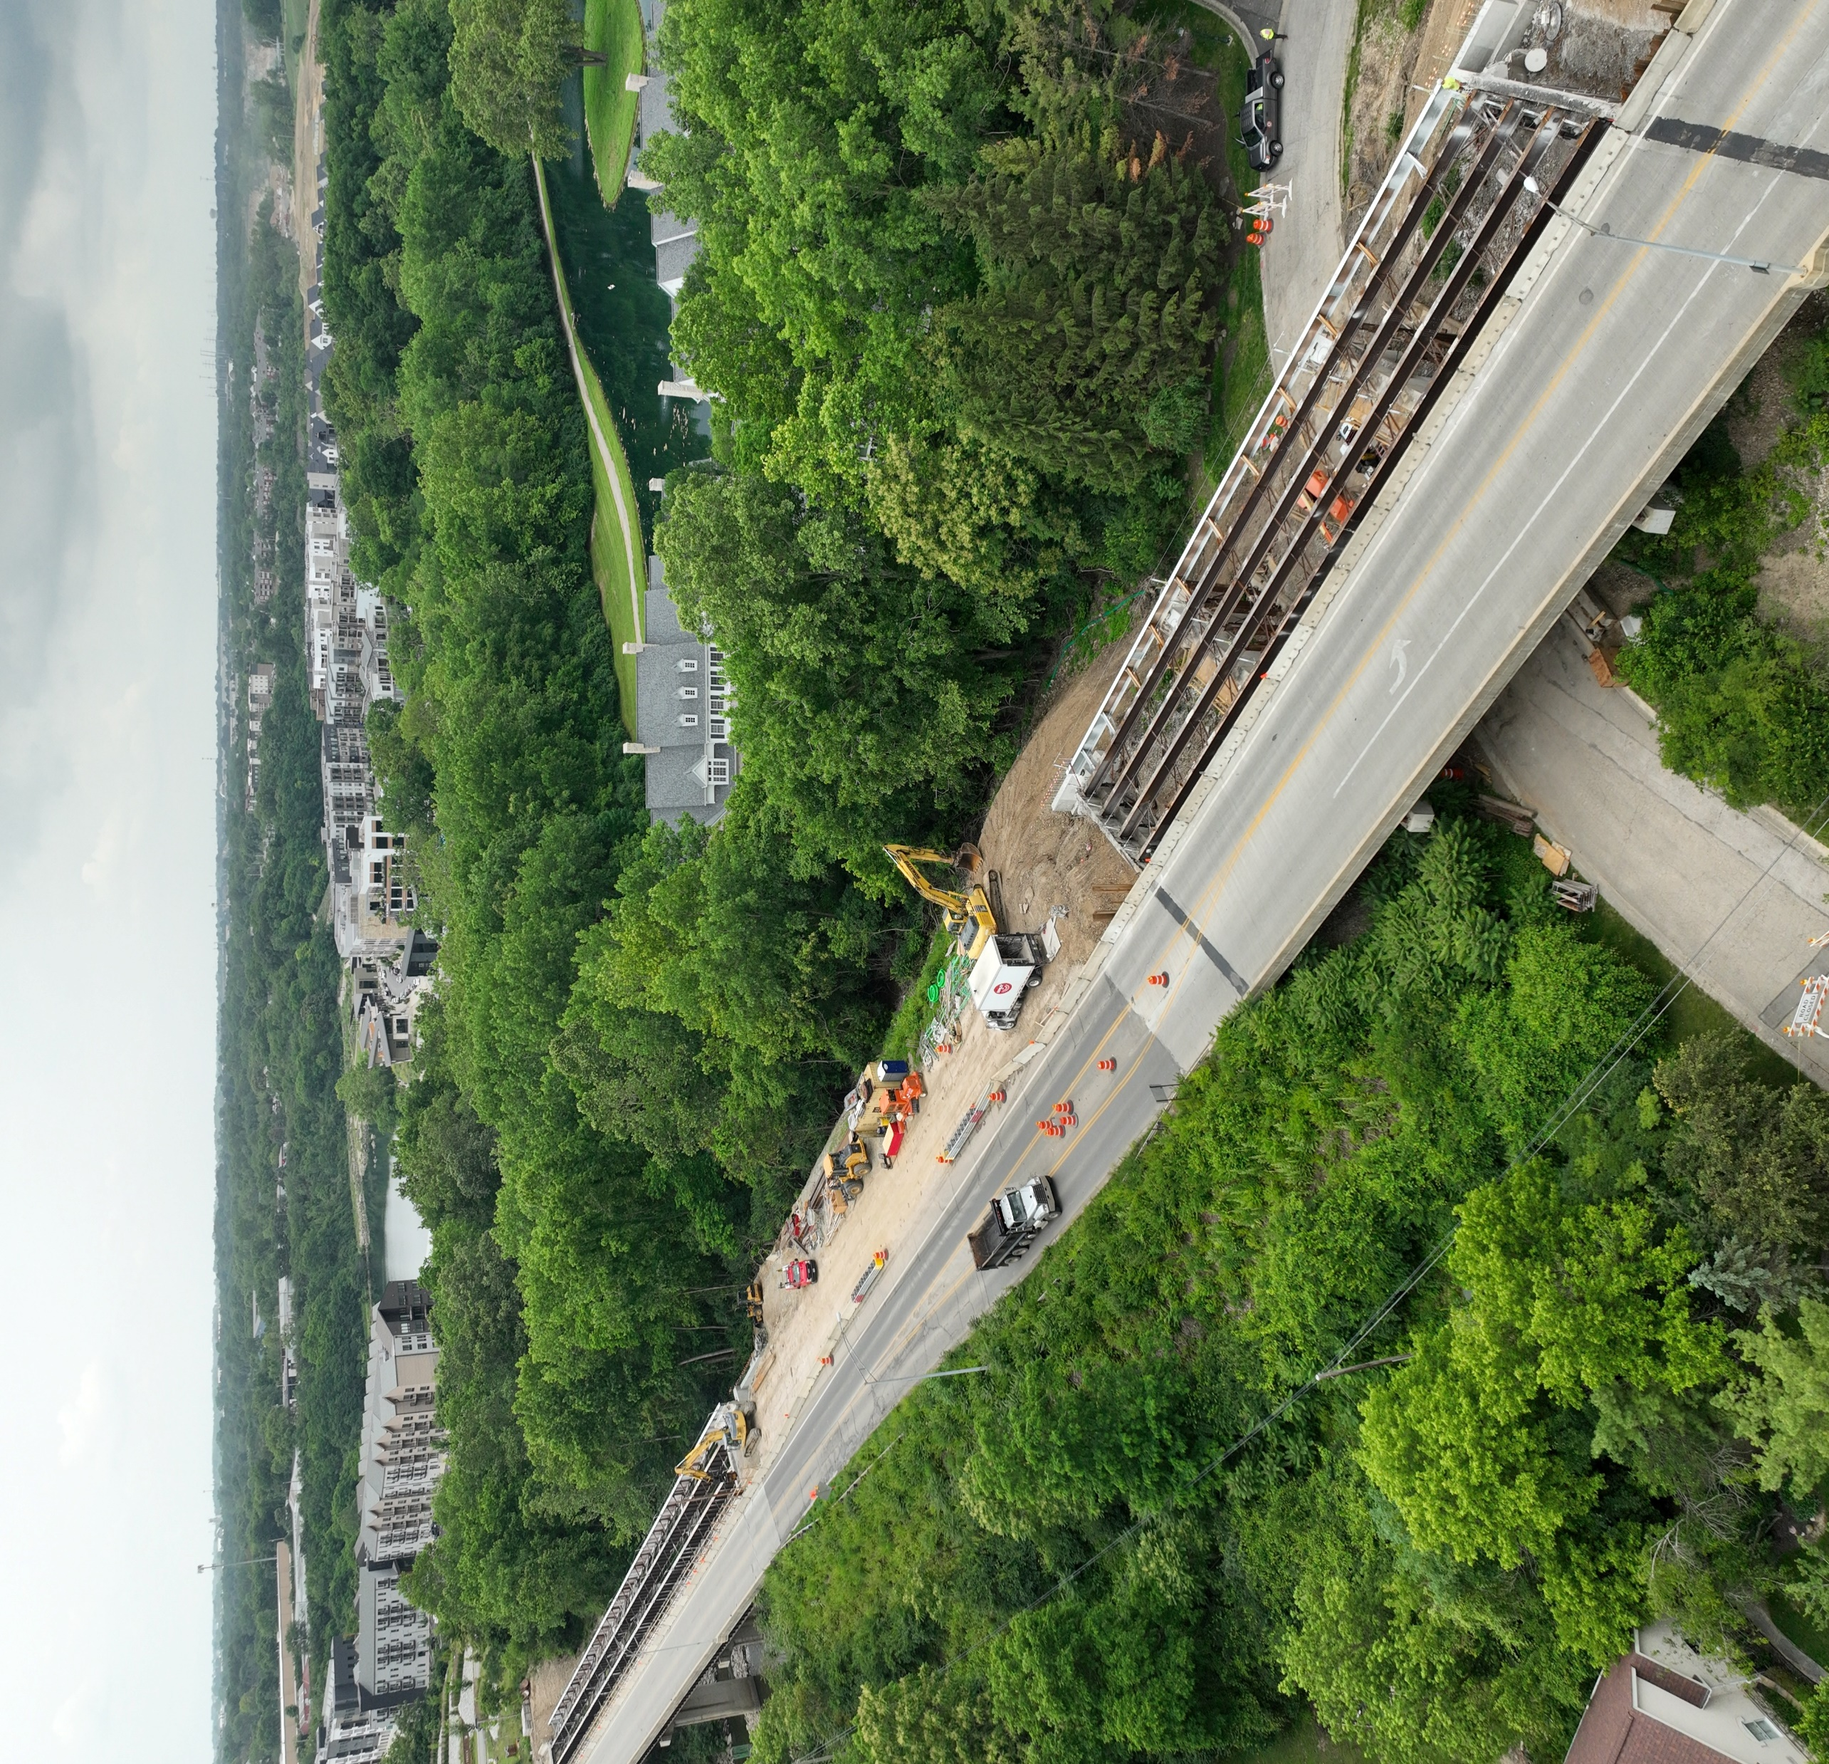
Franklin County
County Engineer
Adam W. Fowler, P.E., P.S.
Maintenance Responsibility
+1.3M Population
850 Lane Miles of Roadway
357 Bridges
Current Bridge Projects With Outside Funding
4 Local Major Bridge Program
3 Ohio Publics Works (OPWC)
1 MORPC Attributable Funding
2 Local Bridge Program (LBR/BFP)
Credit Bridge
$35 million
In Current Bridge Funding
Bridge Project Funding Examples August 12, 2026

Slide 12
Franklin County Budget
2025 Total Revenue
$68,494,146
2025 Total Expenditures
$71,857,150
Bridge Project Funding Examples August 12, 2026

Slide 13
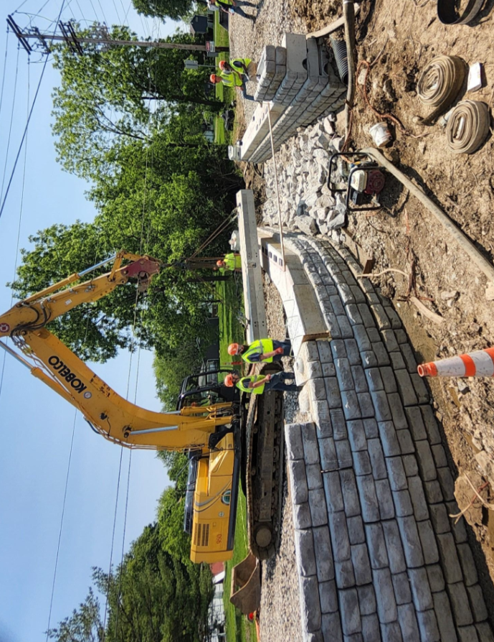
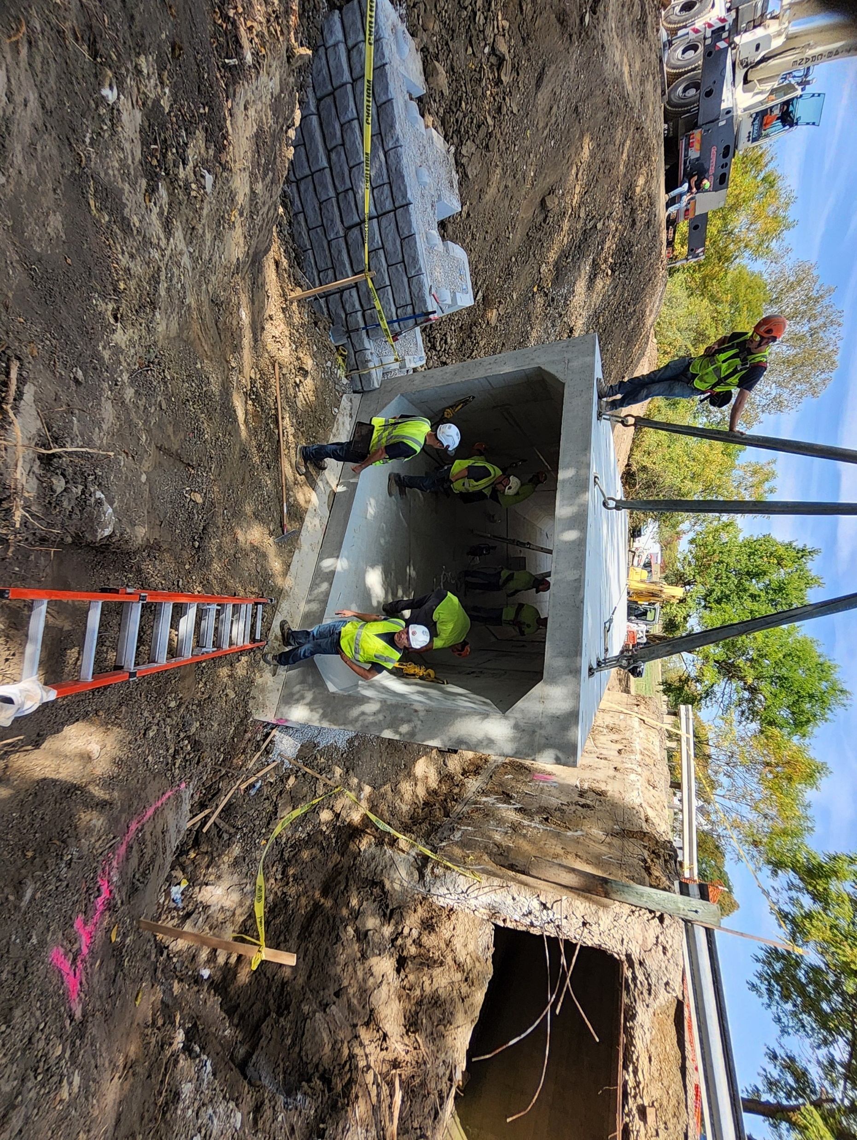
Force Account Projects
Roberts Road over Morris Ditch
Project Cost: $255,356
Force Account Cost: $235,687
Old Haughn Road over Holton Run
Project Cost: $240,047
Force Account Cost: $176,481
Bridge Project Funding Examples August 12, 2026

Slide 14
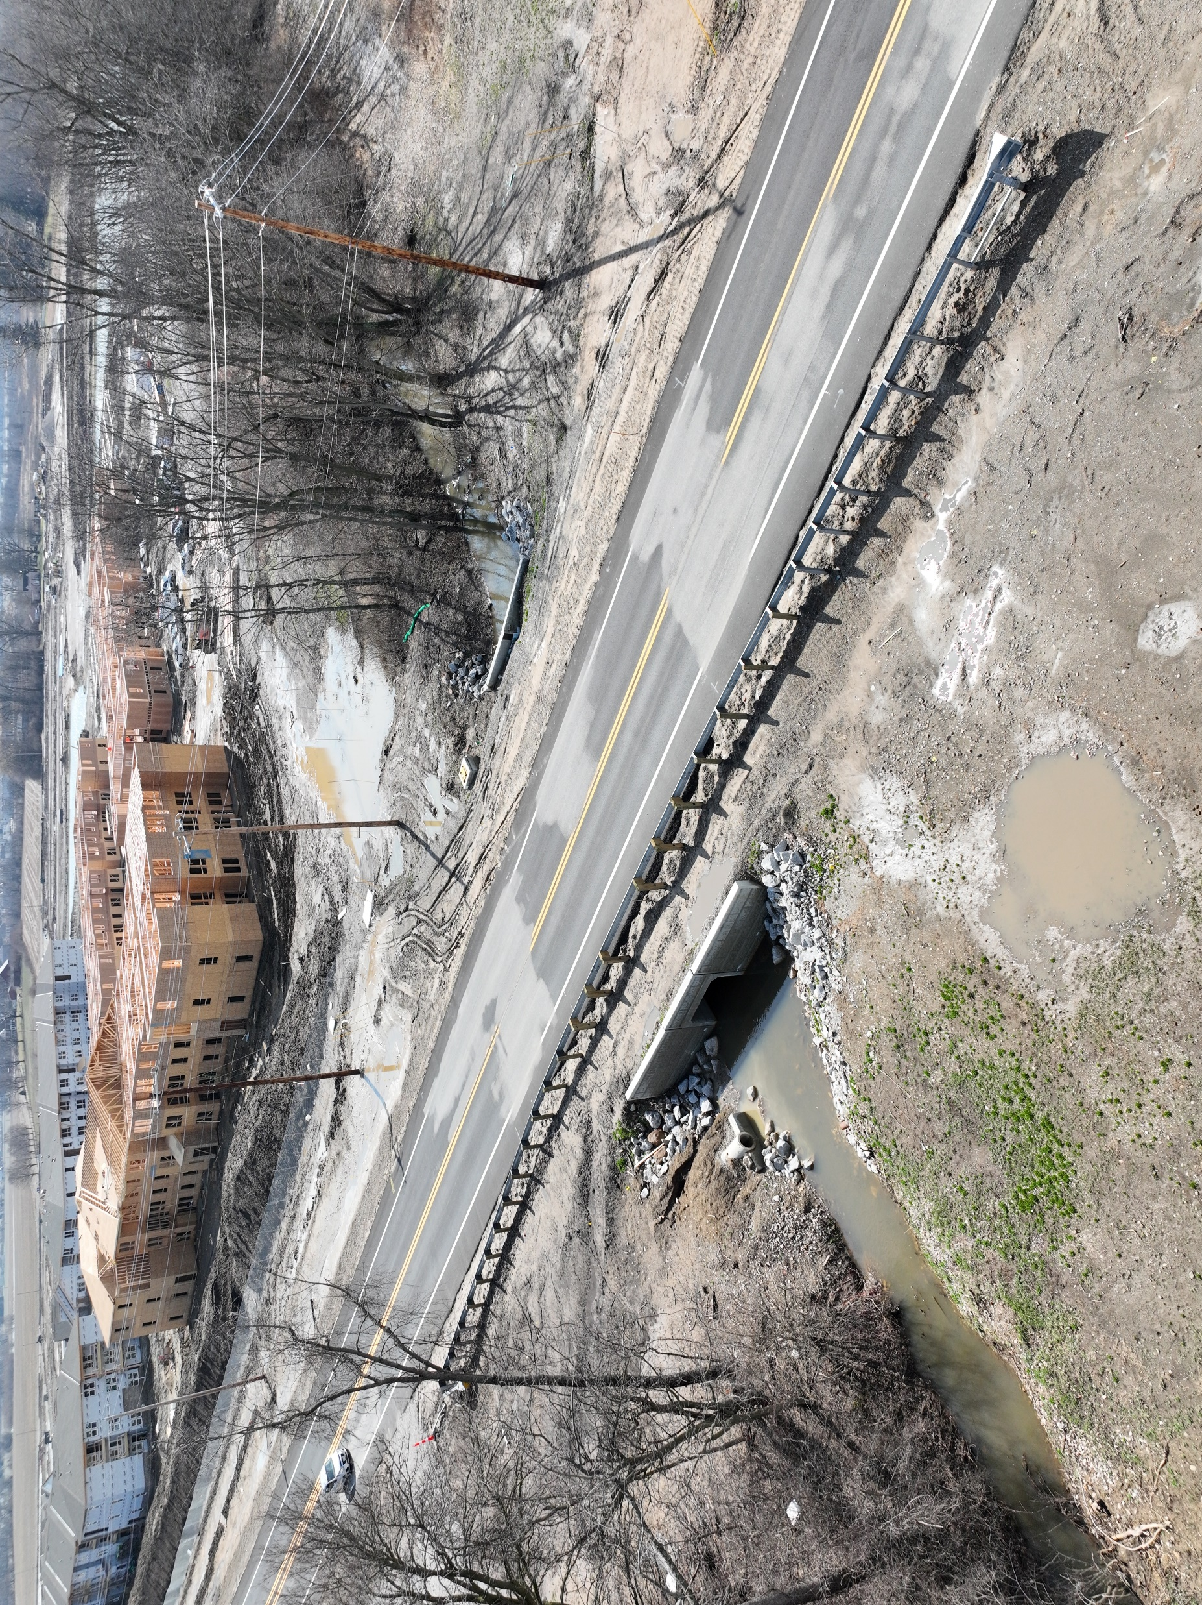
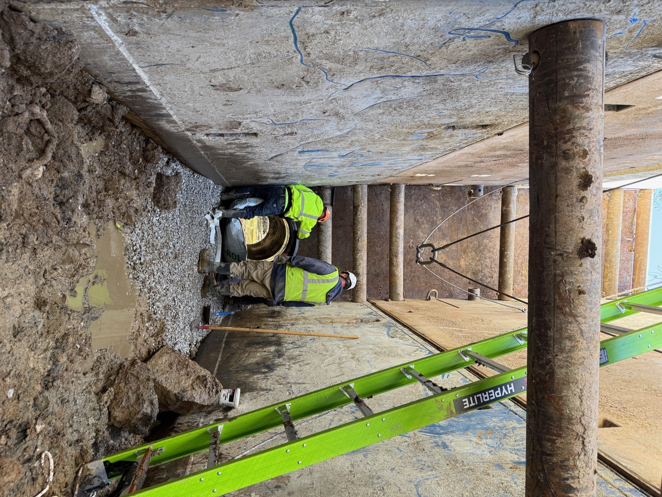
Force Account Projects
Pontius Rd over Tributary to Little Walnut Creek
Project Cost: $150,186
Force Account Cost: $150,186
Winchester Pike over Coble Bowman Ditch
Project Cost: $240,047
Force Account Cost: $240,594
Bridge Project Funding Examples August 12, 2026

Slide 15
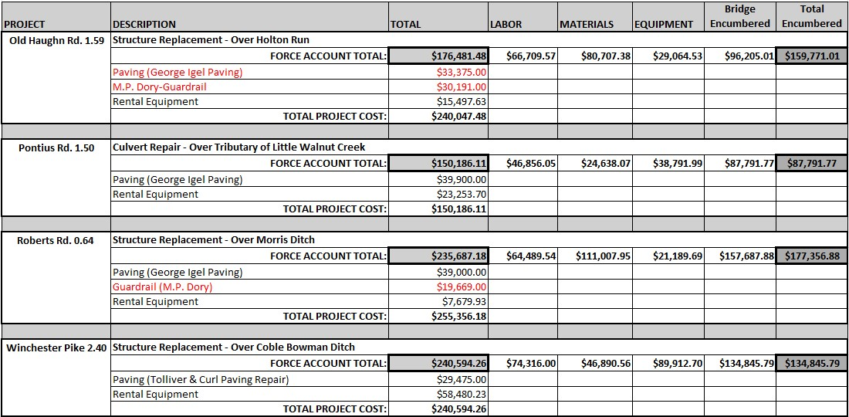
2025 Force Account Project Final Costs
Bridge Project Funding Examples August 12, 2026
BID CONTRACT WORK

Slide 16
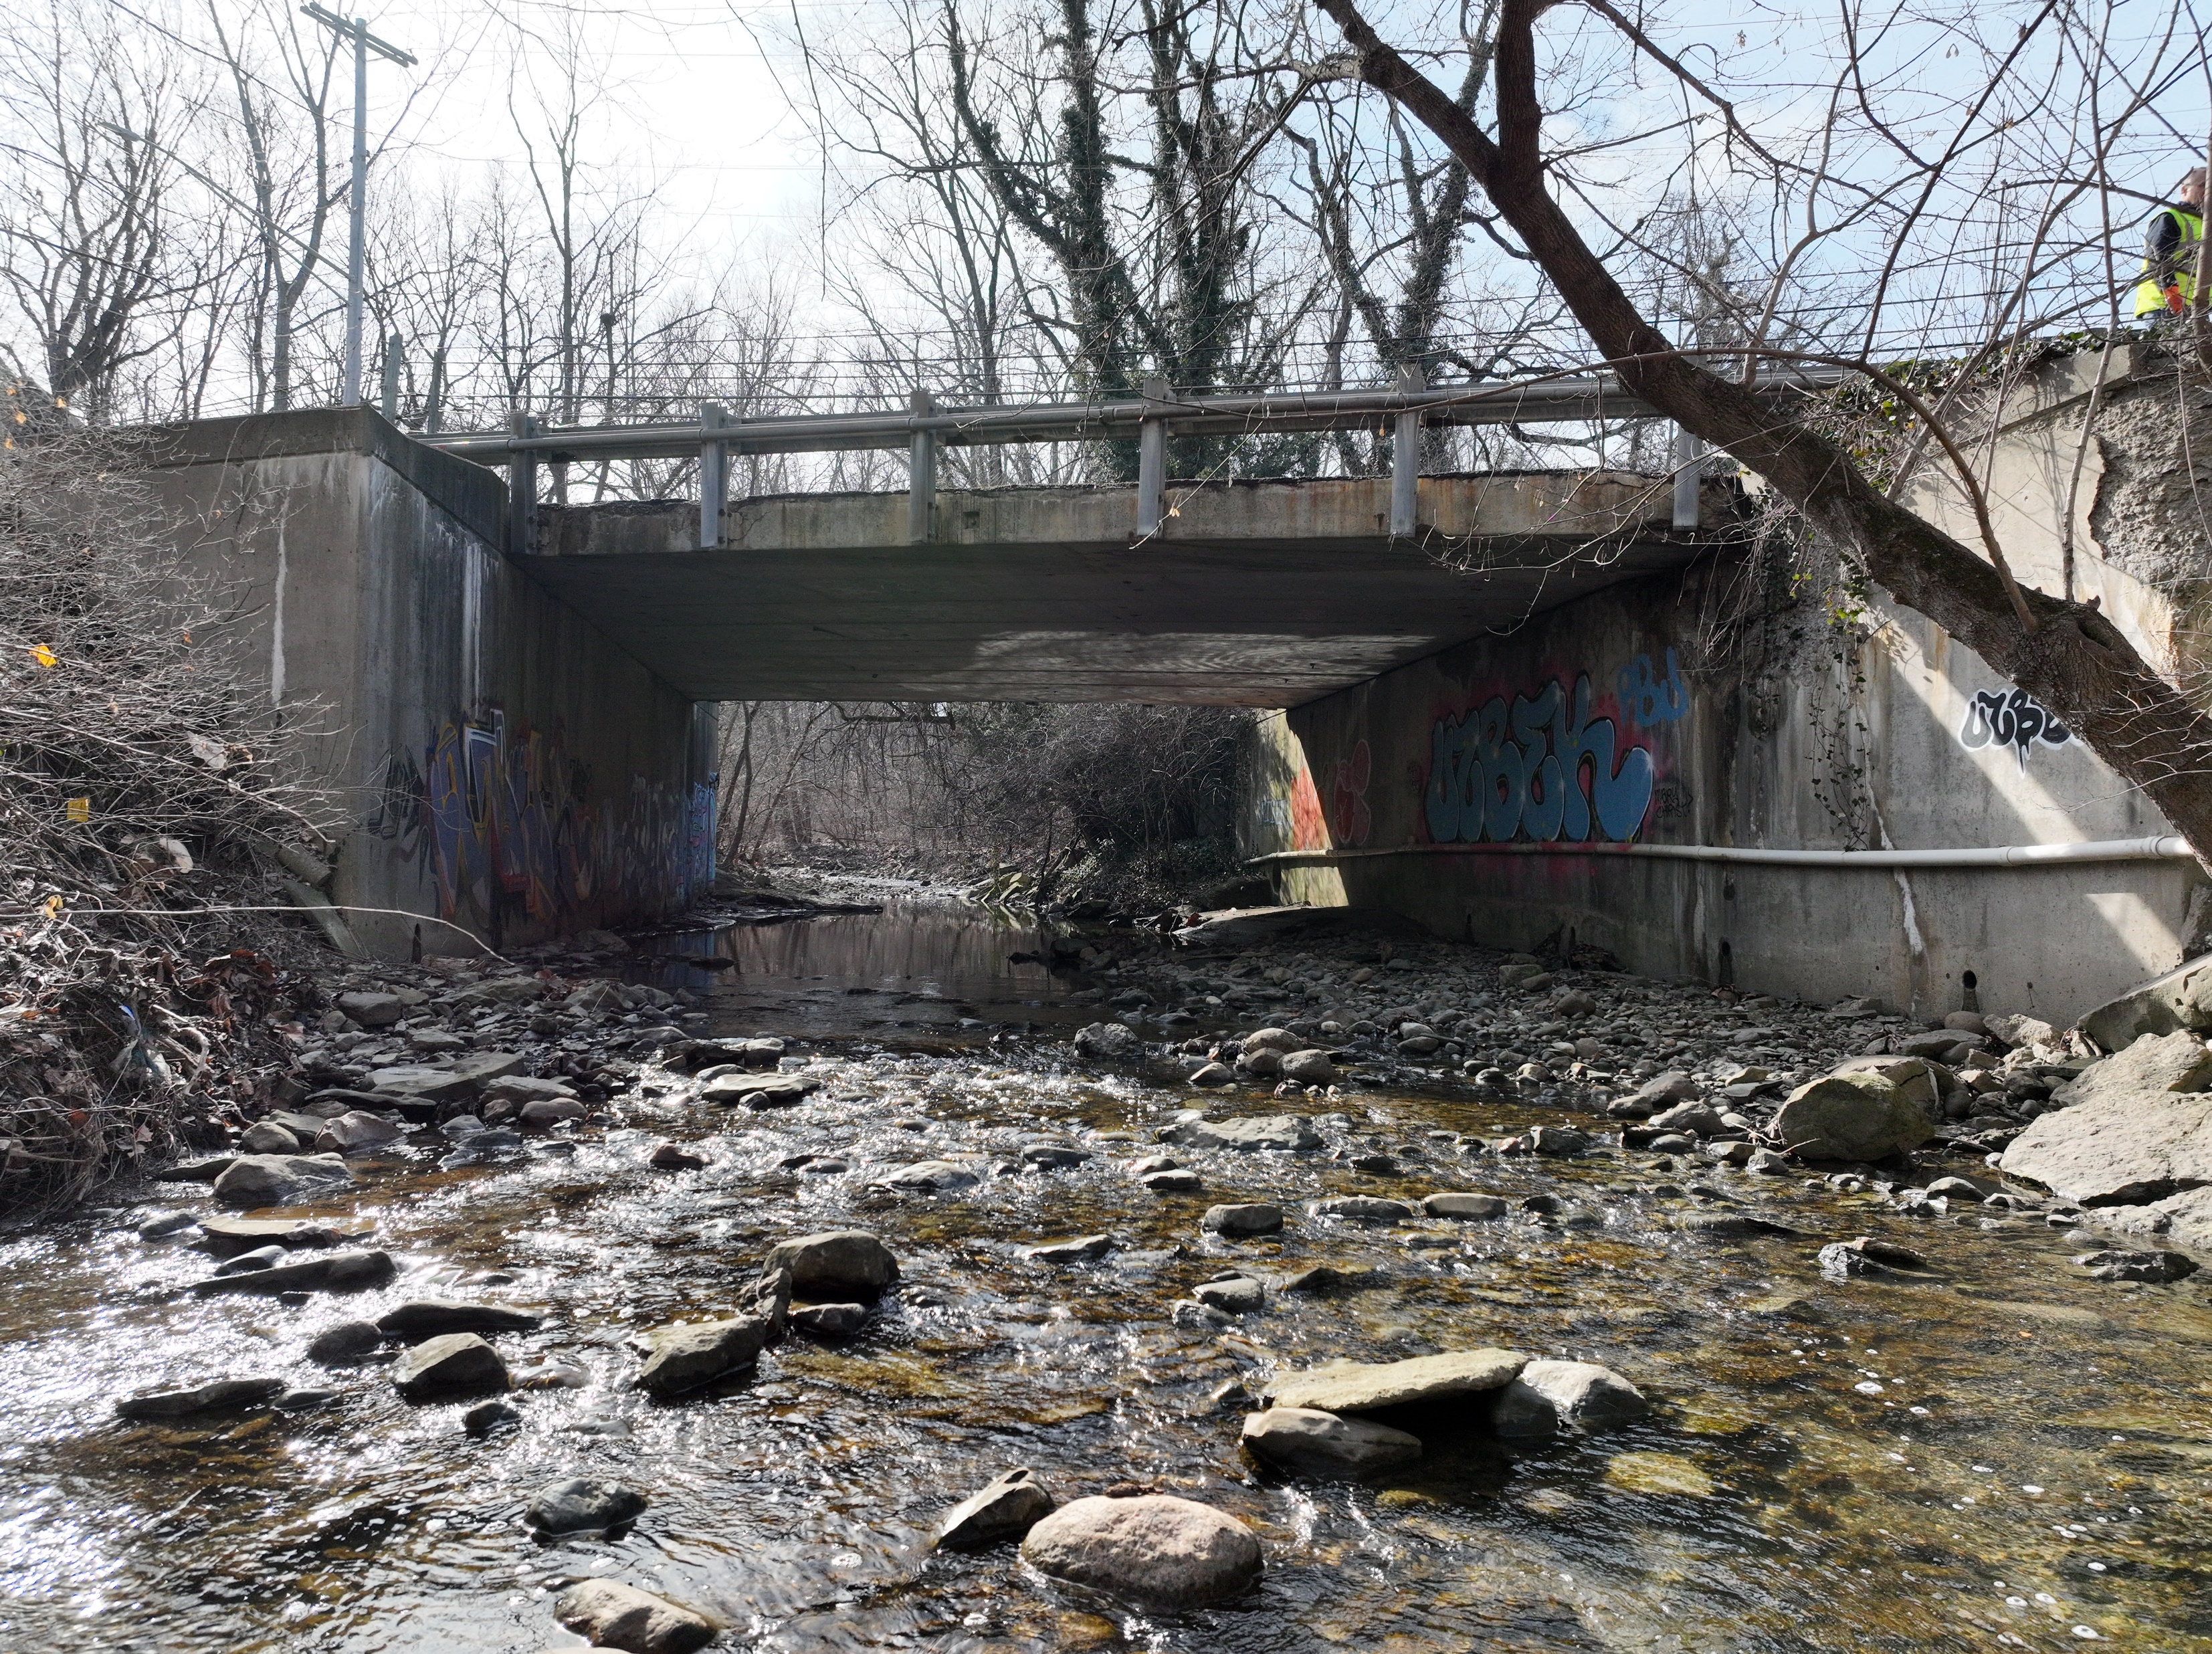
Cooper Road over Noble Run
Bridge Project Funding Examples August 12, 2026

Slide 17
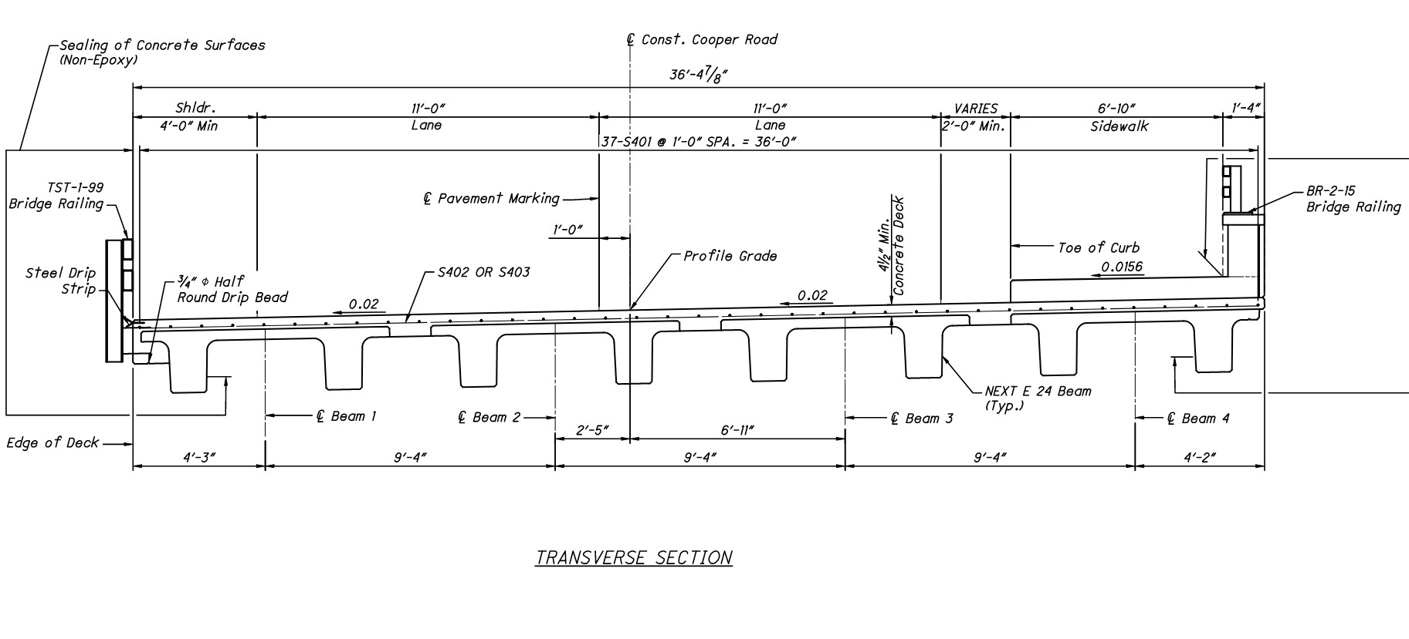
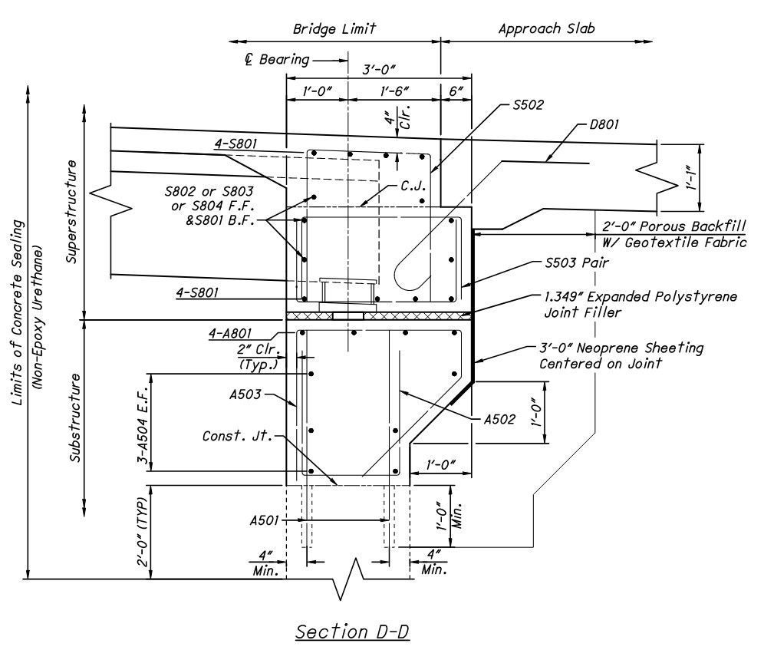
Force Account Projects
Force Account abutment work
Superstructure and abutment cap demo
Rebuild abutment seats
General Bridge Maintenance Contract
Install NEXT E Beams on converted semi-integral abutments
Pour concrete deck on a skewed, superelevated, vertical curve
Bridge Project Funding Examples August 12, 2026

Slide 18
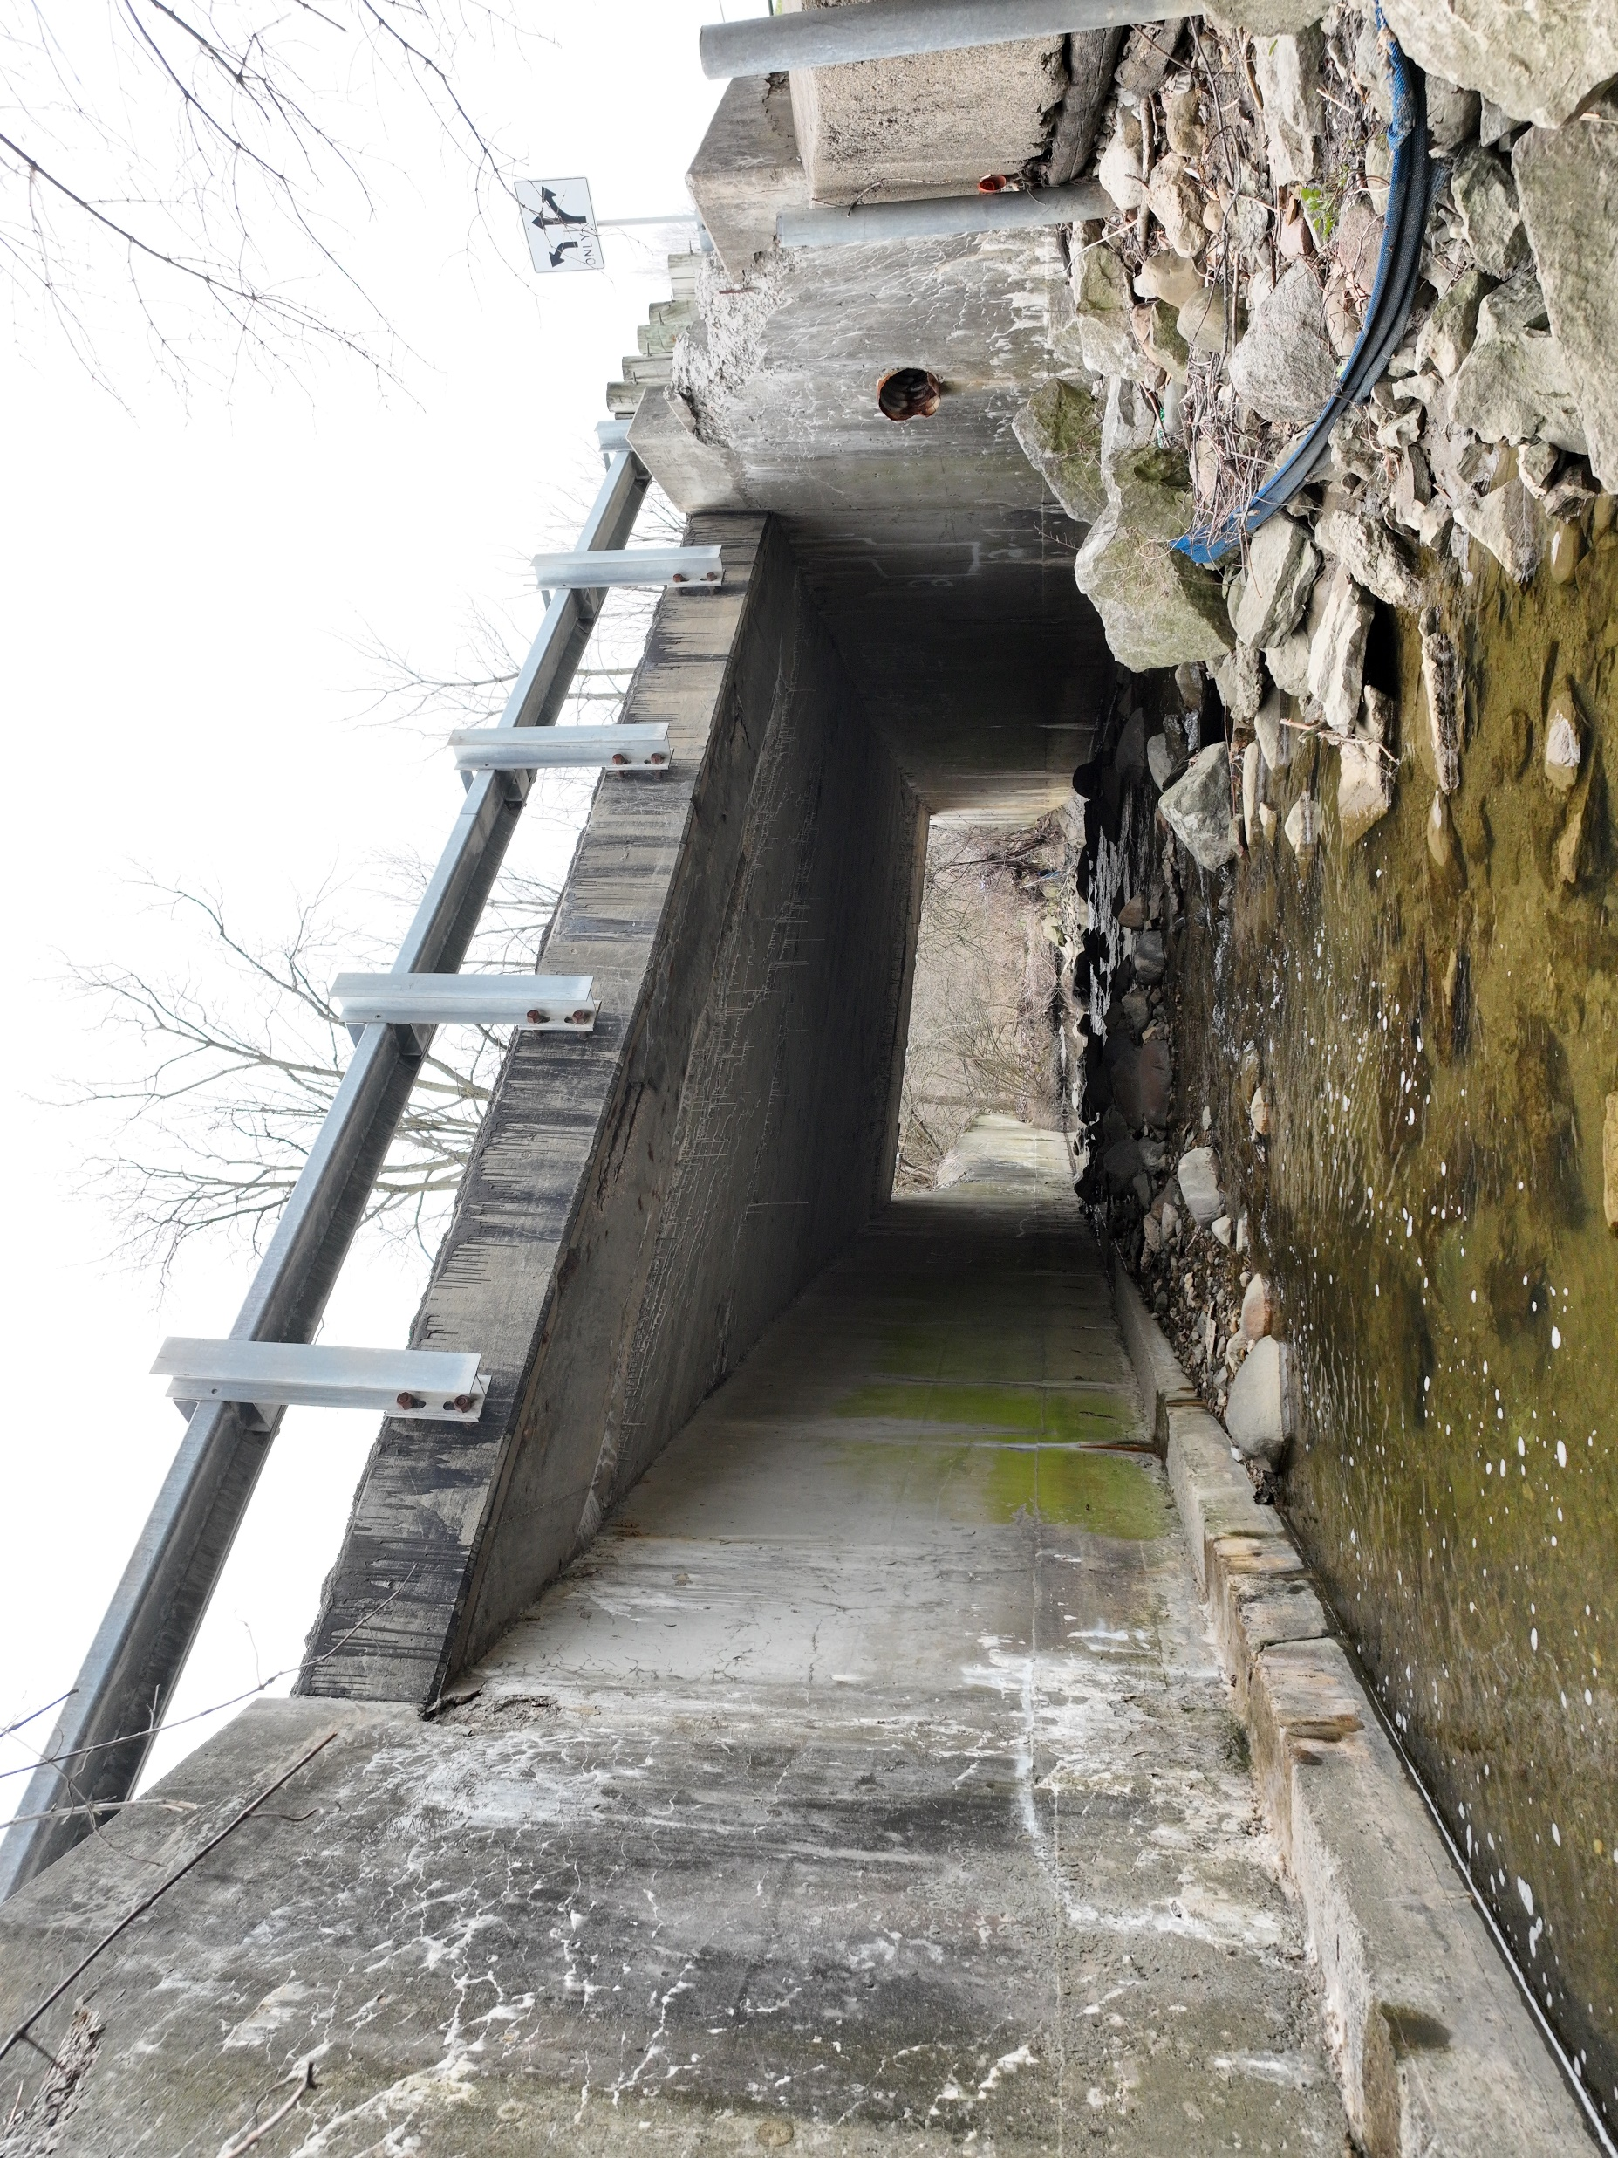
Marlane Drive over Marsh Run
2027 FULL REPLACEMENT
Redi-Rock abutments
Superstructure TBD
Force Account approx. $250k
($150k encumbered)
Gen Bridge Maintenance Contract approx. $500k
Bridge Project Funding Examples August 12, 2026

Slide 19

Mahoning County
MAH-Mahoning Avenue Industrial Corridor Bridge over Morrison Run
Bridge Project Funding Examples August 12, 2026
Notes:
Good Morning everyone and thank you for the opportunity to discuss our a few bridge projects recently completed in Mahoning County Engineer.

Slide 20
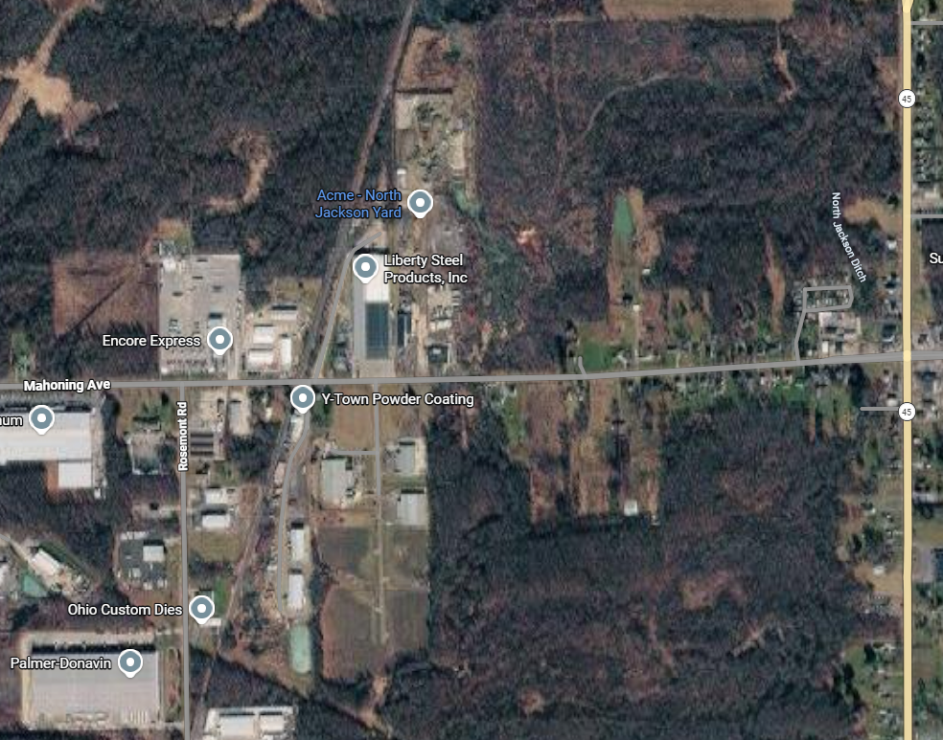
PROJECT LOCATION
MAH-Mahoning Avenue Industrial Corridor Bridge over Morrison Run
Bridge Project Funding Examples August 12, 2026
Notes:
The Mahoning Avenue Bridge over Morrison Run is located ½ mile west of S.R. 45 is an east-west thoroughfare in Jackson Township in the main Industrial Corridor

Slide 21
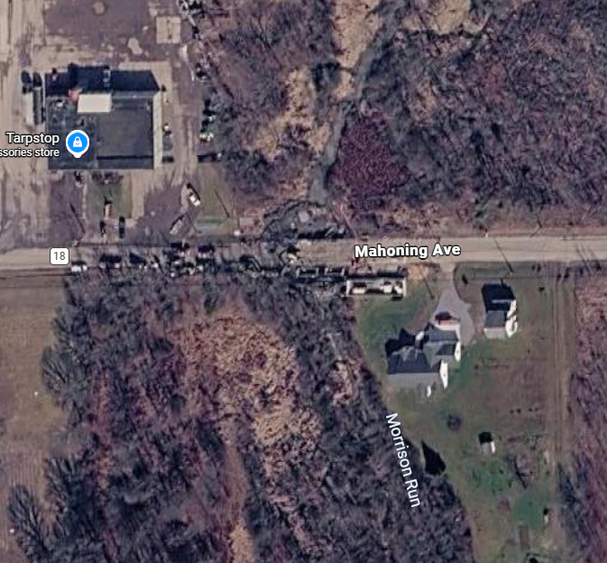
PROJECT LOCATION
MAH-Mahoning Avenue Industrial Corridor Bridge over Morrison Run
Bridge Project Funding Examples August 12, 2026

Slide 22
PROJECT FUNDING
MAH-Mahoning Avenue Industrial Corridor Bridge over Morrison Run
The total cost of the bridge replacement project was $417,392
(33%) funded by U.S. EDA $137,739
(19%) funded by OPWC $79,304
(8%) funded by MCTID $33,391
(18%) funded by TIF $75,131
(22%) funded by Sales Tax $91,827
Bridge Project Funding Examples August 12, 2026

Slide 23
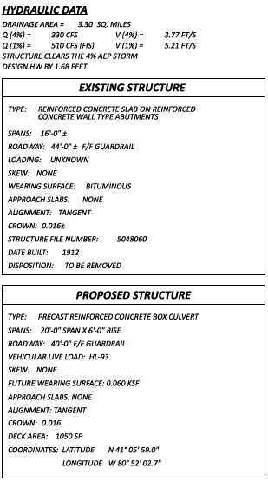
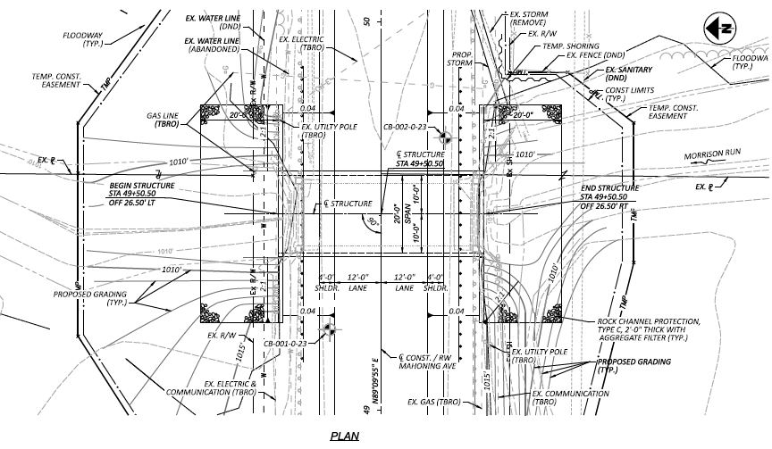
PROPOSED WORK
MAH-Mahoning Avenue Industrial Corridor Bridge over Morrison Run
Bridge Project Funding Examples August 12, 2026

Slide 24
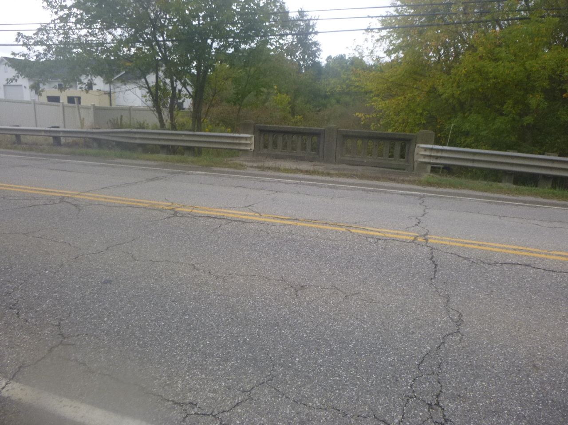
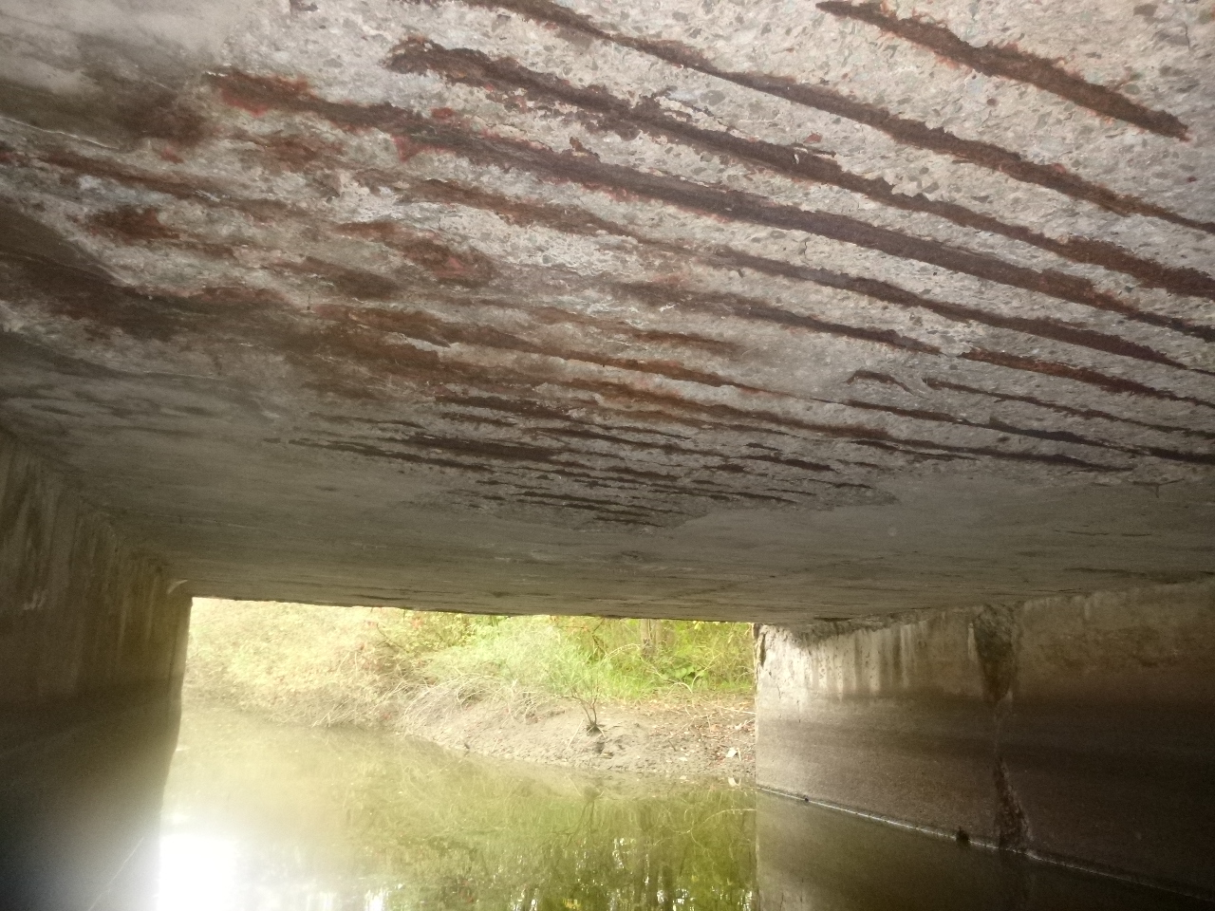
EXISTING BRIDGE PHOTOS
MAH-Mahoning Avenue Industrial Corridor Bridge over Morrison Run
View of surface (left) and view underneath looking north (right)
Bridge Project Funding Examples August 12, 2026

Slide 25
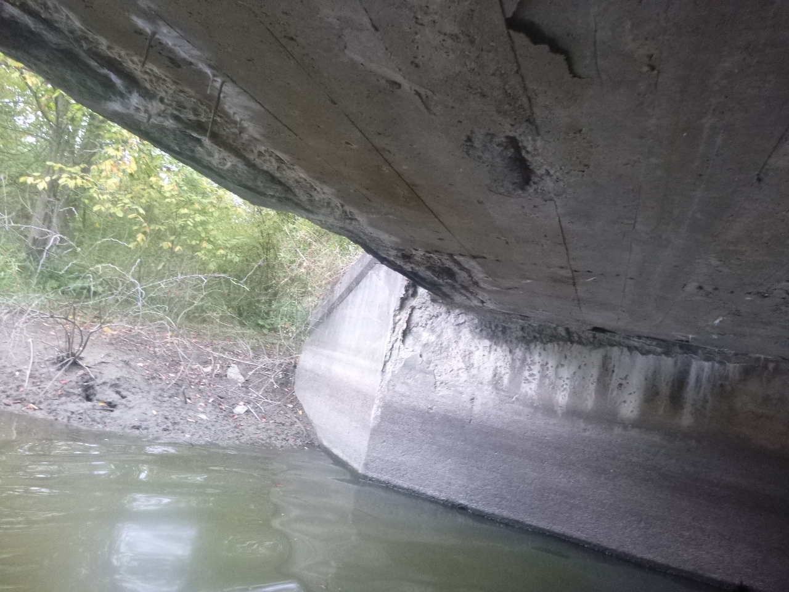
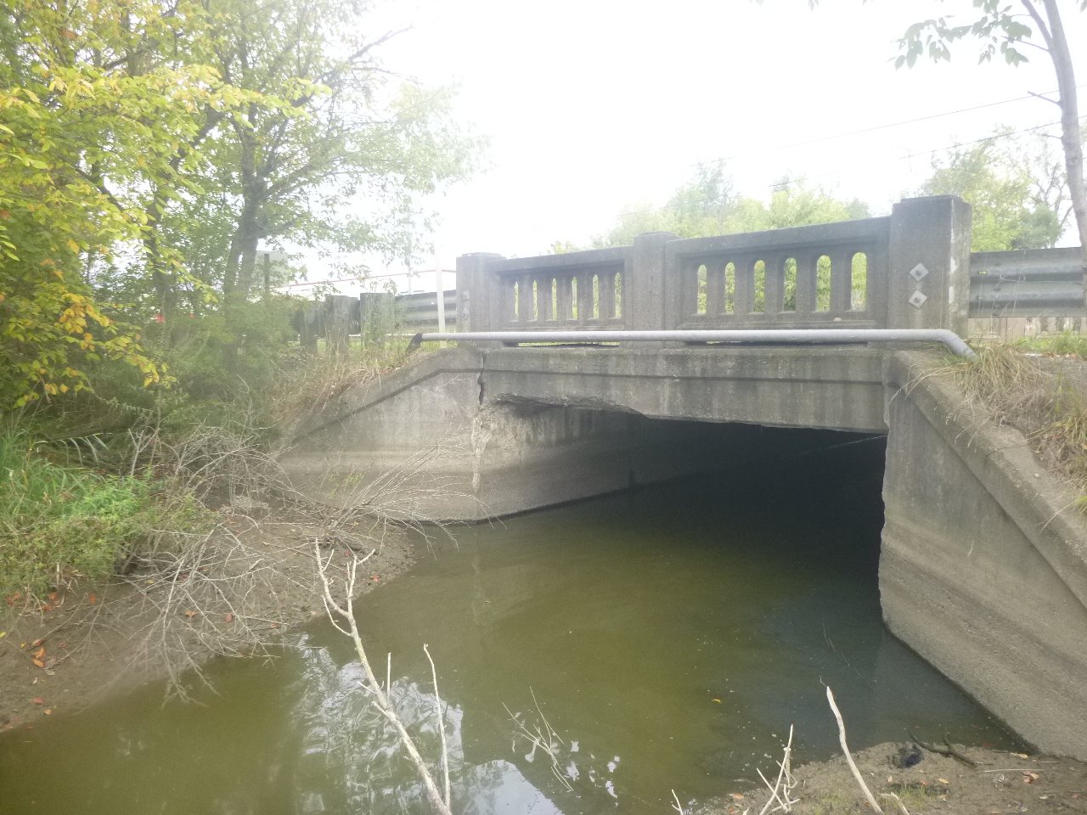
EXISTING BRIDGE PHOTOS
MAH-Mahoning Avenue Industrial Corridor Bridge over Morrison Run
View of underneath looking east (left) and view looking south (right)
Bridge Project Funding Examples August 12, 2026

Slide 26
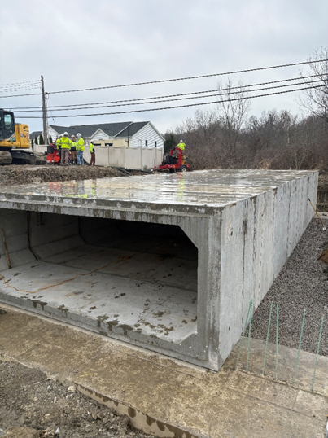
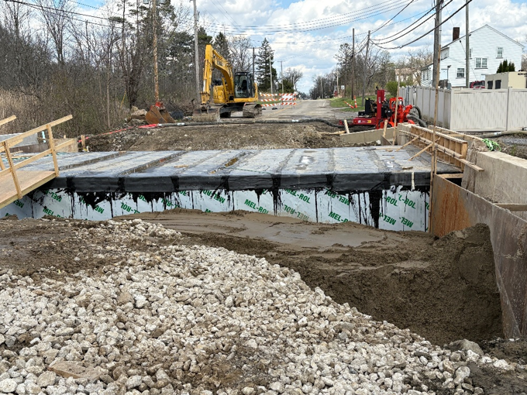
CONSTRUCTION PHOTOS
MAH-Mahoning Avenue Industrial Corridor Bridge over Morrison Run
Installation of 20x6 precast box culvert & placement of LSM backfill along with Type 2 & Type 3 waterproofing
Bridge Project Funding Examples August 12, 2026

Slide 27
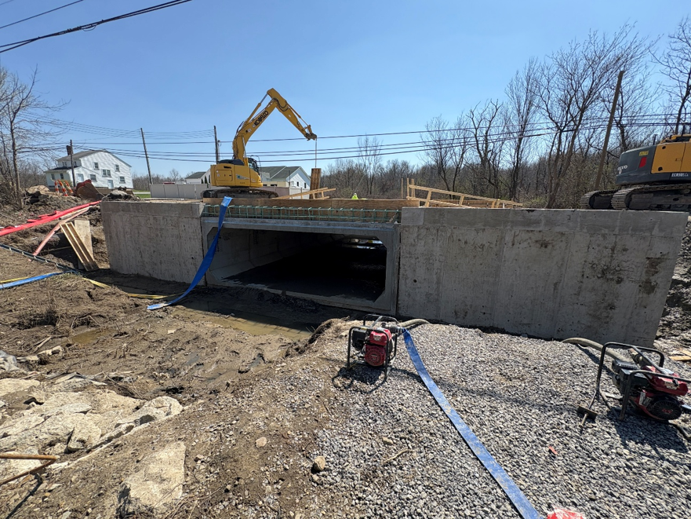
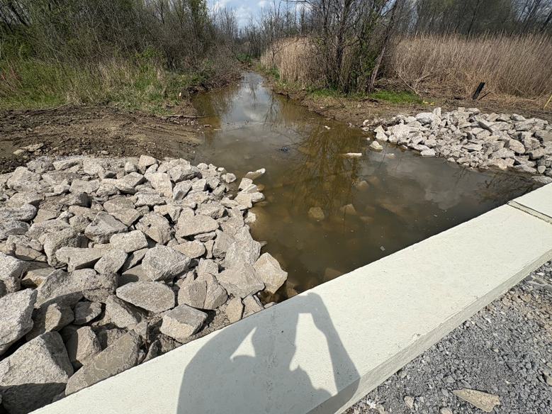
CONSTRUCTION PHOTOS
MAH-Mahoning Avenue Industrial Corridor Bridge over Morrison Run
Poured outlet wingwalls (north side) & Rock Channel Protection on North end
Bridge Project Funding Examples August 12, 2026

Slide 28
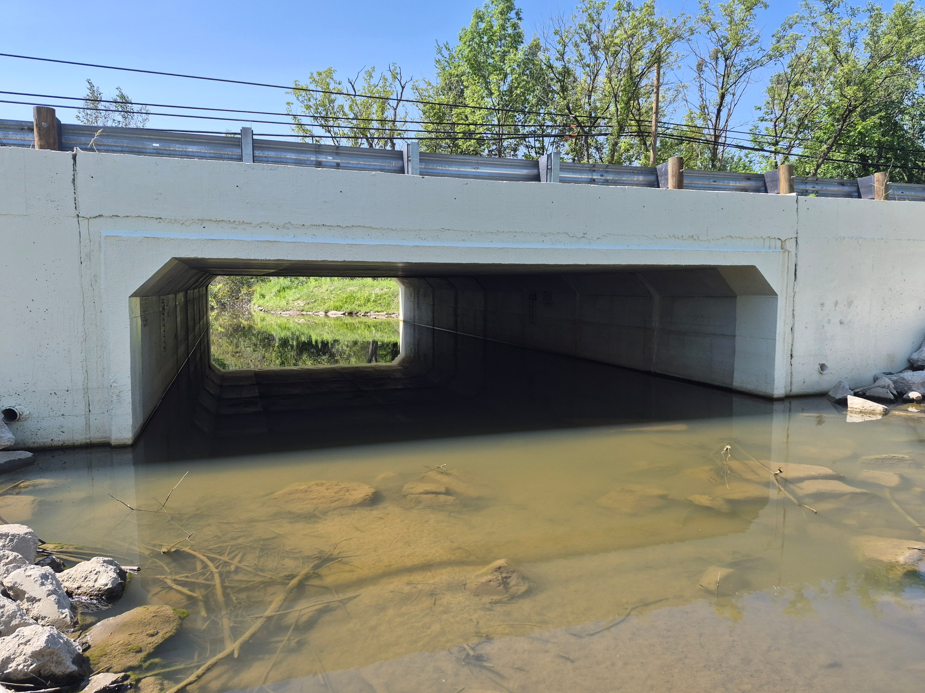
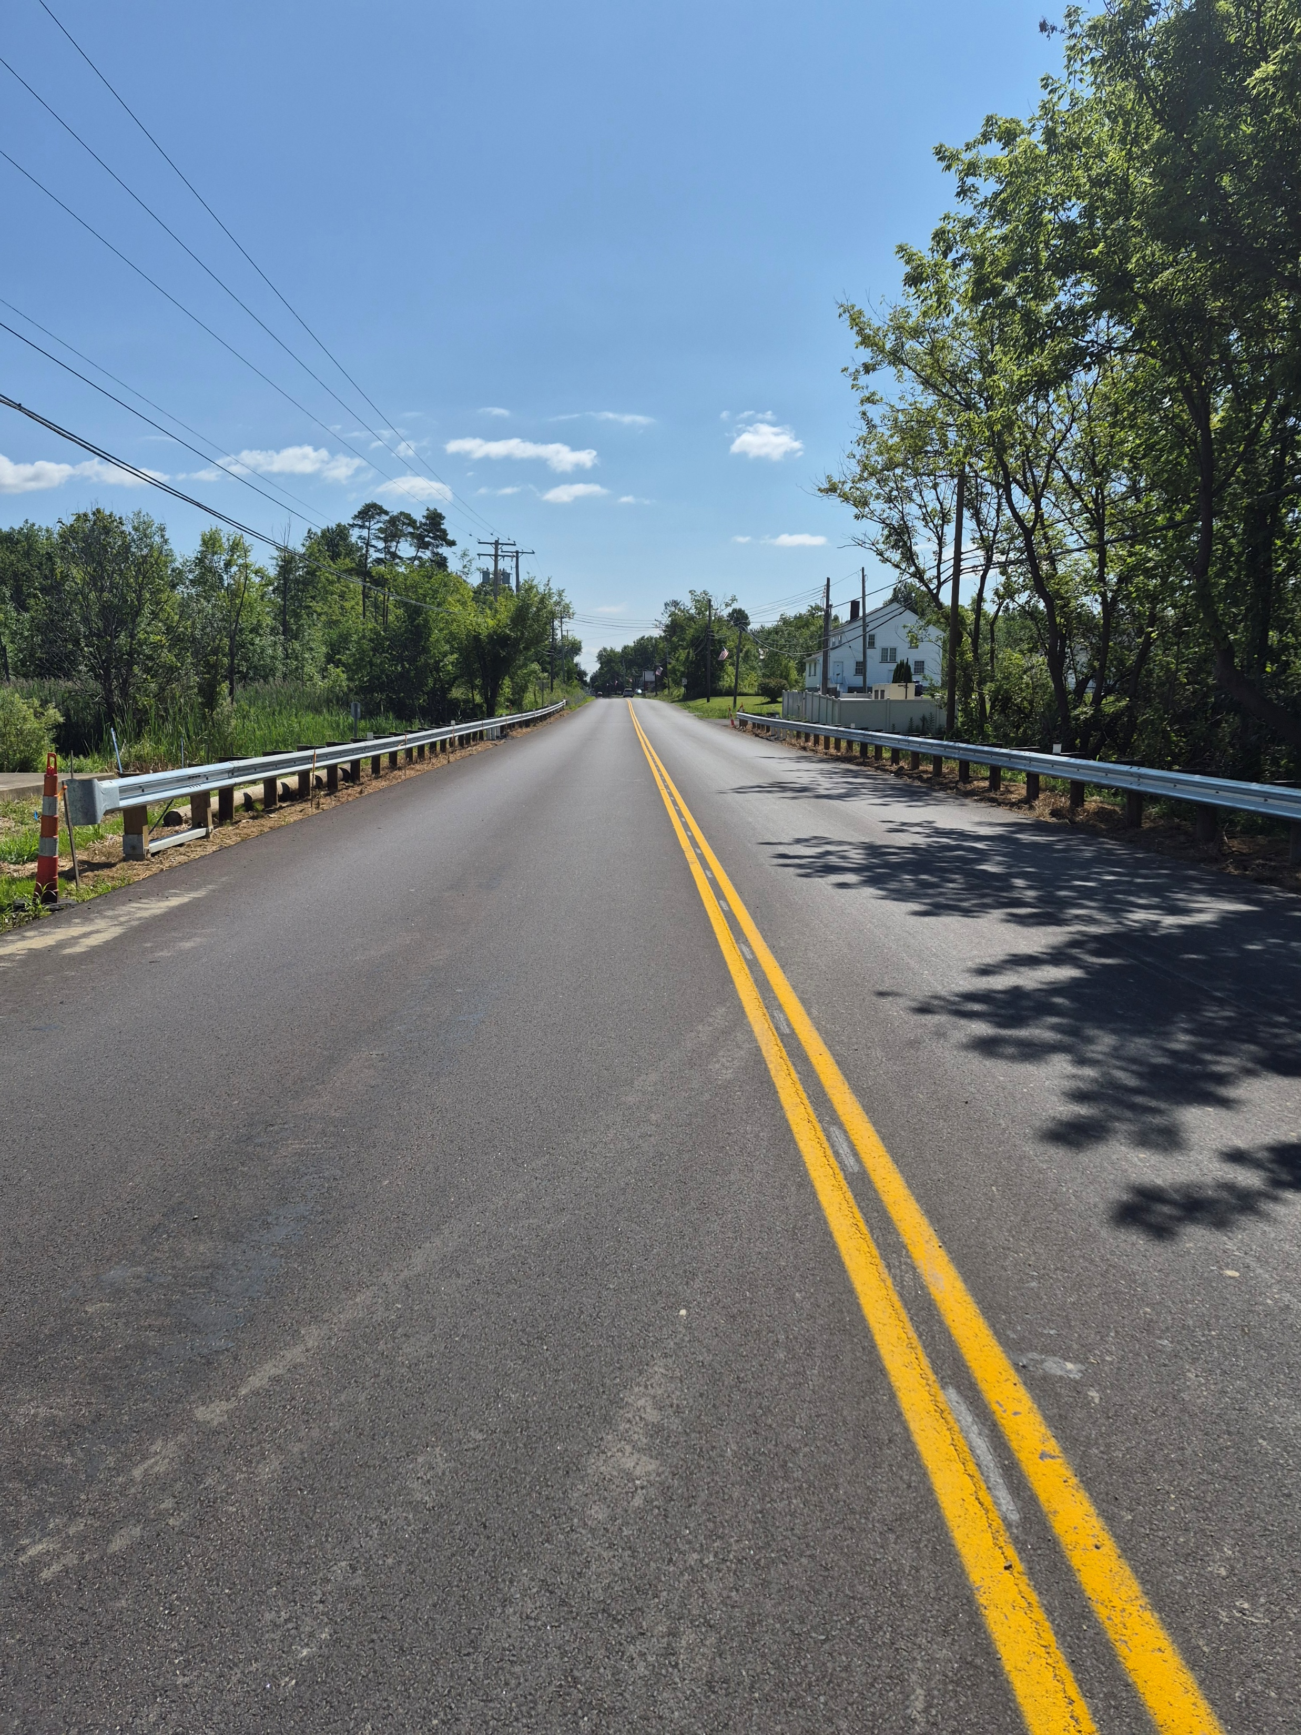
COMPLETED BRIDGE PHOTOS
MAH-Mahoning Avenue Industrial Corridor Bridge over Morrison Run
Bridge Project Funding Examples August 12, 2026

Slide 29
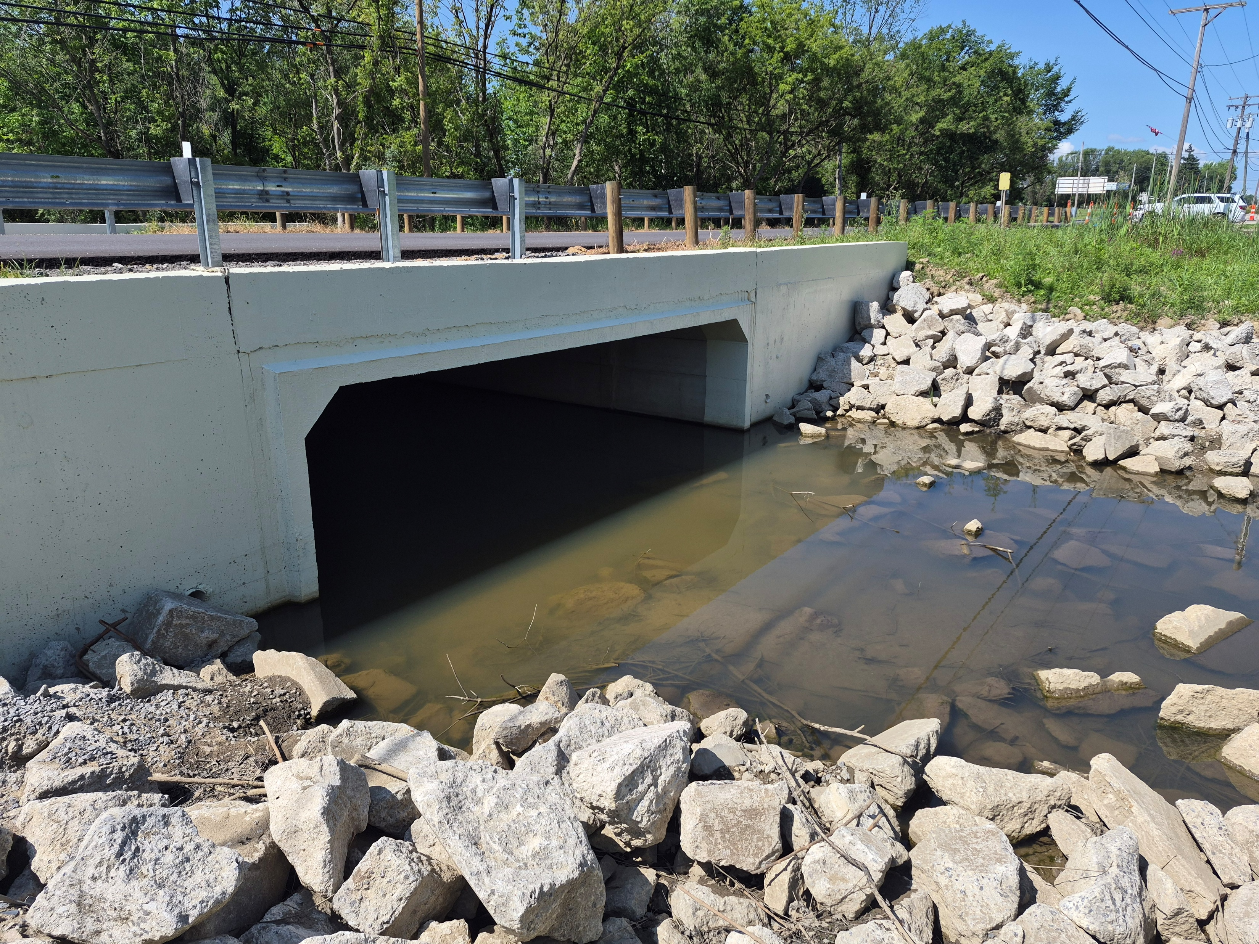
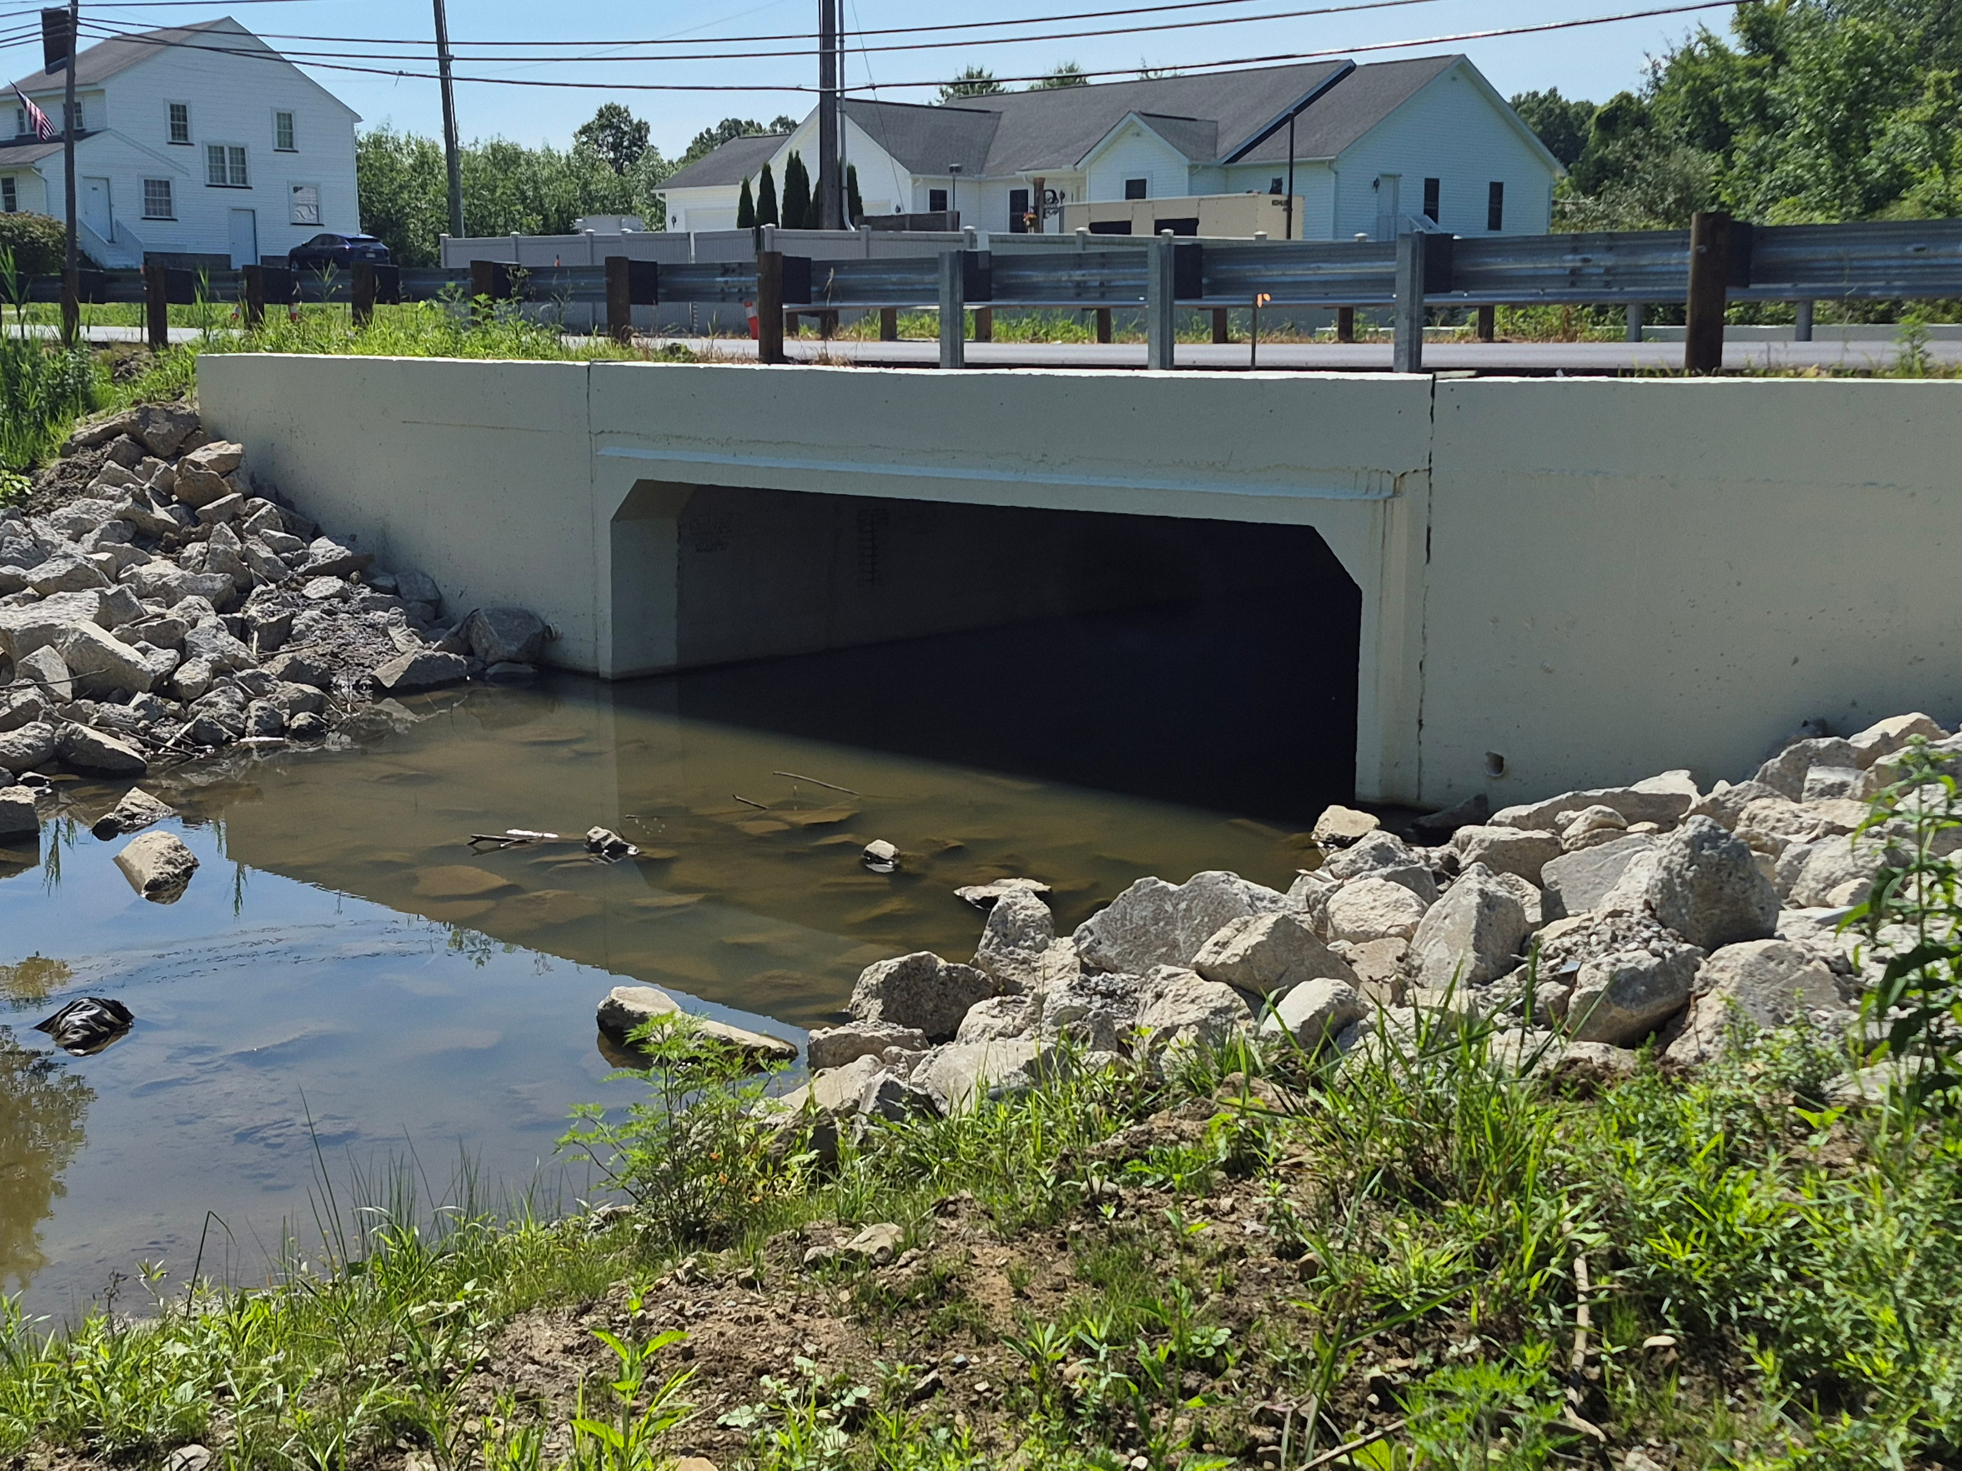
COMPLETED BRIDGE PHOTOS
MAH-Mahoning Avenue Industrial Corridor Bridge over Morrison Run
Bridge Project Funding Examples August 12, 2026

Slide 30
Mahoning County
MAH-Market St. Bridge over Mahoning River & NS & CSXT RR
Bridge Project Funding Examples August 12, 2026

Slide 31
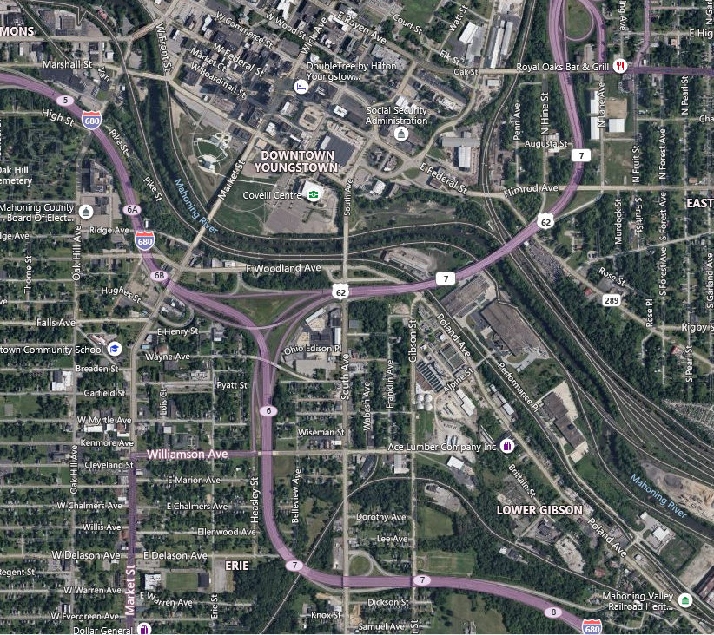
PROJECT LOCATION
MAH-Market St. Bridge over Mahoning River & NS & CSXT RR
Bridge Project Funding Examples August 12, 2026
Notes:
The Market street bridge is the main southern access point into downtown Youngstown and some of you may know that this route used to be SR 7 into and through the downtown prior to it being rerouted across Williamson Avenue to US 62

Slide 32
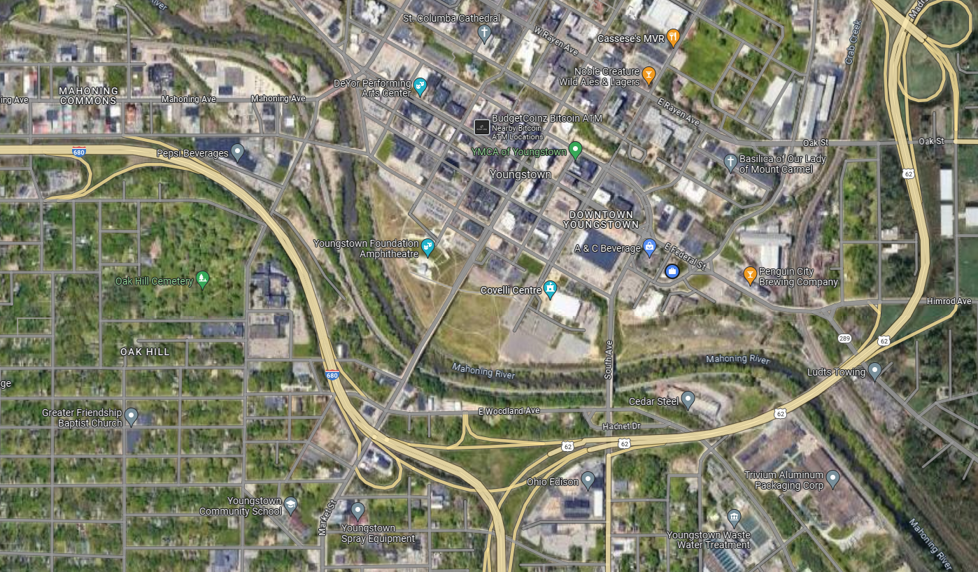
LOCATION MAP
MAH-Market St. Bridge over Mahoning River & NS & CSXT RR
Bridge Project Funding Examples August 12, 2026
Notes:
As you can see in this picture the Covelli Centre is to the east of the bridge, and it’s the home of the Youngstown Phantom Hockey team and to the west of the bridge is the Youngstown Foundation Ampitheatre where several great outdoor concerts have been held and all of the grassy area between these two venues is called Ween Park. This project started out as a deck maintenance project that would not involve the railroad in any way.

Slide 33
PROJECT FUNDING
MAH-Market St. Bridge over Mahoning River & NS & CSXT RR
The original Major Bridge funding grant was $1,878,000 (49%) and we were using $1,955,221 (51%) Bridge Sales Tax.
The final construction cost was $3,835,308 and ODOT paid $3,536,949 (92%). We paid $186,155.22 (8%) with Bridge Sales Tax.
Bridge Project Funding Examples August 12, 2026
Notes:
ms consultants was the design engineer for this project as well as the previous maintenance project completed in 2014. This project started out with the intent to patch the deck, replace the lighting and add safety fencing. Thanks to the passage of the county sales tax for roads & bridges we now had the leverage to apply for funding to expand the scope by giving us a revenue stream to cover the local match.
At the completion of the in-depth inspection by ms consultants, the project scope was expanded due to finding additional maintenance work items needing to be addressed. The County was successful in securing the Local Major Bridge Funding (LMB funding). Had the county not been successful in passing the sales tax which is dedicated to roads & bridge, we would have either pushed the maintenance work into another year in hopes of securing LMB funds in a future fiscal year or reduce the scope and use our local funding to do only those items that are deemed most critical to extending the life of the bridge. As you can see by the original funding, the local match would have been almost $2 Million on this bridge.

Slide 34
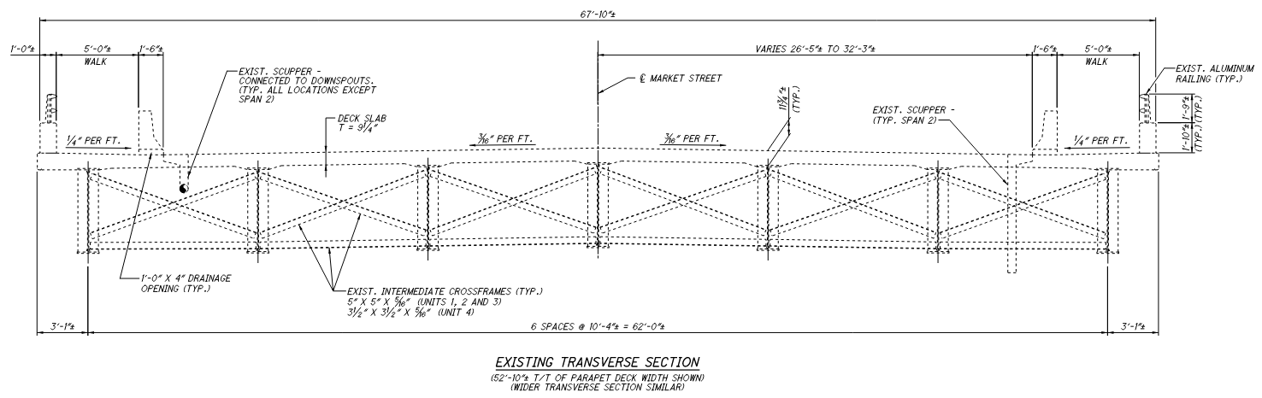
EXISTING BRIDGE
MAH-Market St. Bridge over Mahoning River & NS & CSXT RR
Constructed in 1981
Continuous A588 (weathering steel) welded plate girders with reinforced concrete deck and cap-and-column piers & abutments
13 Spans = 191’, 210’, 168’, 99.33’, 111’, 111’, 111’, 116’, 116’, 93’, 85’, 85’, 78.17’ = +/- 1,574’
Skew = None
Design Loading = HS20-44 & Alt. Military Loading
Bridge Project Funding Examples August 12, 2026
Notes:
The bridge was built in 1981 has 13 spans comprising 4 units with an overall length of 1,574’ which makes it the 6th longest county bridge in the state of Ohio out of the approximately 25,300 bridges maintained by the 88 Ohio County Engineer’s. The width varies from 52’ to 68’.

Slide 35
PROPOSED WORK
MAH-Market St. Bridge over Mahoning River & NS & CSXT RR
Remove and replace existing bridge lighting
Replace existing strip seals at expansion joints
Replace existing elastomeric compression seal and joint armor at North Abutment
Install new vandal protection fence (8’ tall to allow future snooper inspections)
Install new micro silica modified concrete overlay (at Units 3 & 4 only)
Patching concrete deck (at Units 1 & 2)
Patching concrete abutments and piers
Re-face parapets
Repair structural steel & perform repair painting
Repair drainage system (scuppers & downspouts)
Seal bridge deck with gravity fed resin (Units 1 & 2)
Seal concrete substructures and parapets
Provide new pavement striping on bridge
Bridge Project Funding Examples August 12, 2026
Notes:
As you'll see in the upcoming pictures, the existing bridge lighting needs to be replaced and actually 3 poles have already fallen over and had to be removed, the seals and expansion joints all need to be replaced, Units 3 & 4 will receive a new silica modified concrete overlay as these 2 units comprise the majority of the deck repair area. Units 1 & 2, the parapets, abutments & piers will be patched and sealed, the drainage system will be repaired, some structural steel will be repaired and painted and unfortunately we have a need to place fencing on the bridge due to the fact that three people jumped from the bridge over the last 7 years.

Slide 36
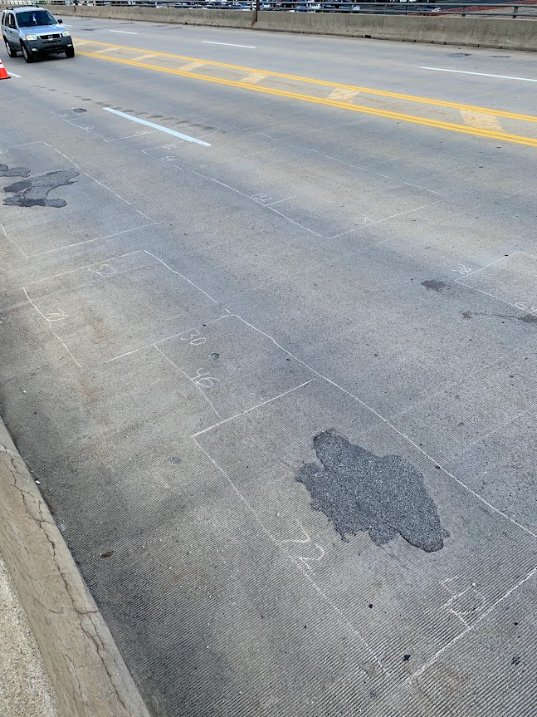
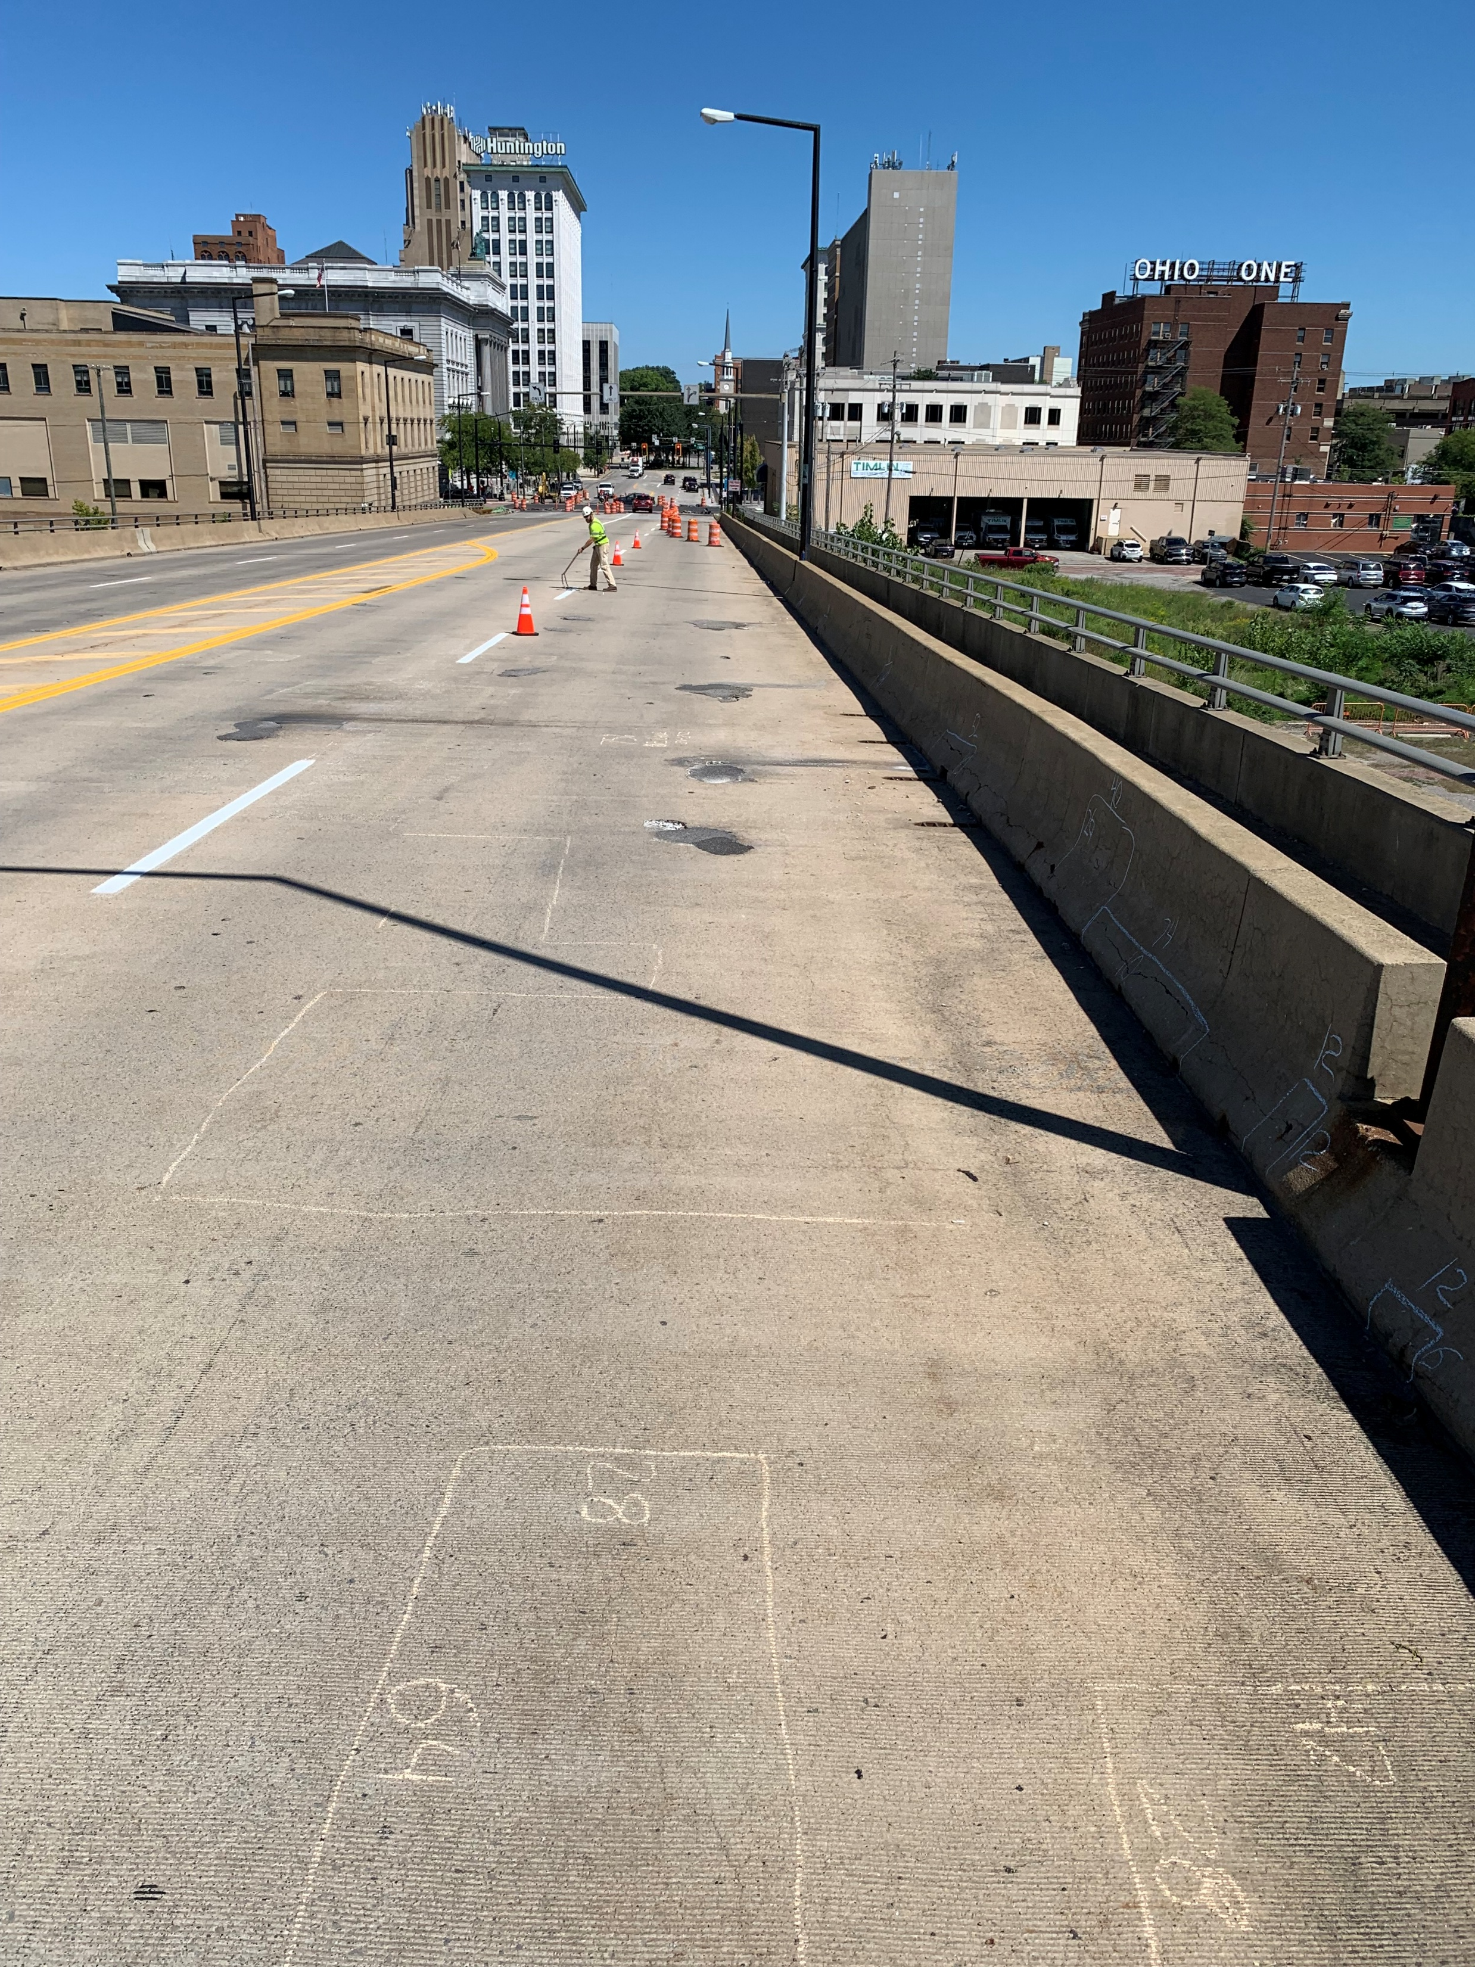
EXISTING BRIDGE PHOTOS
MAH-Market St. Bridge over Mahoning River & NS & CSXT RR
Areas of delaminated or unsound concrete on top surface of deck
Bridge Project Funding Examples August 12, 2026

Slide 37
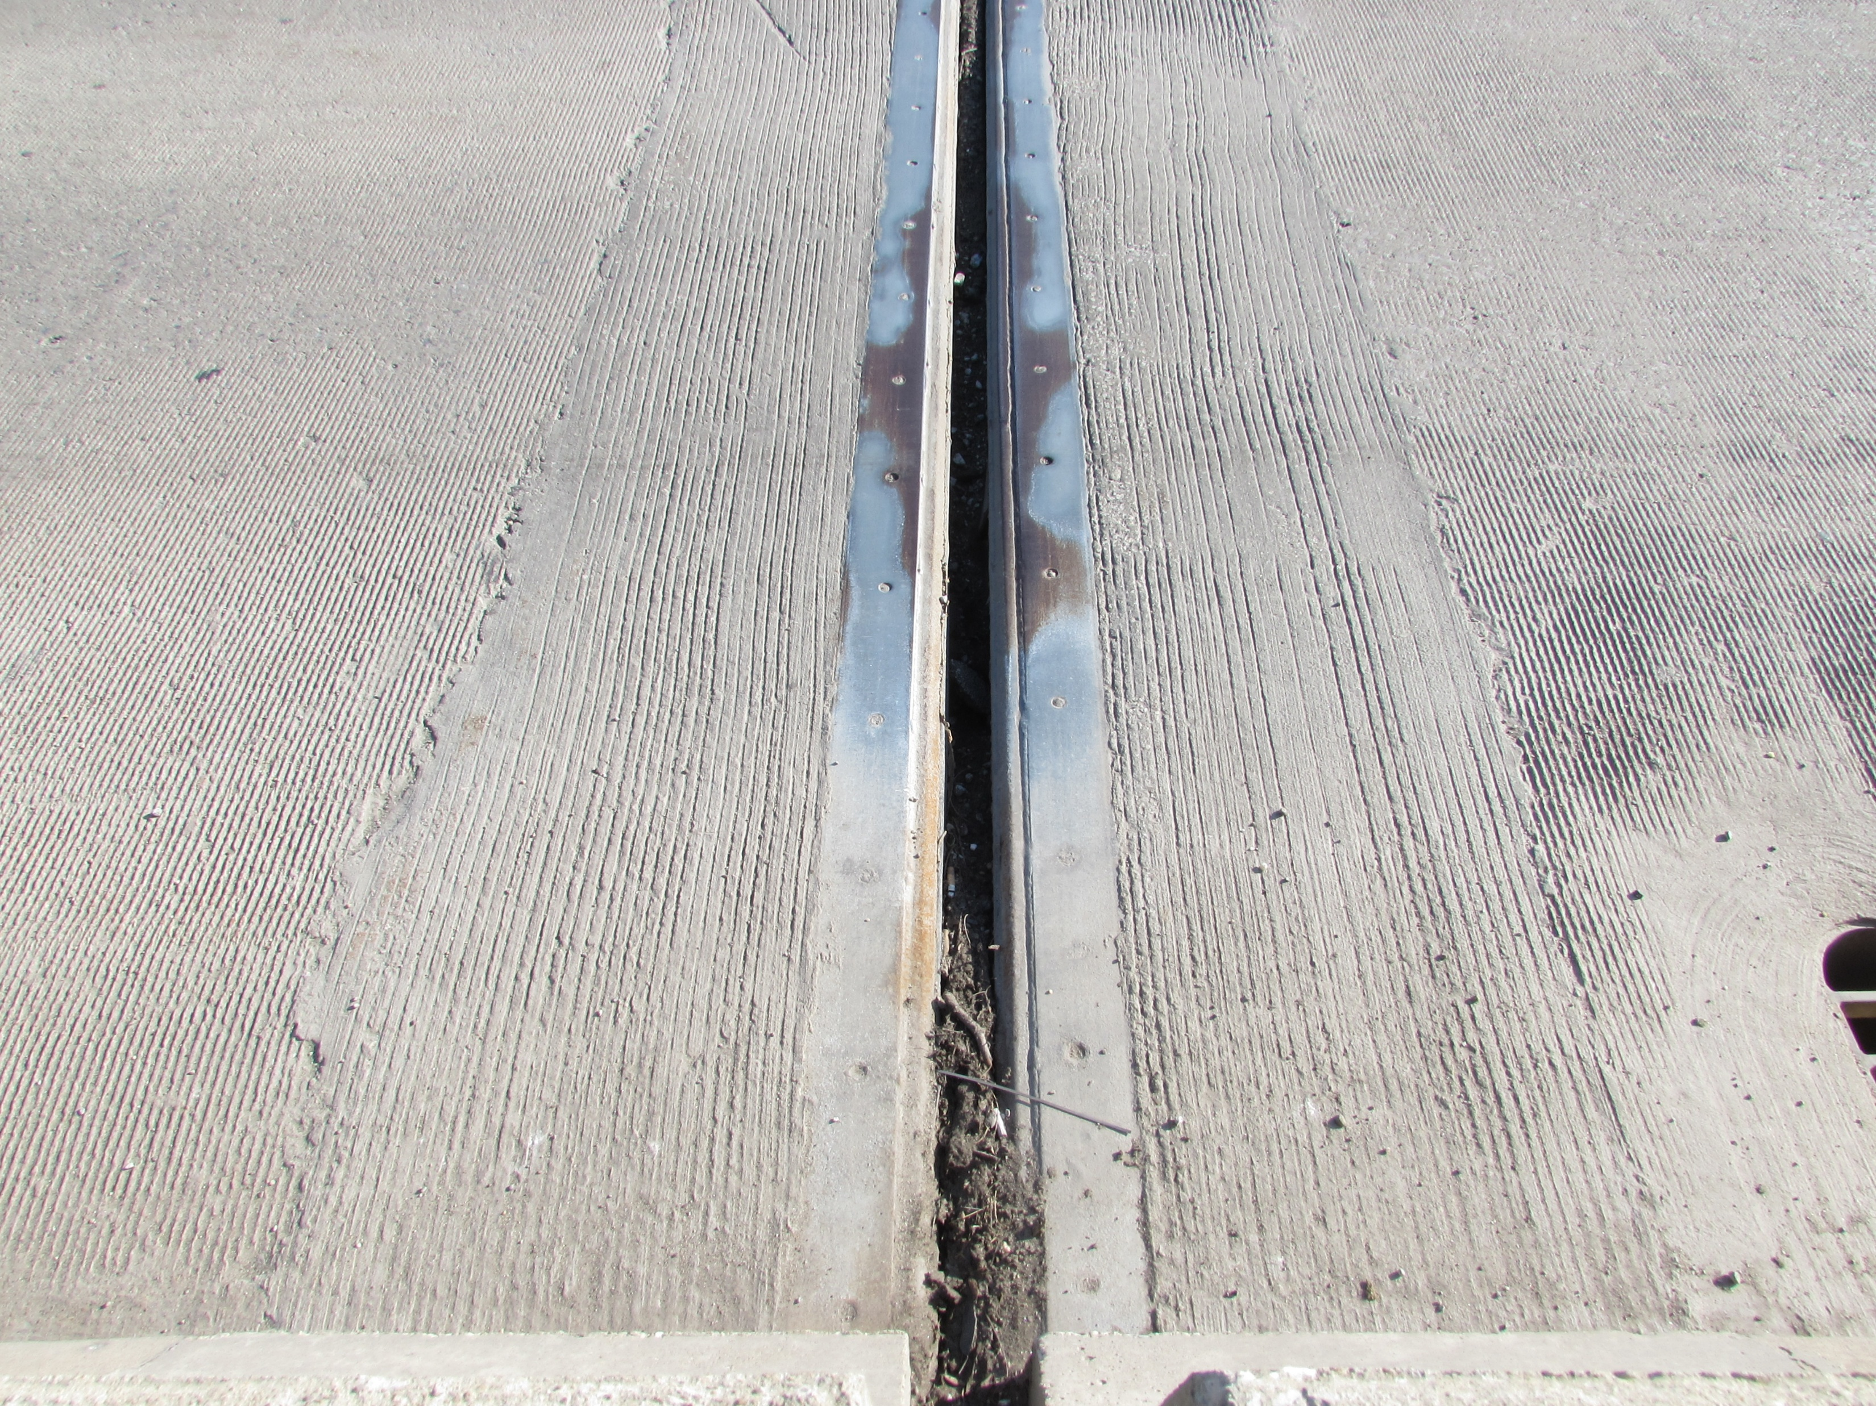
EXISTING BRIDGE PHOTOS
MAH-Market St. Bridge over Mahoning River & NS & CSXT RR
View of Expansion Joint showing tears in elastomeric strip seal (typ. of all existing strip seals)
Bridge Project Funding Examples August 12, 2026

Slide 38
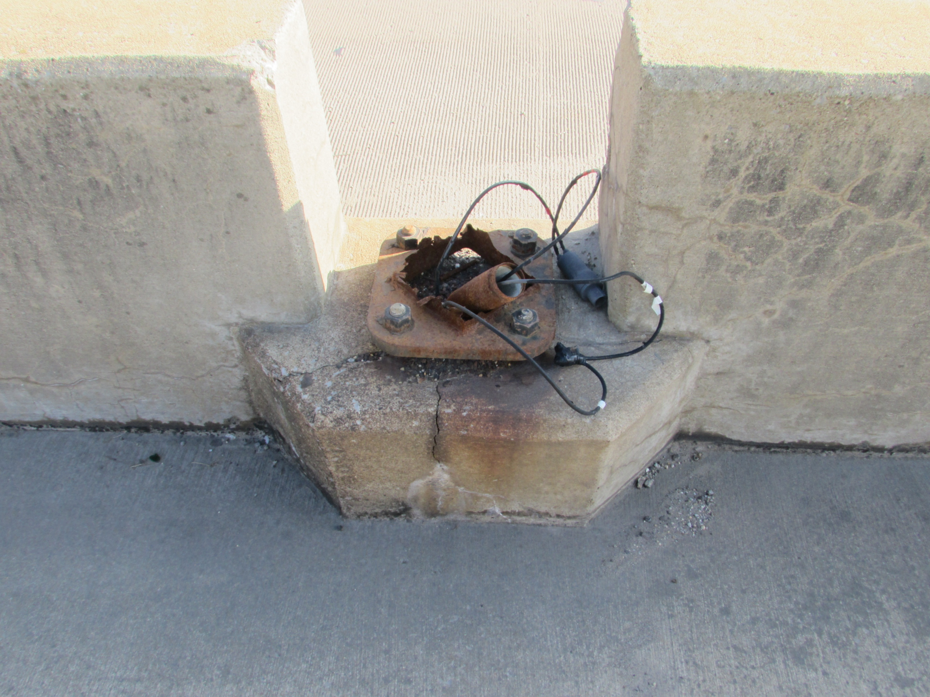
EXISTING BRIDGE PHOTOS
MAH-Market St. Bridge over Mahoning River & NS & CSXT RR
View of missing light pole (typical of three locations on bridge)
Bridge Project Funding Examples August 12, 2026

Slide 39
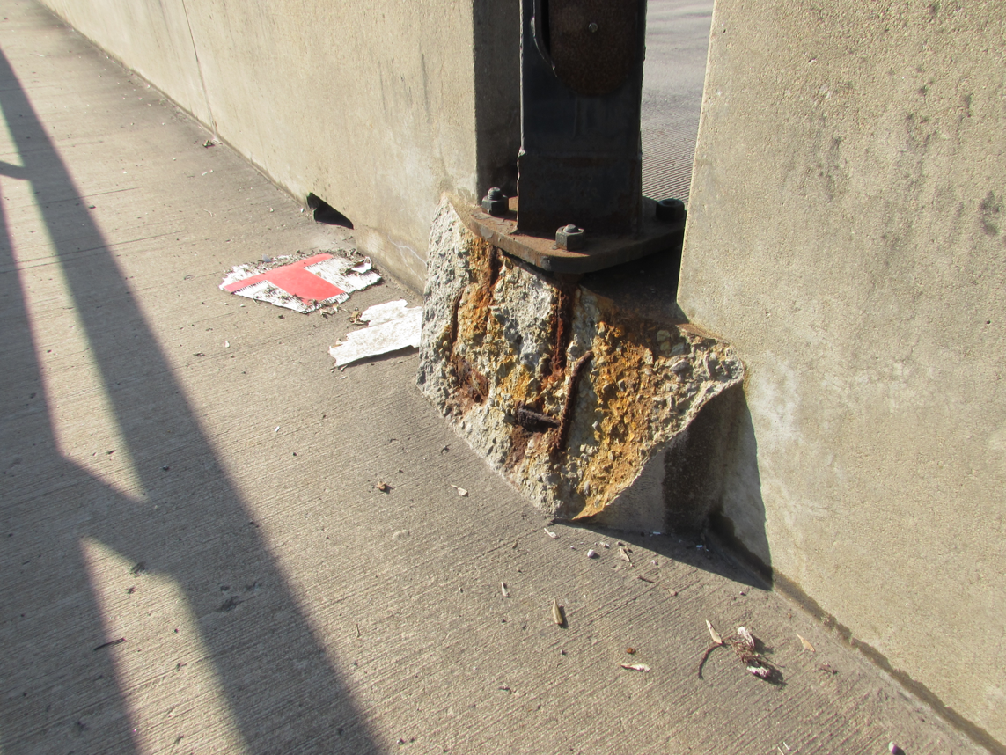
EXISTING BRIDGE PHOTOS
MAH-Market St. Bridge over Mahoning River & NS & CSXT RR
View of light pole pilaster with spalled concrete and corroded reinforcing steel (typ. of several locations)
Bridge Project Funding Examples August 12, 2026

Slide 40
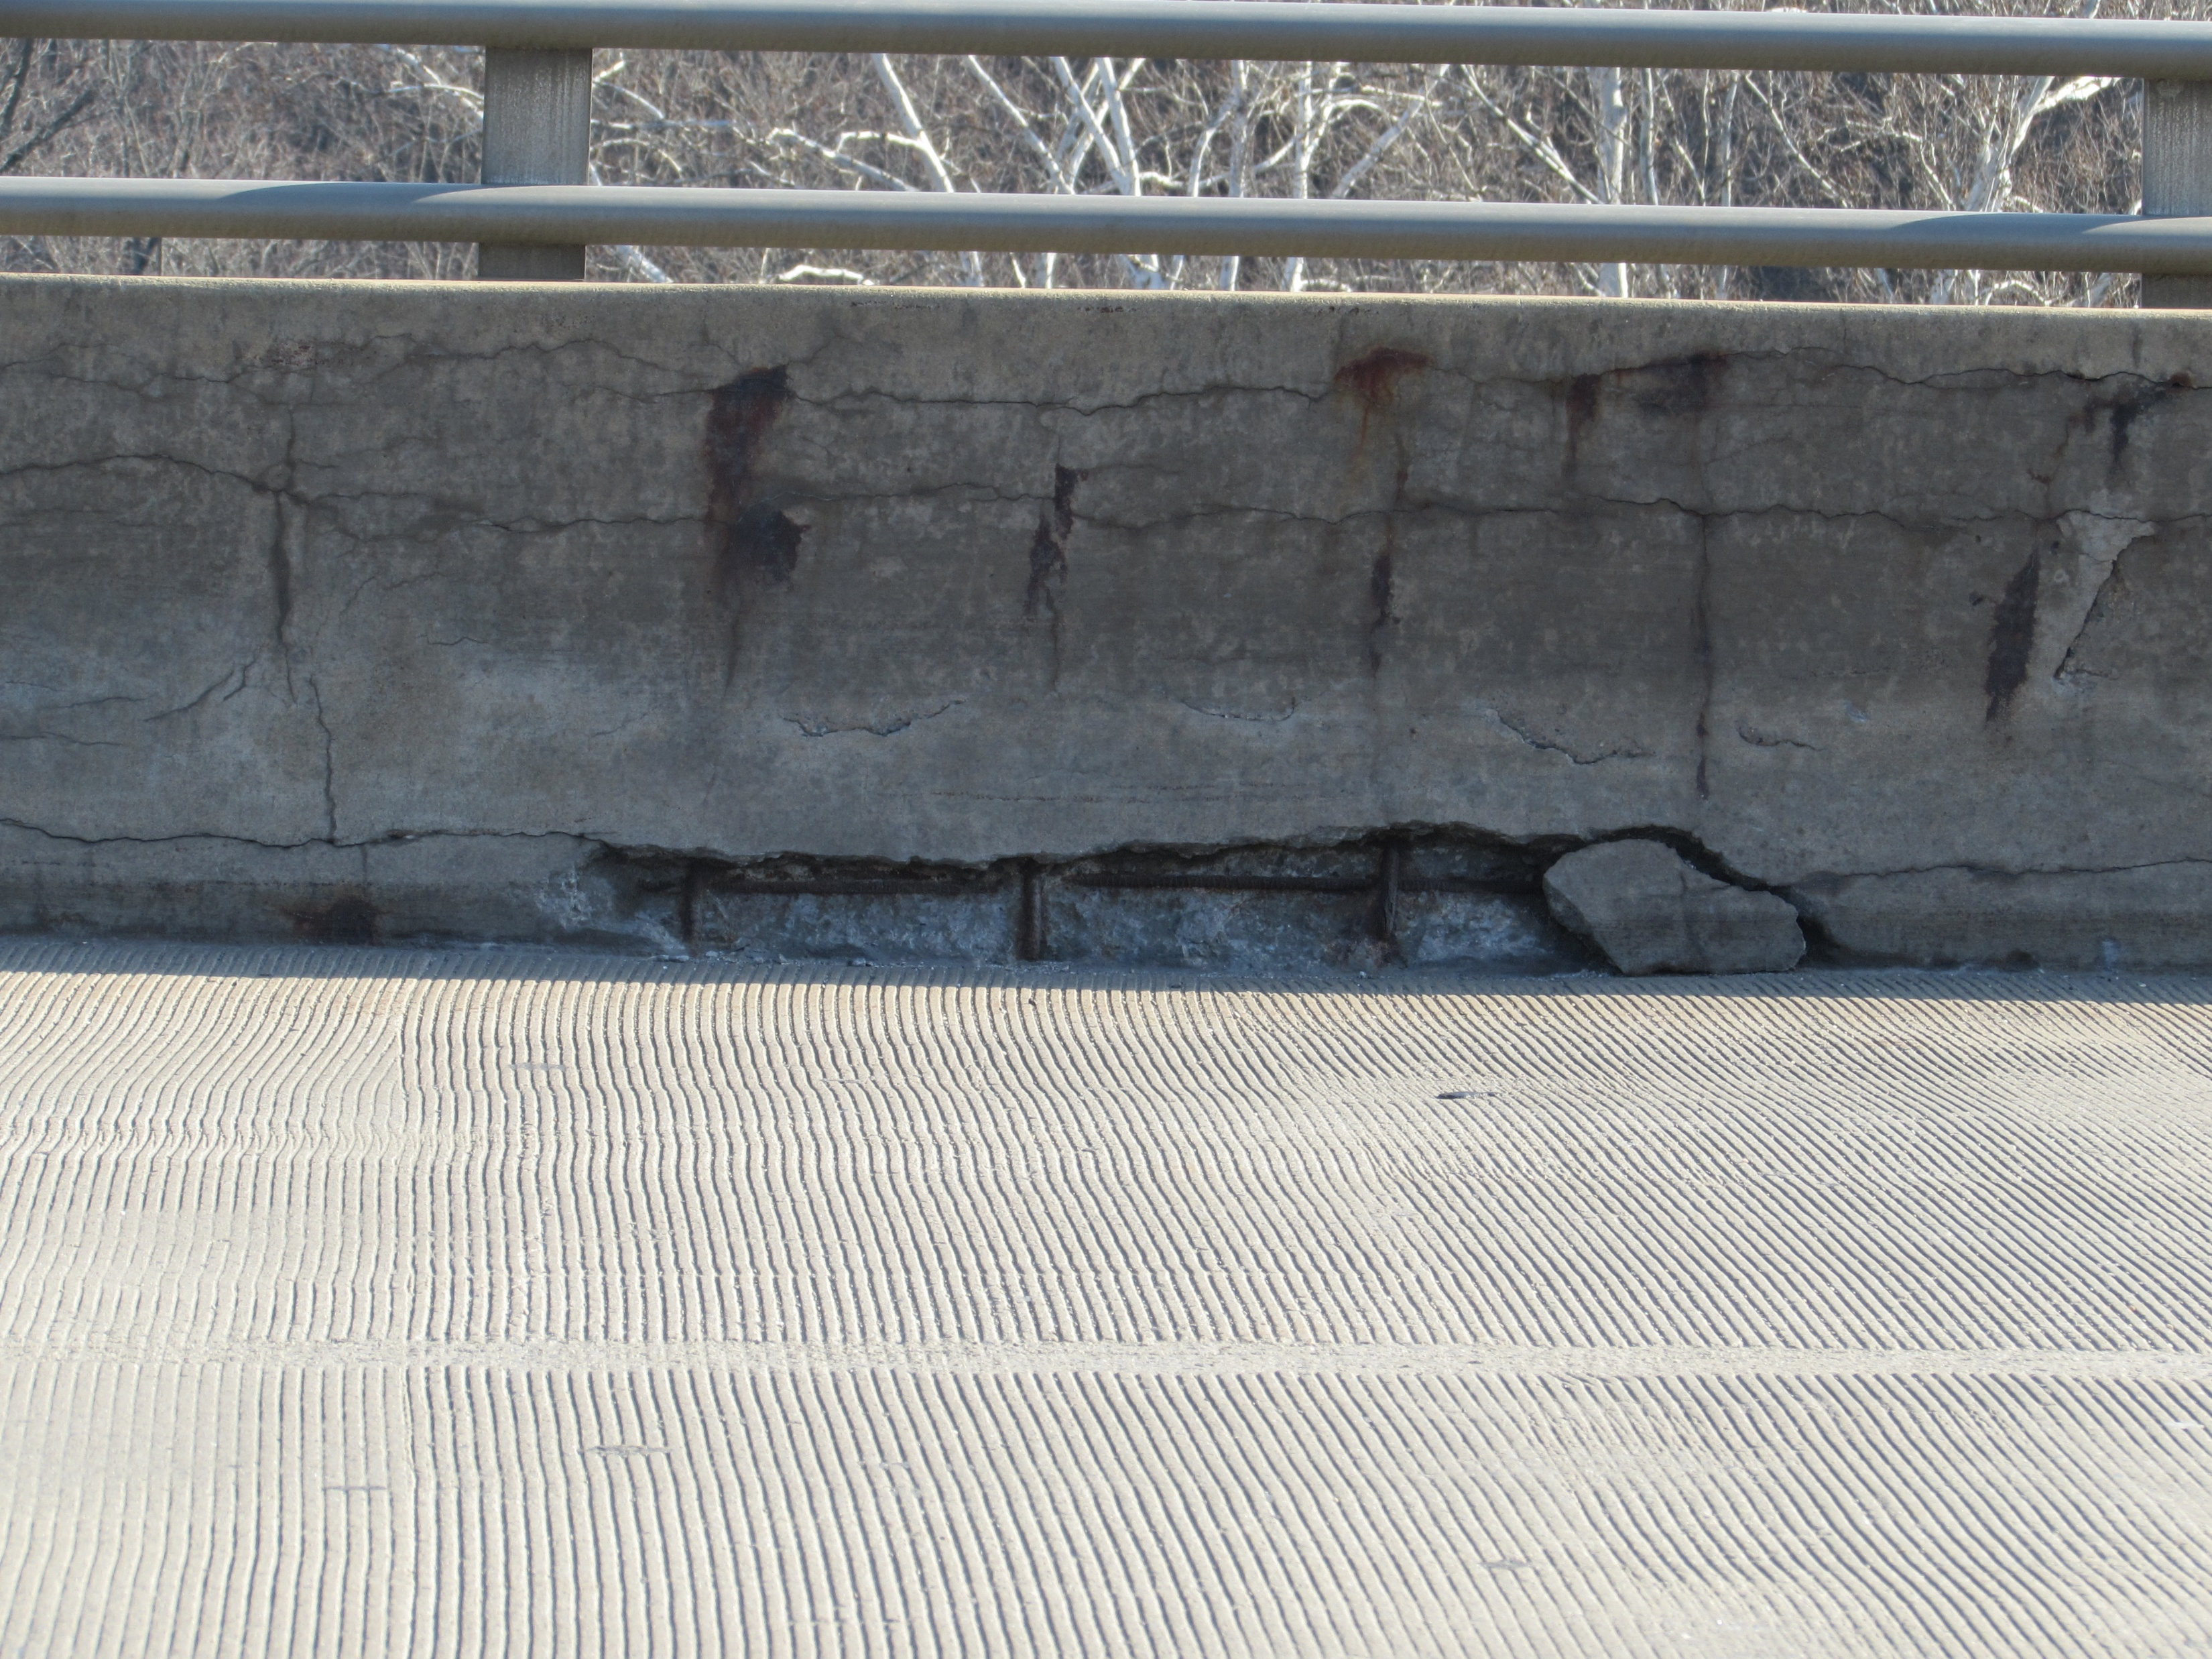
EXISTING BRIDGE PHOTOS
MAH-Market St. Bridge over Mahoning River & NS & CSXT RR
View of cracked and spalled concrete parapet and exposed and corroded reinforcing steel
Bridge Project Funding Examples August 12, 2026

Slide 41
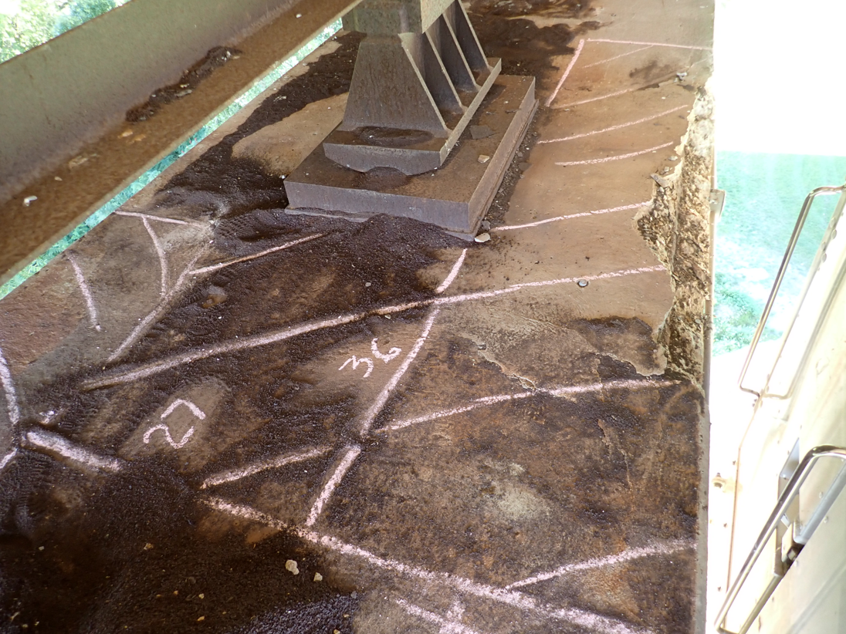
EXISTING BRIDGE PHOTOS
MAH-Market St. Bridge over Mahoning River & NS & CSXT RR
View of top of Pier #3 showing delaminated and spalled concrete with exposed reinforcing steel
Bridge Project Funding Examples August 12, 2026

Slide 42
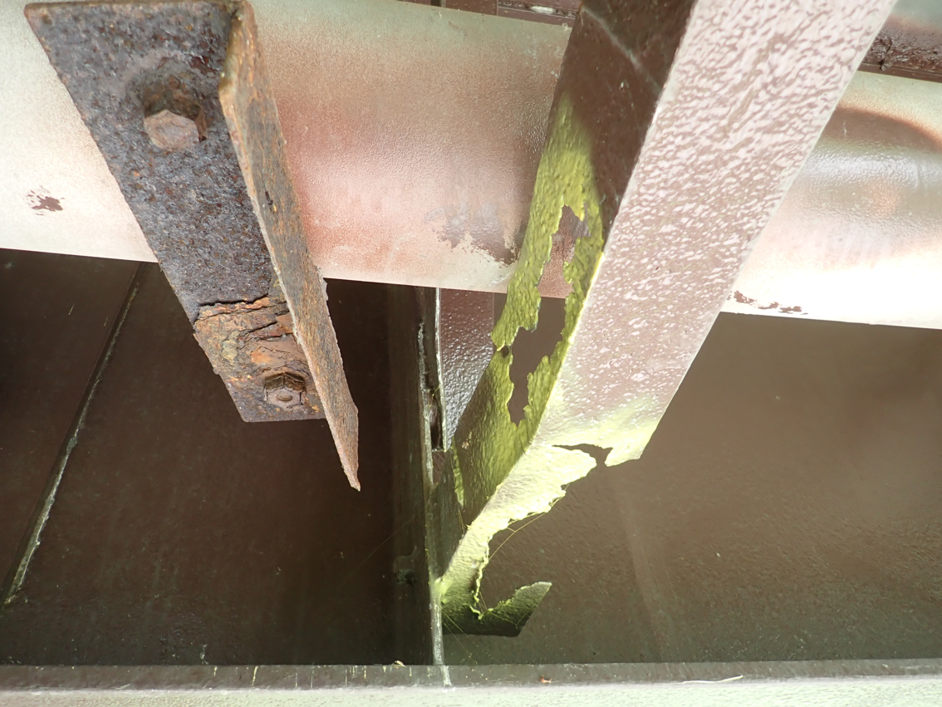
EXISTING BRIDGE PHOTOS
MAH-Market St. Bridge over Mahoning River & NS & CSXT RR
View of nearly 100% section loss to horizontal angle at first cross frame to the north of Hinge #1
Bridge Project Funding Examples August 12, 2026

Slide 43

EXISTING BRIDGE PHOTOS
MAH-Market St. Bridge over Mahoning River & NS & CSXT RR
View from below deck (looking up) showing leaking drainage system
Bridge Project Funding Examples August 12, 2026

Slide 44

EXISTING BRIDGE PHOTOS
MAH-Market St. Bridge over Mahoning River & NS & CSXT RR
View of broken weld between end diaphragm angle and back of channel (at Hinge #2)
Bridge Project Funding Examples August 12, 2026

Slide 45

EXISTING BRIDGE PHOTOS
MAH-Market St. Bridge over Mahoning River & NS & CSXT RR
View of leaky compression seal at expansion joint at Fwd. Abutment
Bridge Project Funding Examples August 12, 2026

Slide 46

EXISTING BRIDGE PHOTOS
MAH-Market St. Bridge over Mahoning River & NS & CSXT RR
Steel Corrosion at Beam at South Abutment
Bridge Project Funding Examples August 12, 2026

Slide 47

EXISTING BRIDGE PHOTOS
MAH-Market St. Bridge over Mahoning River & NS & CSXT RR
View of Pier #3 showing delaminated concrete and drainage system deficiency
Bridge Project Funding Examples August 12, 2026

Slide 48

COMPLETED BRIDGE PHOTOS
MAH-Market St. Bridge over Mahoning River & NS & CSXT RR
Bridge Project Funding Examples August 12, 2026

Slide 49

COMPLETED BRIDGE PHOTOS
MAH-Market St. Bridge over Mahoning River & NS & CSXT RR
Bridge Project Funding Examples August 12, 2026

Slide 50

THANK YOU!
MAH-Market St. Bridge over Mahoning River & NS & CSXT RR
Bridge Project Funding Examples August 12, 2026

Slide 51


Muskingum County
County Engineer
Mark Eicher, P.E., P.S.
Maintenance Responsibility
528 Miles of Roadway (Centerline)
398 Structures
Bridge Projects With Outside Funding - Last 10 Years
1 Local Major Bridge Program
1 Ohio Publics Works (OPWC)
1 Accelerated Innovation Deployment (AID)
13 Local Bridge Program (LBR/BFP) (5 More Funded FY27-31)
Bridge Project Funding Examples August 12, 2026

Slide 52


Duncan Falls / Philo Bridge Replacement Project
NEW BRIDGE (ONE STRUCTURE)
7 SPANS - 862 FT LONG (2018-2021)
OLD BRIDGE (TWO STRUCTURES)
7 SPANS - 828 FT LONG (Piers-1875, Superstructure-1979)
3 SPANS - 130 FT LONG (1953)
Bridge Project Funding Examples August 12, 2026

Slide 53

Duncan Falls / Philo Bridge Replacement Project
Project Challenges
Funding, Funding, Funding
Bridge Location
Historic Significance
Right of Way
Utility Relocations
Muskingum River
Coordination
Bridge Project Funding Examples August 12, 2026

Slide 54
Duncan Falls / Philo Bridge Replacement Project
Bid Price = $9,984,026 (Final = $12,633,026) | Federal Match | Federal Funds | Credit Bridge | Local Match | Local Funds | Total
Preliminary Engineering | 80% | $261,108 |  | 20% | $65,277 | $326,385
Environmental & Design Engineering, R/W Services | 80% | $1,106,410 |  | 20% | $276,602 | $1,383,012
R/W Acquisition & Utility Relocation | 95% | $1,600,000 | $300,000 | 5% | $100,000 | $2,000,000
CEAO – LBR Construction | 80% | $262,715 |  | 20% | $65,679 | $328,394
CEAO – LBR Construction Inspection & Engineering | 80% | $854,815 |  | 20% | $213,704 | $1,068,519
Local Major Bridge - Construction | 95% | $11,689,400 |  | 5% | $615,232 | $12,304,632
Local Funded - Construction Engineering & Inspection |  |  |  | 100% | $78,022 | $78,022
Grand Total |  | $15,774,448 | $300,000 |  | $1,414,516 | $17,488,964
$4,085,048
CEAO LBR Funding
$11,689,400
Local Major Bridge Funding
$300,000
Credit Bridge
$916,130
SIB Loan
$498,386
Local Funds
$17,488,964
Total Cost
Bridge Project Funding Examples August 12, 2026

Slide 55

Duncan Falls / Philo Bridge Replacement Project
Bridge Project Funding Examples August 12, 2026

Slide 56

Duncan Falls / Philo Bridge Replacement Project
2019 FHWA Excellence in Right of Way Award
2022 ACEC Partnering Award
Bridge Project Funding Examples August 12, 2026

Slide 57


Gaysport Bridge Replacement Project
NEW BRIDGE (ONE STRUCTURE)
7 Spans - 686 ft (2022-2024)
OLD BRIDGE (ONE STRUCTURE)
7 Spans - 686 ft (Piers-1886, Superstructure-1971)
Bridge Project Funding Examples August 12, 2026

Slide 58

Gaysport Bridge Replacement Project
Project Challenges
Funding, Funding, Funding
Bridge Location
Historic Significance
Right of Way
Utility Relocations
Muskingum River
Coordination
Bridge Project Funding Examples August 12, 2026

Slide 59
Gaysport Bridge Replacement Project
Bid Price = $6,855,410 (Final = $7,370,994) | Federal Match | Federal Funds | Credit Bridge | Local Match | Local Funds | Total
Preliminary Engineering (STS & Hydraulics) & R/W Acquisition | 0% |  |  | 100% | $78,757 | $78,757
Environmental & R/W Services (Task Order) | 100% | $267,702 |  | 0% |  | $267,702
Design Engineering | 0% |  |  | 100% | $21,750 | $21,750
CEAO - LBR Construction | 80% | $5,484,328 |  | 20% | $1,371,082 | $6,855,410
CEAO - LBR Construction Inspection & Engineering | 80% | $383,902 |  | 20% | $95,976 | $479,878
CPF - Construction | 80% | $412,593 |  | 20% | $103,147 | $515,740
Local Funded - Construction Engineering & Inspection | 0% |  |  | 100% | $32,105 | $32,105
Grand Total |  | $6,548,525 |  |  | $1,702,817 | $8,251,342
$5,868,230
CEAO LBR Funding
$412,593
Community Project Funding
$1,507,163
SIB Loan
$195,654
Local Funds
$8,251,342
Total Cost
Bridge Project Funding Examples August 12, 2026

Slide 60

Gaysport Bridge Replacement Project
Bridge Project Funding Examples August 11, 2026

Slide 61


Gaysport Bridge Replacement Project
2024 Historic Bridge Preservation
Sustainable Design Award
Bridge Project Funding Examples August 12, 2026

Slide 62


Thompson Road Bridge Replacement
NEW BRIDGE
1 SPANS - 56 FT LONG
OLD BRIDGE
1 SPAN - 56 FT LONG
Bridge Project Funding Examples August 12, 2026

Slide 63
Thompson Road Bridge Replacement
Bid Price = $343,909 | OPWC Match | OPWC Funds | Credit Bridge | Local Match | Local Funds | Total
Construction | 74% | $240,500 |  | 26% | $103,409 | $343,909
Eligible Cost = $337,532
Credit Amount Approved (80%) |  |  | $270,025
Net Project Cost = - $166,616
Bridge Project Funding Examples August 12, 2026

Slide 64

Panel Questions ???
Bridge Project Funding Examples August 12, 2026

