Slide 1
MARK J. EICHER, P.E., P.S.
COUNTY ENGINEER

Slide 2
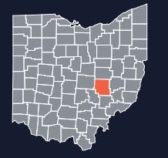
Muskingum County
Southeastern Ohio
Population 86,000
670 Sq. Miles
25 Townships Both the largest (Newton) and the smallest (Jefferson) in the state

Slide 3
Infrastructure
Road Mileage 527 Miles
The most centerline mileage by County in Ohio.
Bridges 396
10th ish most Bridges by County in Ohio.

Slide 4
BUDGET
Annual Budget = 8 Million up 1 Million from last year
Permissive License Plate Fees
That means we have to be creative
Repurposing used Interstate Beams
Fabricate Concrete Beams.
Installing used box culverts
In-house design of LPA Projects

Slide 5
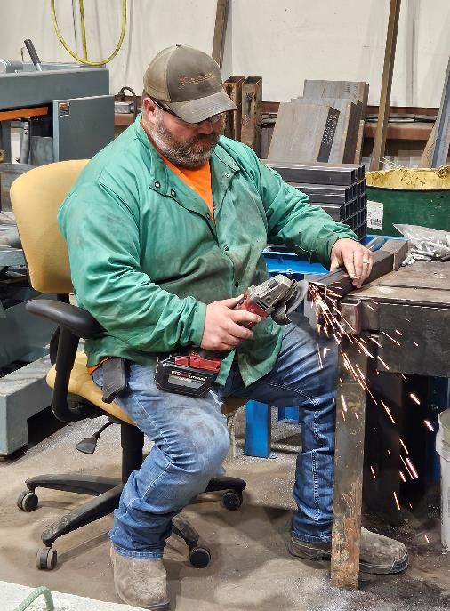
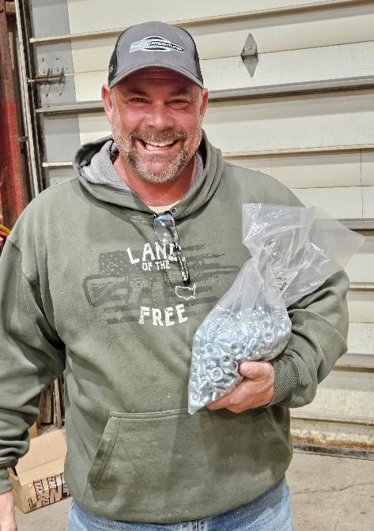
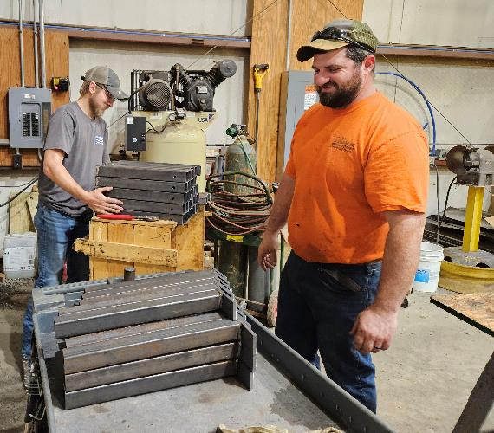
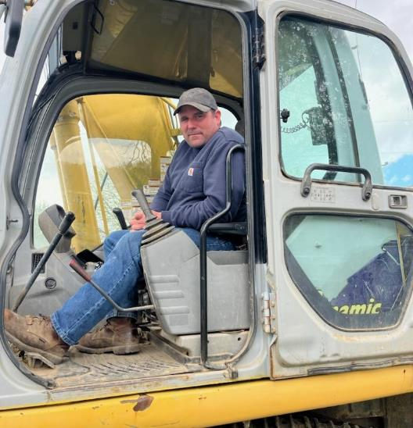
Bridge Crew

Slide 6
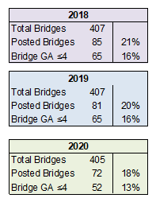
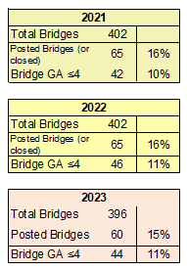
Bridge Conditions

Slide 7
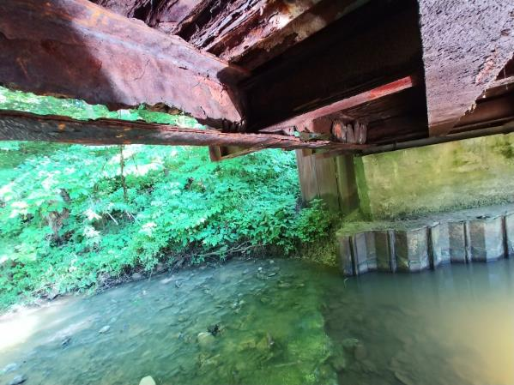
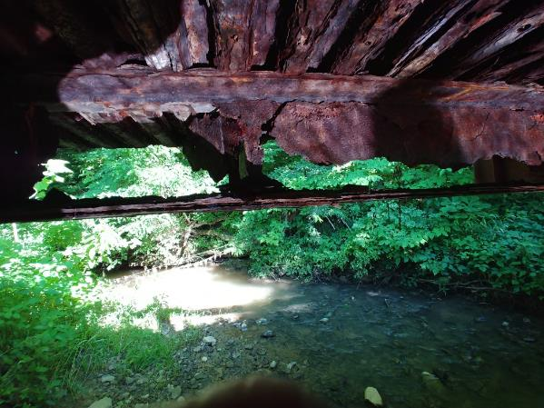
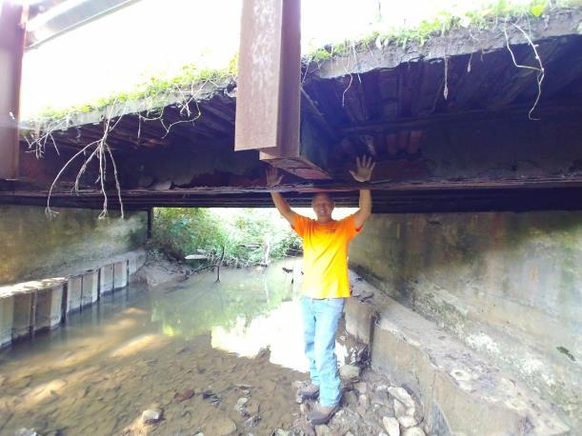
INFRASTRUCTURE
Osborn Road – Replaced
Superstructure 2018

Slide 8
ODOT’s Steel Beam Upcycling Program
HOW THE PROGRAM WORKS
ODOT publishes a list of upcoming ODOT bridge replacement projects where they are willing to make the Steel Beams available.
Counties are welcome to look at the list and request the beams from a project (Primarily within their ODOT District)
If requested, ODOT will add a plan note requiring their successful contractor to deliver the salvaged beams to the requesting county

Slide 9
HOW THE PROGRAM WORKS
The county must unload the beams when delivered
The county must use the beams on at least one bridge replacement within a five year time period.
Recycled beams cannot be used on a credit bridge project or use any federal or state funding sources where the beams are used

Slide 10
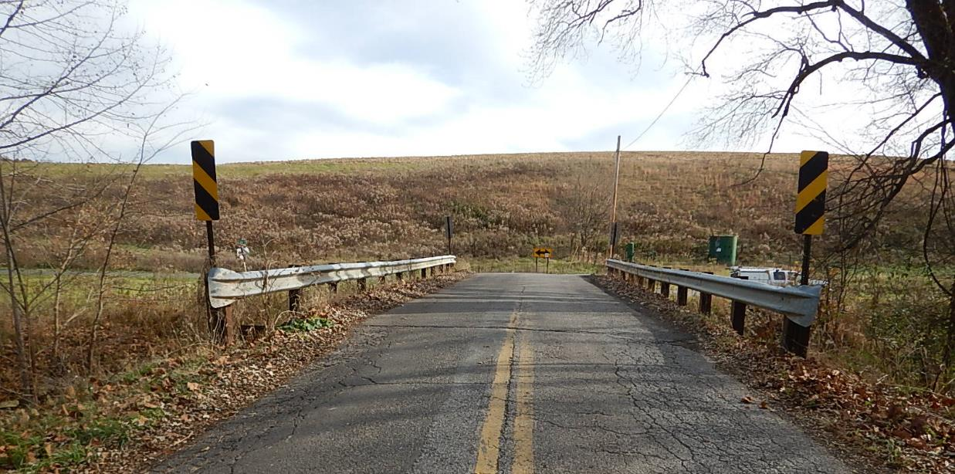
SPRY ROAD

Slide 11
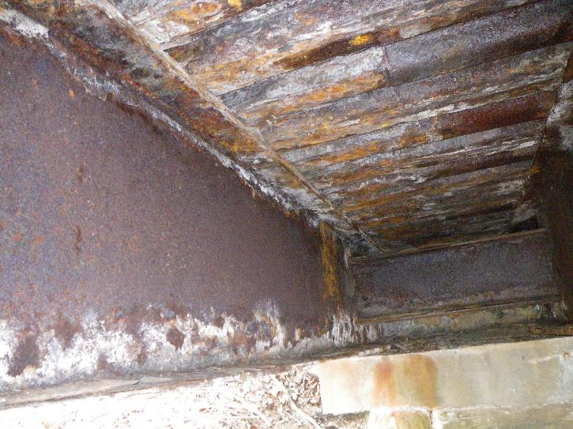
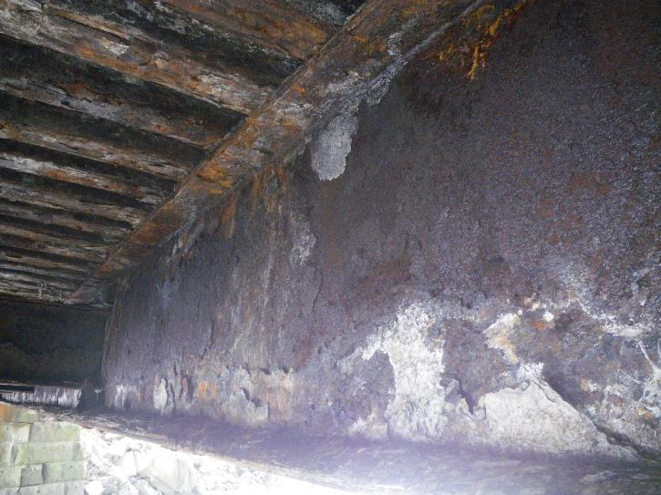
SPRY ROAD

Slide 12
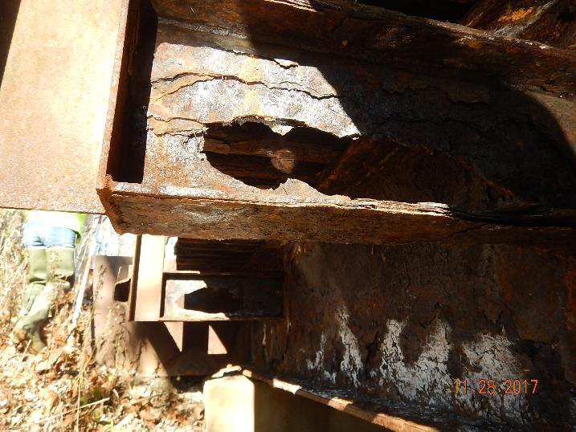
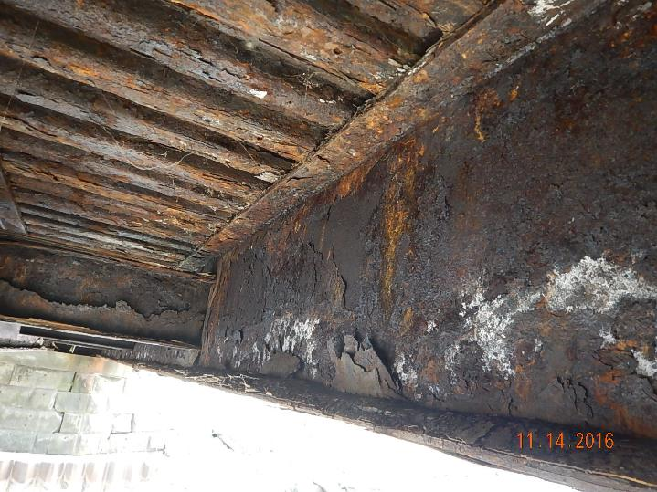
SPRY ROAD

Slide 13
SPRY ROAD
c7.1 Deck has advanced section loss throughout.
c7.2 deck edges have advanced section loss.
C15.1 both facia beams have >40% section loss throughout. Severe delam, pack rust and section loss on upper flange. Beams ends on forward abmt have section loss at web and lower flange

Slide 14
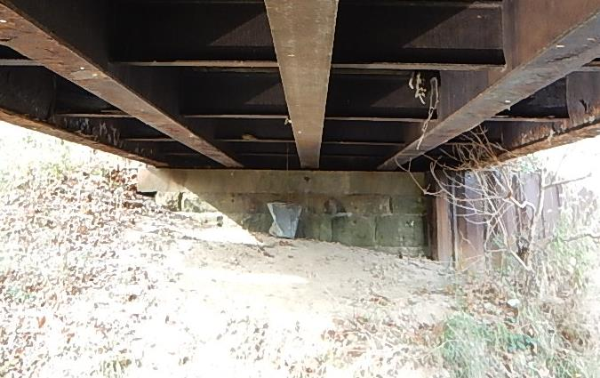
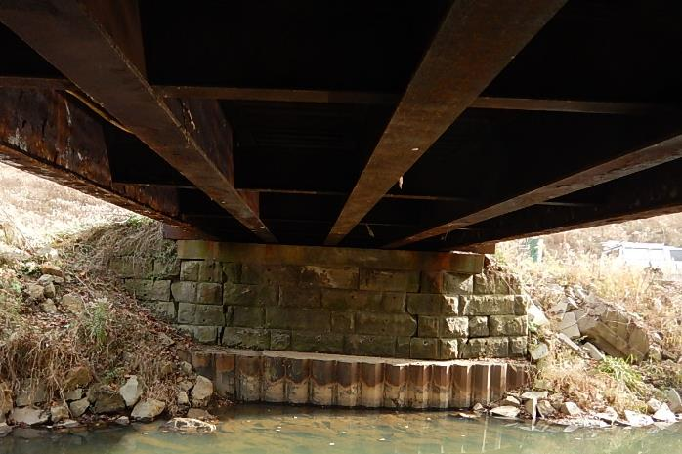
SPRY ROAD
EX. ABUTMENTS WERE SOLID
MAKE MINOR REPAIRS AND REUSE THEM

Slide 15
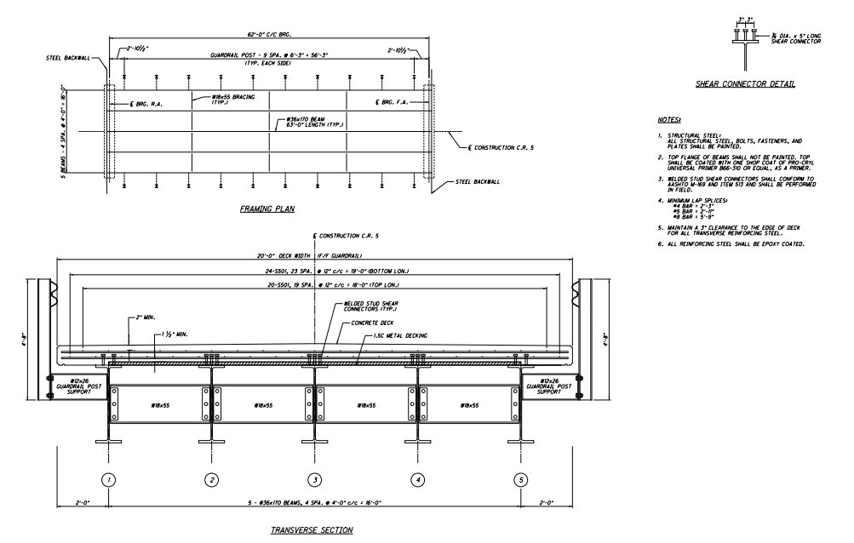
SPRY ROAD

Slide 16
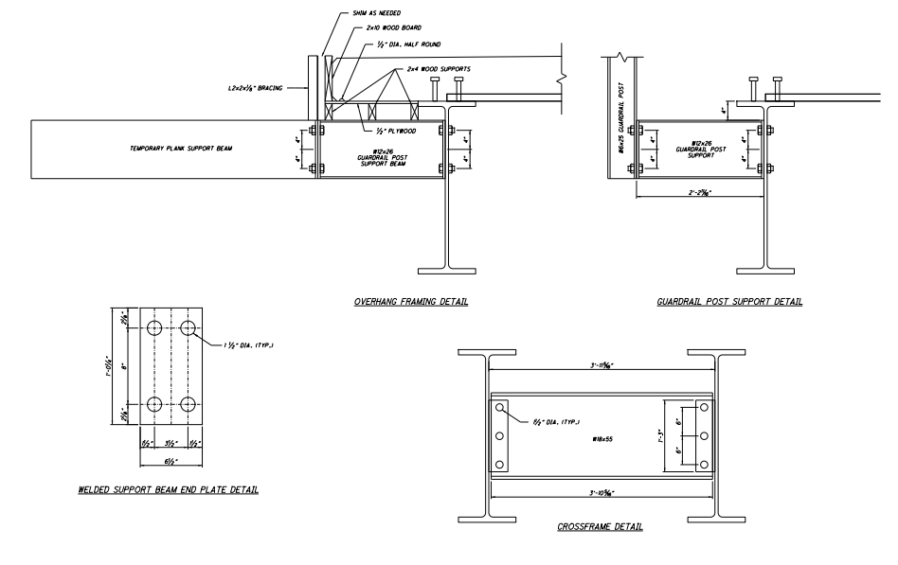
SPRY ROAD

Slide 17
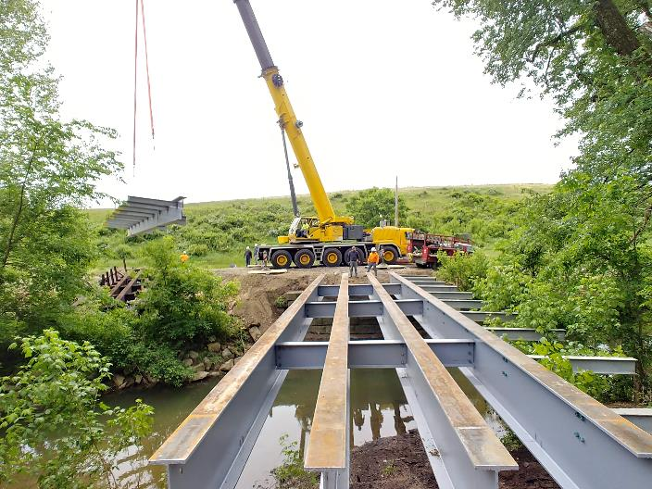
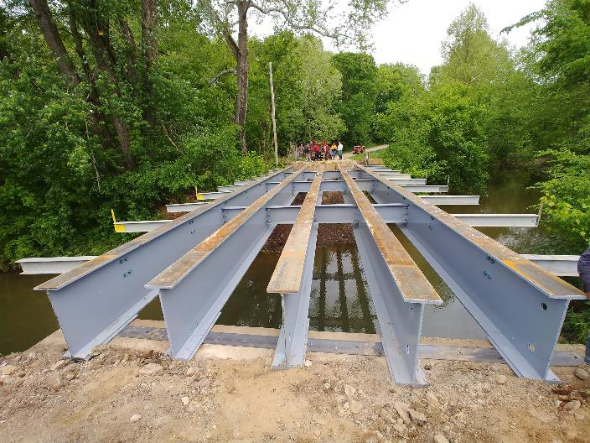
SPRY ROAD

Slide 18
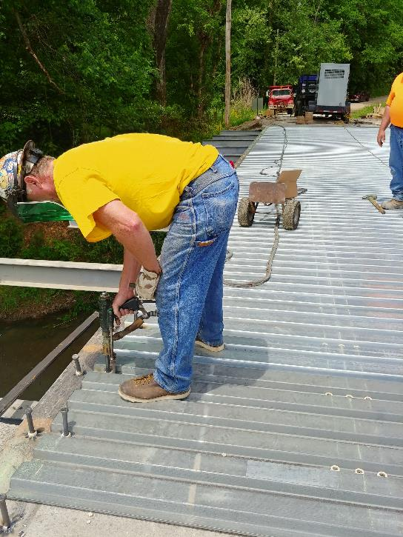
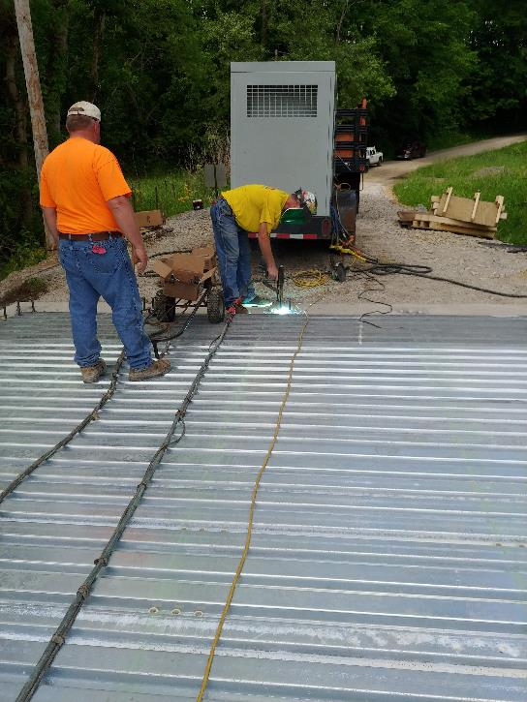
SPRY ROAD

Slide 19
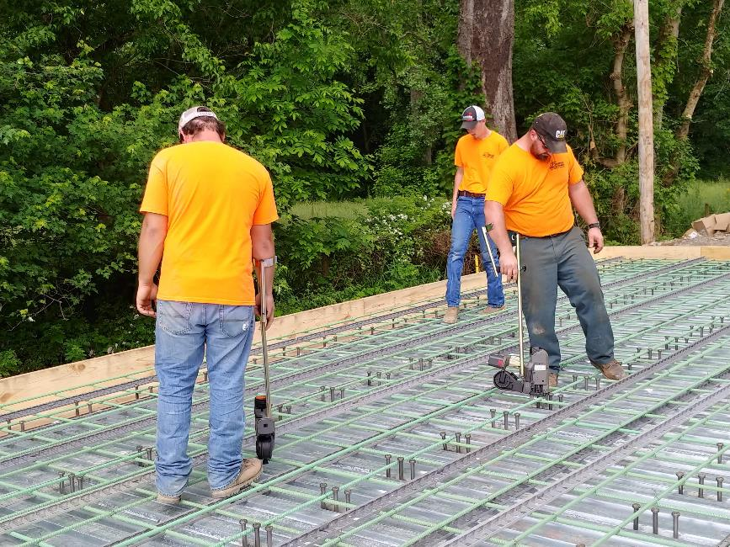
SPRY ROAD

Slide 20
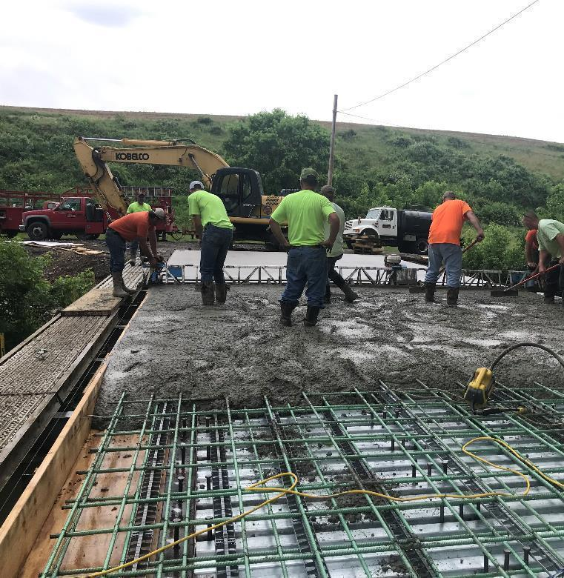
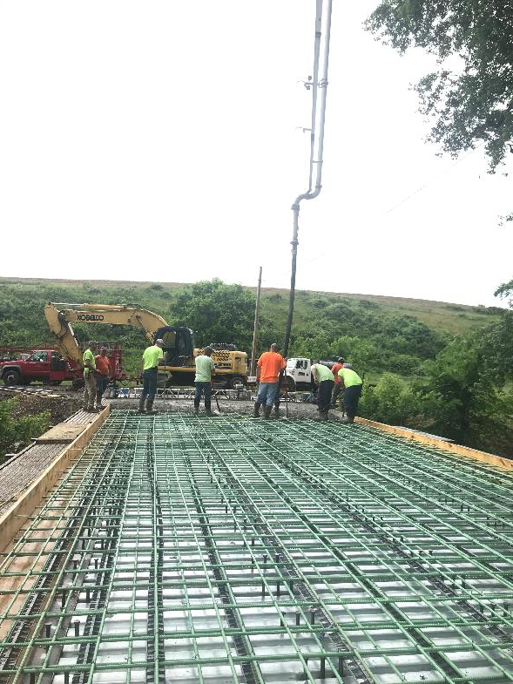
SPRY ROAD

Slide 21
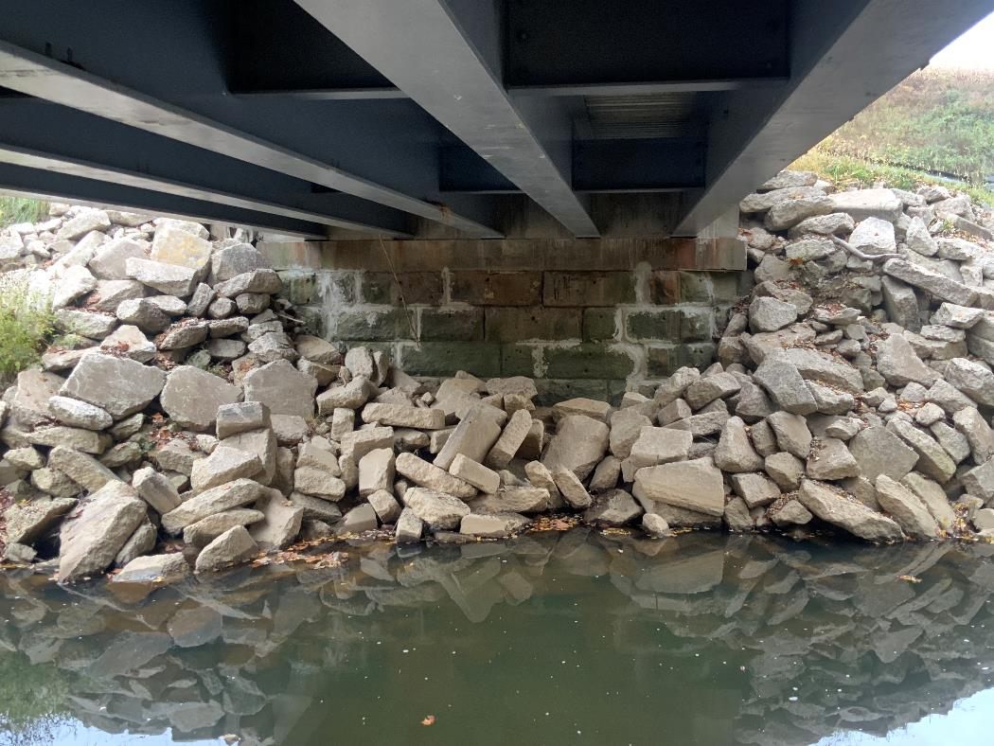
SPRY ROAD

Slide 22
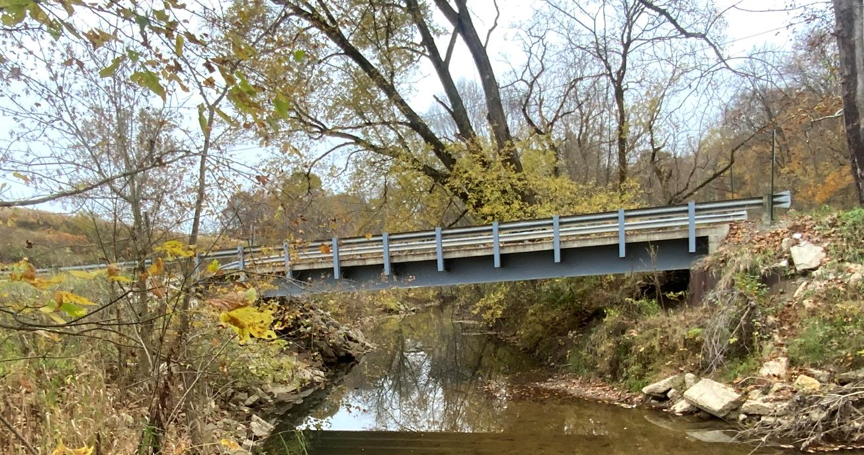
SPRY ROAD

Slide 23
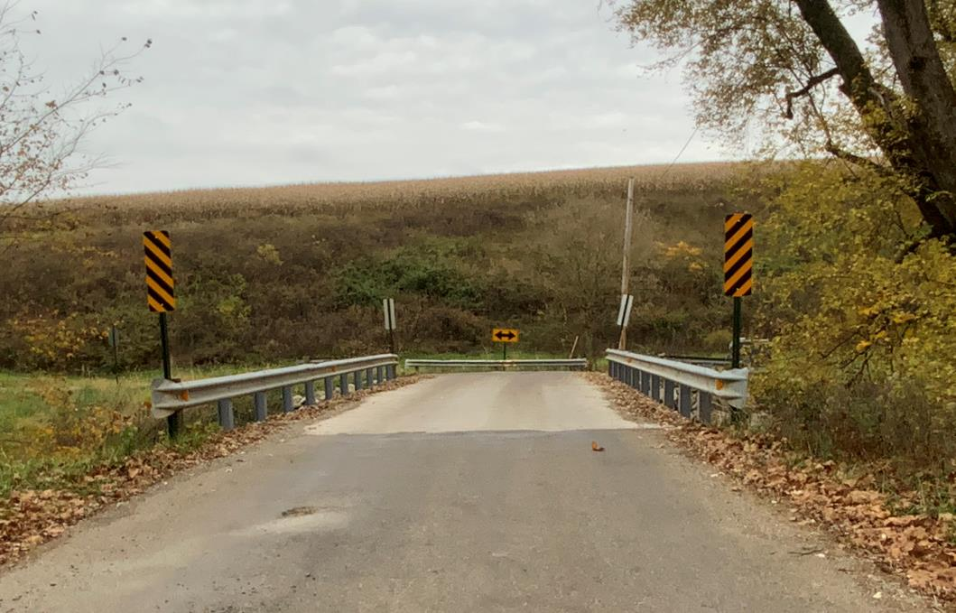
SPRY ROAD

Slide 24
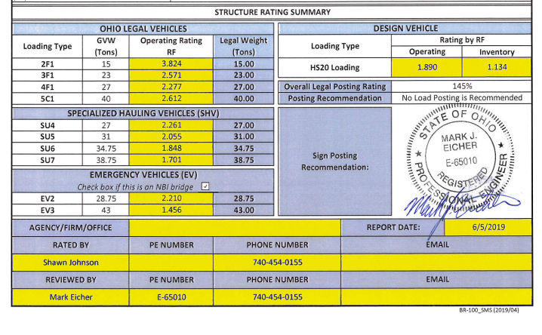
SPRY ROAD

Slide 25
SPRY ROAD
Span 62 Ft.
Total Cost of Project $73,037.06

Slide 26
CHAPEL HILL
C7.1 moisture is leaching thru deck throughout w/efflor. Stalagtite formation is prevelant.
C15.1 beam 1 and 5 have advanced section loss in web at bearing. Beam 2 is nearly the same at original bearing on forward abmt.
C16 cross frames failed b/t beams 1 and 2 at forward abmt.

Slide 27
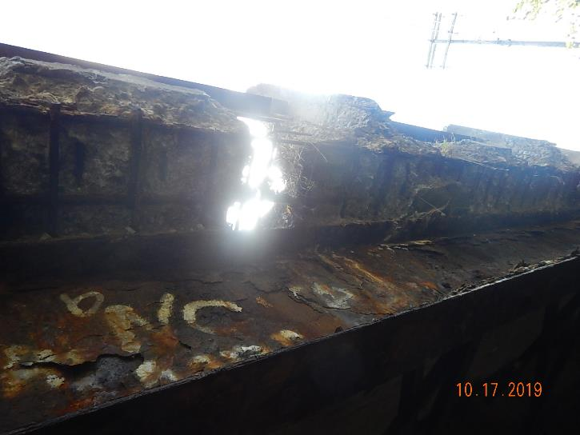
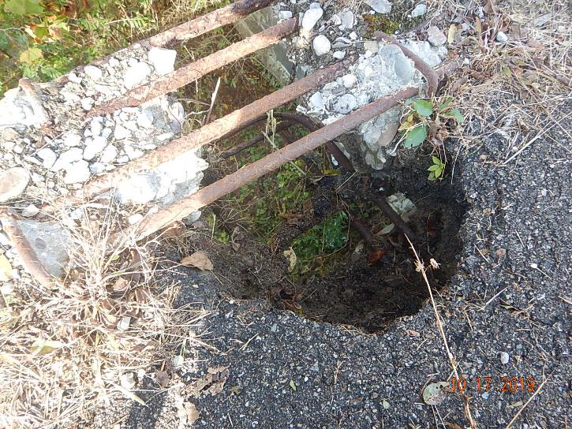
CHAPEL HILL

Slide 28
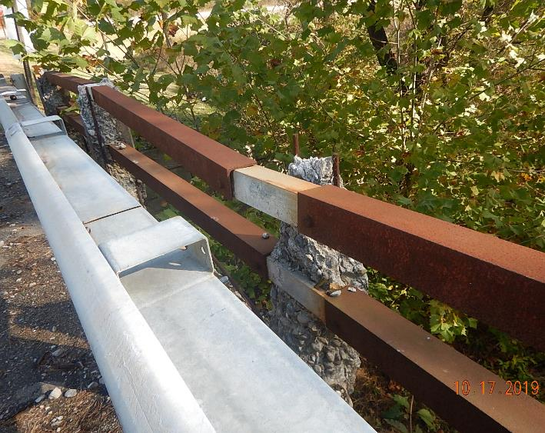
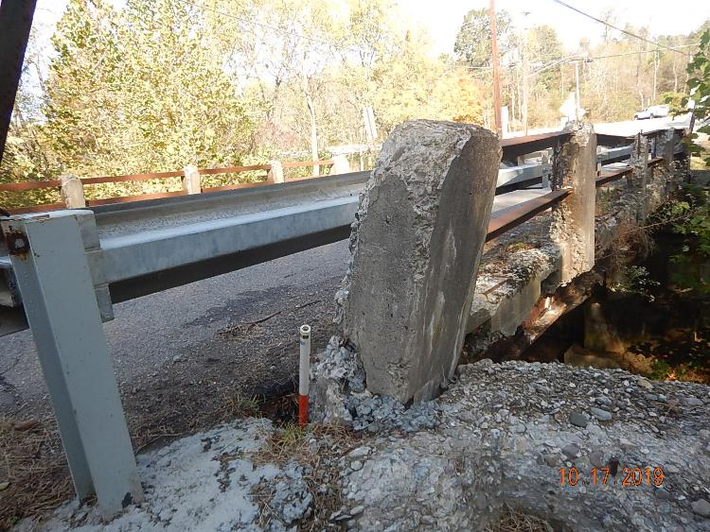
CHAPEL HILL

Slide 29
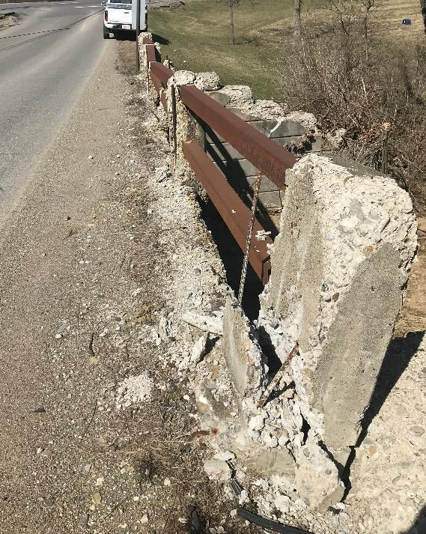
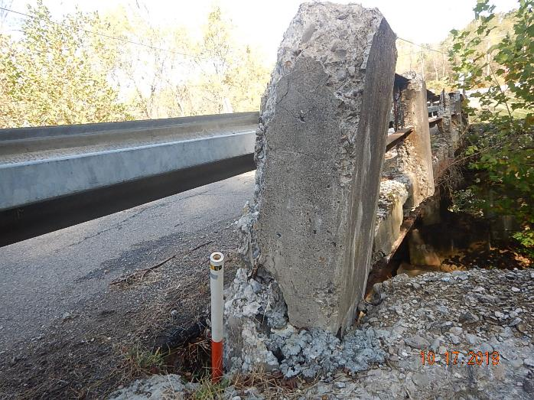
CHAPEL HILL

Slide 30
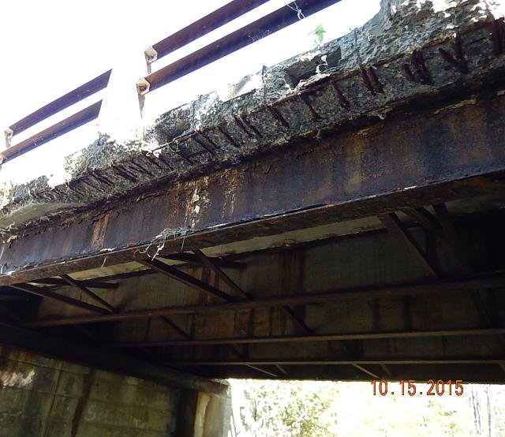
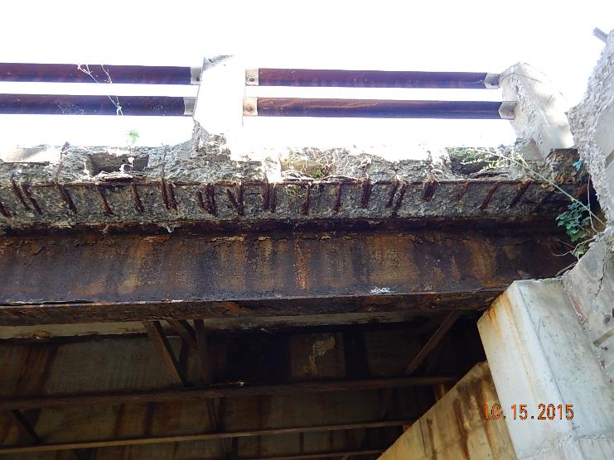
CHAPEL HILL

Slide 31
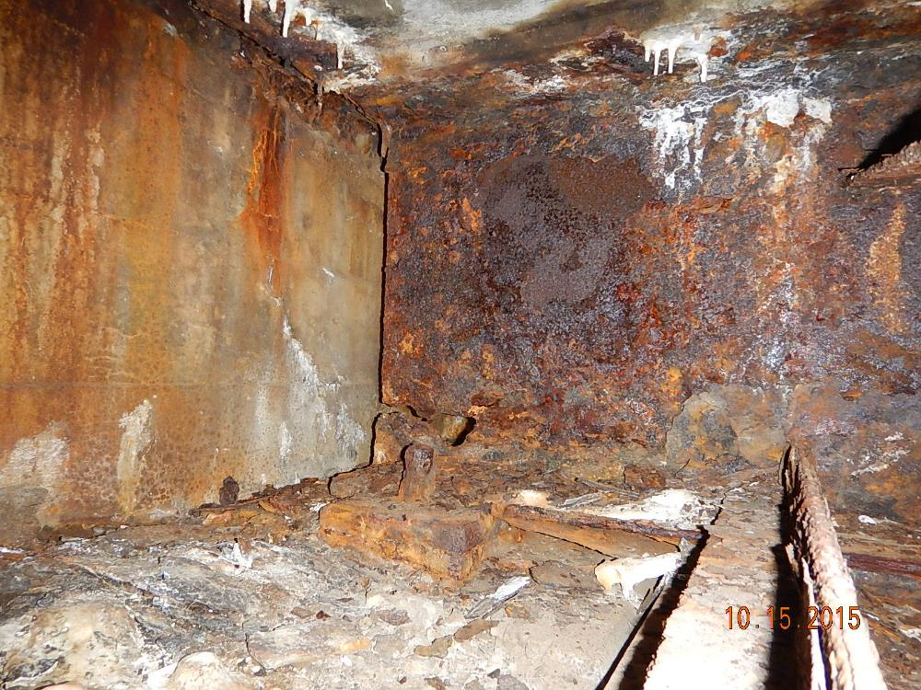
CHAPEL HILL

Slide 32
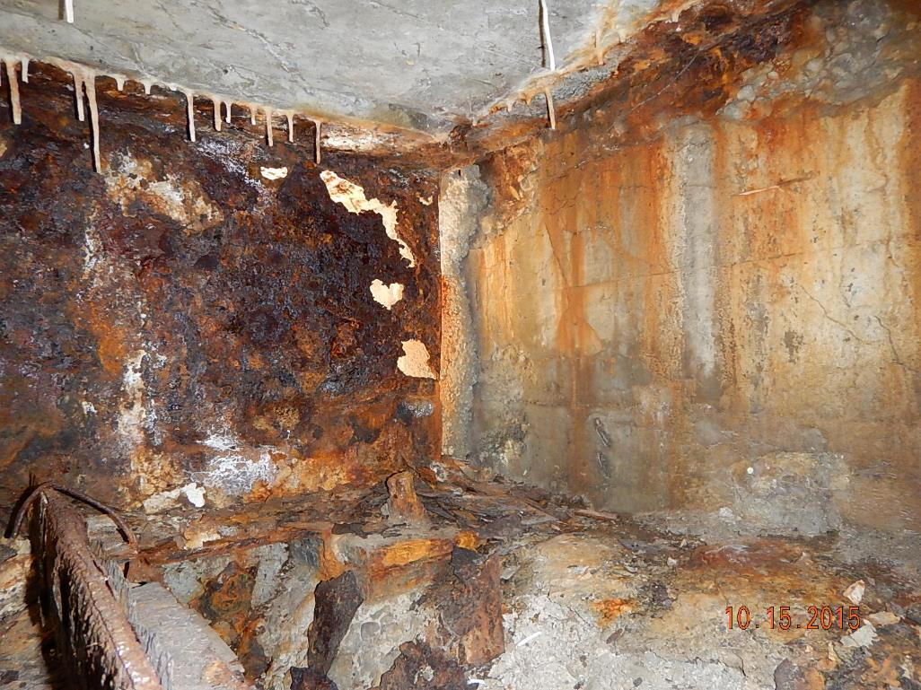
CHAPEL HILL

Slide 33
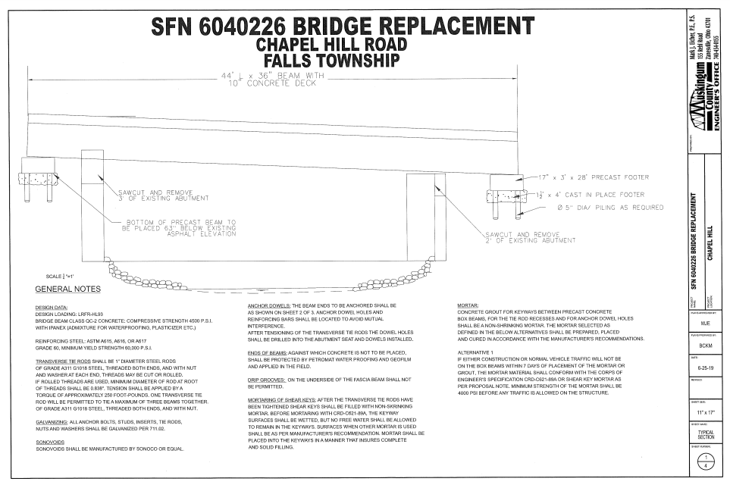
CHAPEL HILL

Slide 34
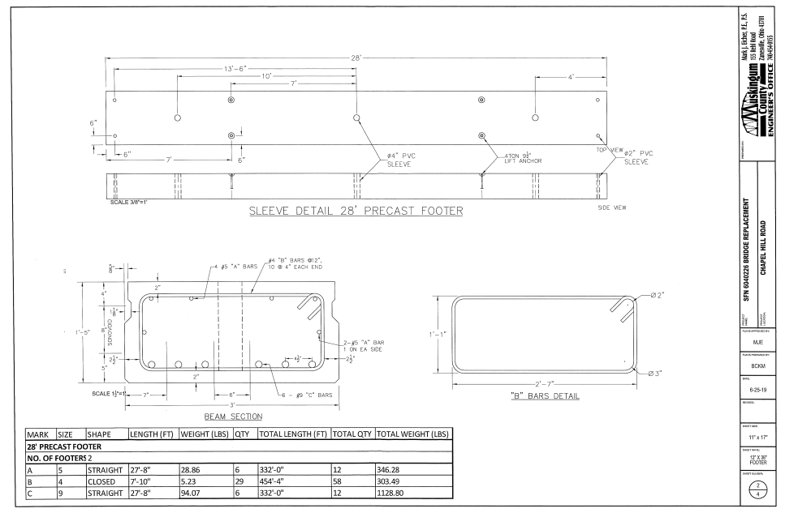
CHAPEL HILL

Slide 35
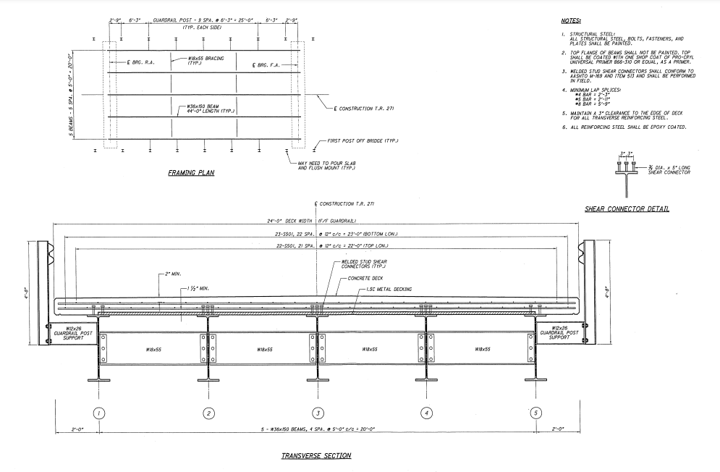
CHAPEL HILL

Slide 36
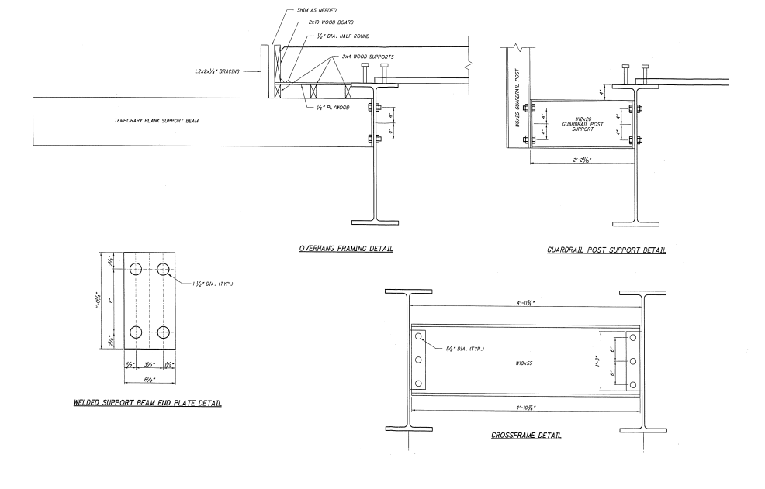
CHAPEL HILL

Slide 37
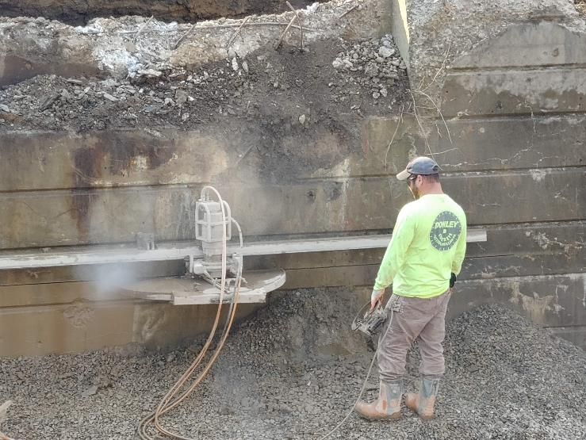
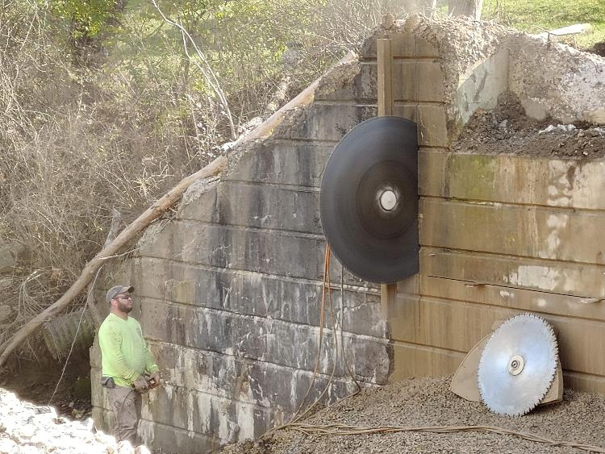
CHAPEL HILL

Slide 38
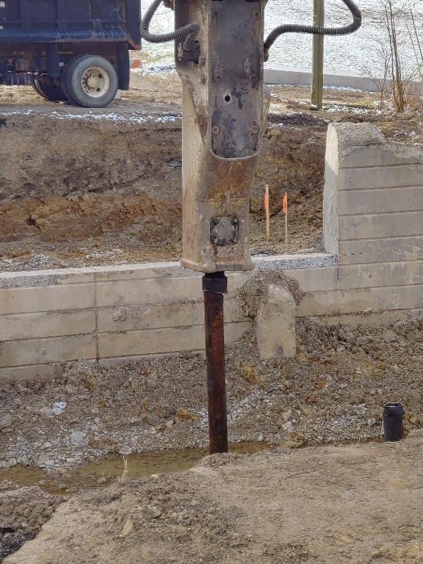
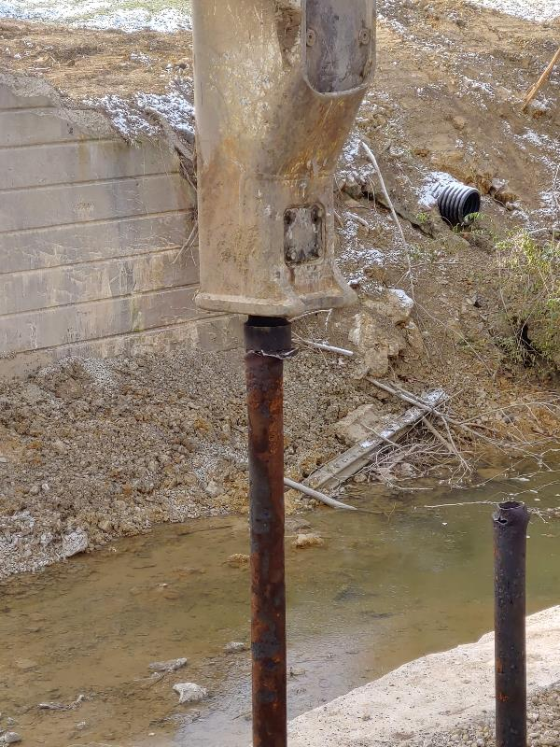
CHAPEL HILL

Slide 39
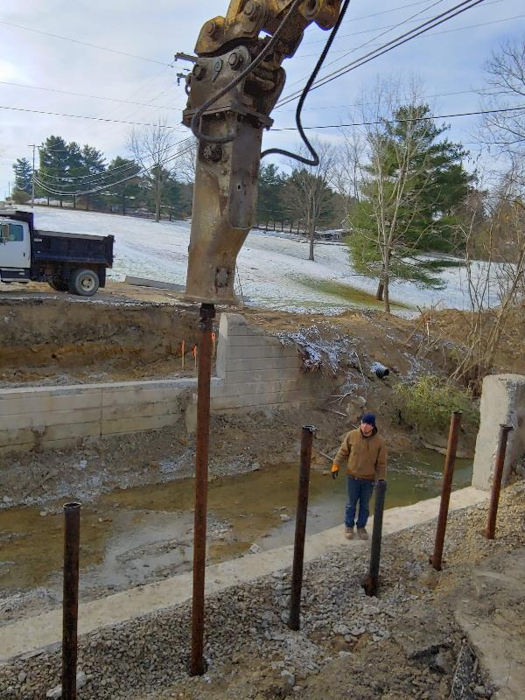
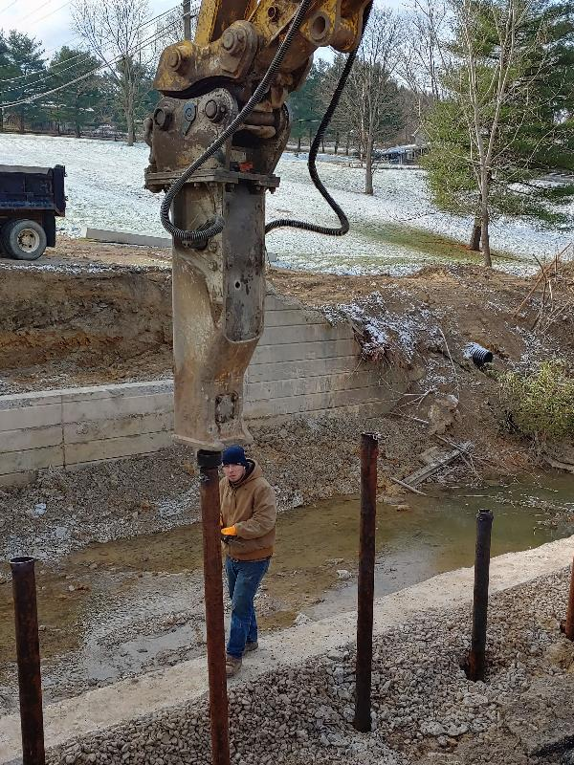
CHAPEL HILL

Slide 40
CHAPEL HILL

Slide 41
CHAPEL HILL

Slide 42
CHAPEL HILL

Slide 43
CHAPEL HILL

Slide 44
CHAPEL HILL

Slide 45
CHAPEL HILL

Slide 46
CHAPEL HILL
Span 40 Ft.
Total Cost of Project $90,559.94
New Abutments
Saw Cutting Existing Abutments

Slide 47
Concrete Beam Program
DESIGN

Slide 48
Concrete Beam Program
DESIGN

Slide 49
Concrete Beam Program

Slide 50
Concrete Beam Program

Slide 51
Concrete Beam Program

Slide 52
Concrete Beam Program

Slide 53
Concrete Beam Program

Slide 54
Shannon Valley Road

Slide 55
Shannon Valley Road

Slide 56
Shannon Valley Road

Slide 57
Shannon Valley Road

Slide 58
Shannon Valley Road

Slide 59
Shannon Valley Road

Slide 60
Shannon Valley Road

Slide 61
Shannon Valley Road

Slide 62
Shannon Valley Road

Slide 63
Jackson Road

Slide 64
Jackson Road

Slide 65
Jackson Road

Slide 66
Jackson Road

Slide 67
Concrete Beam Program

Slide 68
Concrete Beam Program

Slide 69
Concrete Beam Program

Slide 70
Concrete Beam Program

Slide 71
Concrete Beam Program

Slide 72
Concrete Beam Program

Slide 73
Concrete Beam Program

Slide 74
Concrete Beam Program

Slide 75
Used Box Culverts
Used 8’ x 7’ Box Culvert

Slide 76
Used Box Culverts
Used 5’ x 10’ Box Culvert

Slide 77
Used Box Culverts
Used 5’ x 10’ Box Culvert

Slide 78
Administration

Slide 79
In-House Survey & Inspection

Slide 80
In-House Design

Slide 81
In-House Design

Slide 82
In-House Design

Slide 83
In-House Design

Slide 84
In-House Design

Slide 85
In-House Design

Slide 86
Continually Evolving Process

Slide 87
Continually Evolving Process
Gamco Hanger with Custom Fabricated Form

Slide 88
In-House Load Rating

Slide 89
ODOT’s Steel Beam Upcycling Program
https://youtu.be/r5AyX5uDH8U

Slide 90
Gaysport Bridge
ANY QUESTIONS?

